Slide 1
Update on MBA Multifamily
September 19, 2017
For the Western Mortgagee Advisory Council
Eileen Grey
Associate Vice President for Multifamily
Commercial/Multifamily Group, MBA

Slide 2
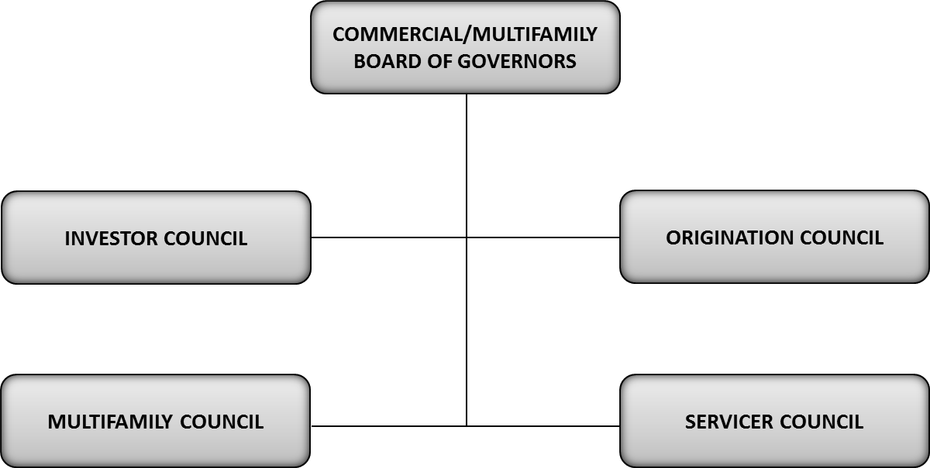
Commercial/ Multifamily Board of Governors:
Council Structure
Email cref1@mba.org to request additional information or join a Committee, Working Group, or Task Force

Slide 3
Multifamily Council, Committees, and Working Groups
Multifamily Council
  Multifamily Steering Committee
  FHA Committee
    FHA Executive Forum
    FHA Servicers Subcommittee
    LIHTC Working Group
CNA-Energy-Environmental Working Group
MBA-ABA FHA Closing Working Group
Davis-Bacon Working Group
FHA 4350.1 Review Working Group
Affordable Rental Housing Working Group
Appraisal Working Group

Slide 4

Key C/MF Policy Accomplishments
    Long-term extension of Terrorism Risk Insurance Act (TRIA).
    Ensured multifamily agency securitizations are excluded
    from disruptive mandatory margin requirements proposed by the FINRA/SEC.
    Obtained favorable multifamily objectives in 2016, 2017, and 2018 FHFA Duty to Serve plans and Housing Goals
    Reduction in FHA Multifamily MIPs (for affordable and energy efficient insured properties)
    Section 232 Handbook was released and was responsive to many comments raised by the 20 lenders who participated in the MBA review effort.
    MBA working group provided comments on FHA’s preliminary proposed Section 221(d)(4) extension of its LIHTC program and which we hope will launch soon.
    HUD guidance on balcony noise regulations was responsive to MBA advocacy

Slide 5

Ongoing Policy Priorities
    GSE Reform recommendations that support core principles for multifamily finance
    Ensuring that FHA remains a key capital source for supporting work force and affordable multifamily housing and residential healthcare facilities
    Commercial/ Multifamily Appraisal Initiative
    Home Mortgage Disclosure Act
    National Flood Insurance Program (NFIP) Reauthorization/Legislation
Notes:
The CMF team helps our members understand the ways policy impacts your business and respond to governing bodies appropriately. Some of our current efforts on legislation and regulation include:

Slide 6
Conferences & Events to Meet Your Needs
MBA holds nearly 20 events each year, including dedicated commercial and multifamily conferences and meetings.
    CREF/Multifamily Housing Convention & Expo
    Commercial/Multifamily Servicing & Technology Conference
    FHA Roundtables
    Small Balance Lending Summit
    Accounting and Financial Management Conference
    National Advocacy Conference
    Summit on Diversity & Inclusion
    CREF Connects and mPact (as announced)

Slide 7
MBA’s mPact Program
Purpose - To engage early to mid-career professional MBA members from all sectors and backgrounds in the commercial/multifamily finance industry to foster industry networking and personal career growth
mPact Target Audience - Younger demographic of ages 35 and under with 15 years of C/MF experience or less
Ways to Get Involved -
mPact Community
mPact Instagram @mba_mpact
Contact Ashley Gunn, Associate Director, MBA at agunn@mba.org or Rachel Raeder, CREF Associate, MBA at rraeder@mba.org

Slide 8
MBA’s Mortgage Action Alliance
The Mortgage Action Alliance (MAA) is MBA’s grassroots advocacy network
  Join for free at mba.org/joinmaa
MAA Members will receive:
  Calls to Action when legislation affecting the real estate finance industry is being considered by Congress or your state government
  A weekly newsletter with legislative and regulatory developments
  Free Quarterly Advocacy Update Webinars hosted by MBA’s Legislative and Political Affairs team
Questions?
Contact maa@mba.org, or (202) 557-2933

Slide 9
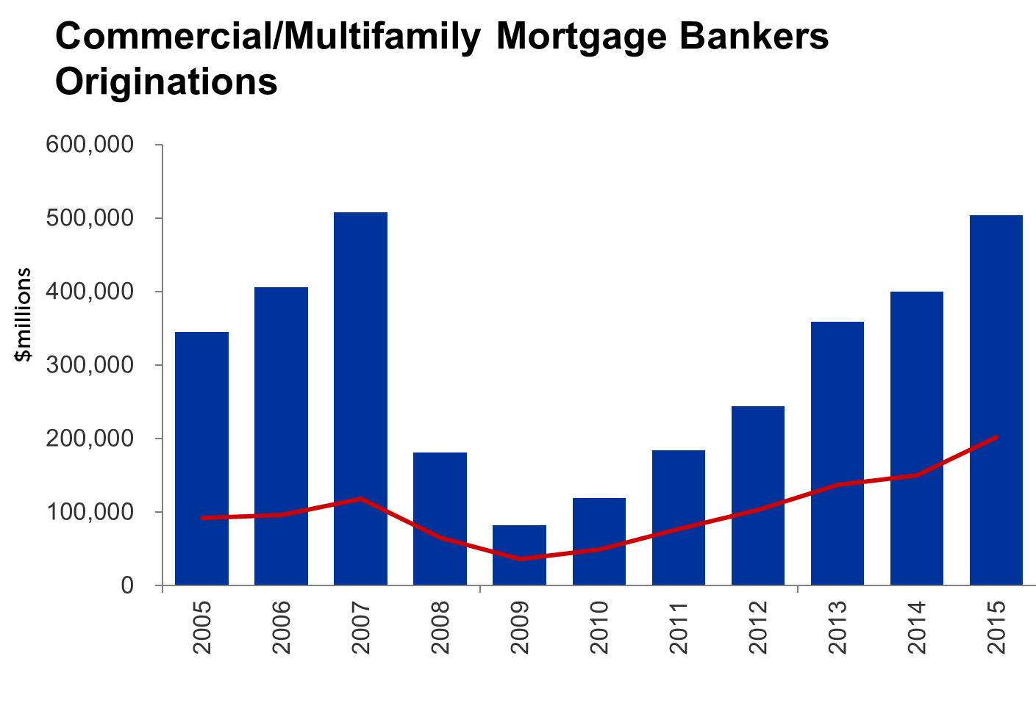
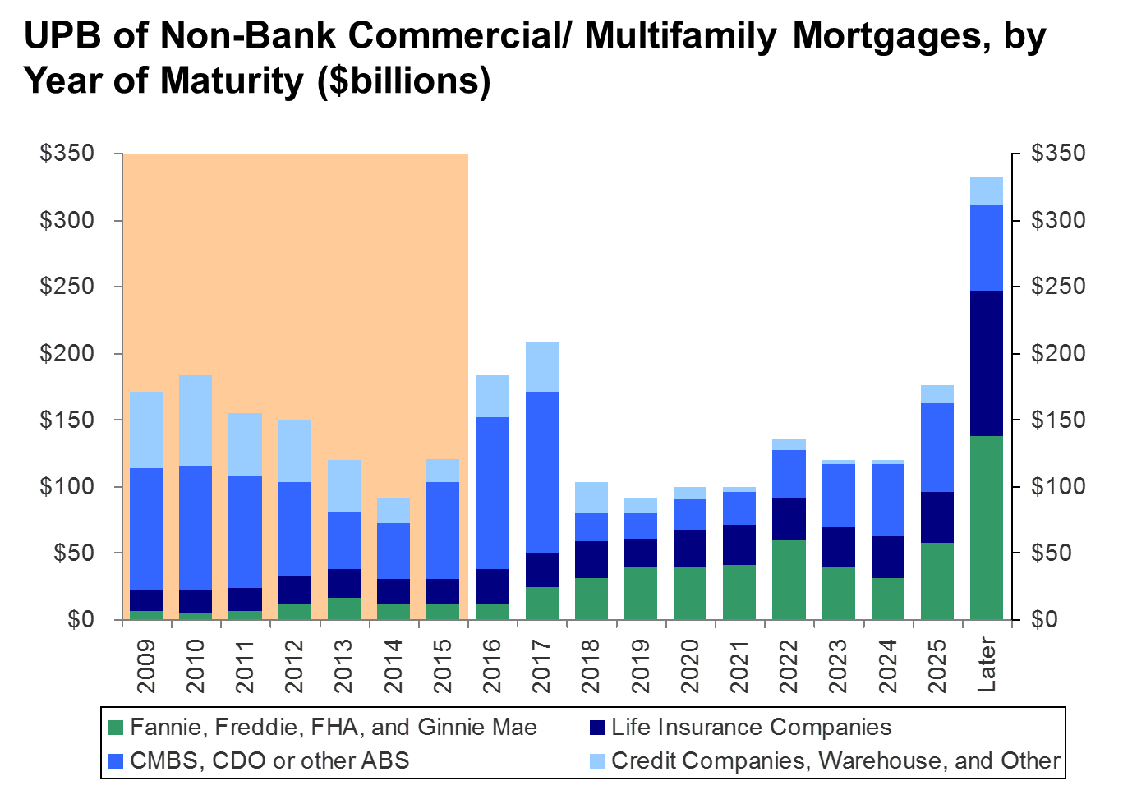
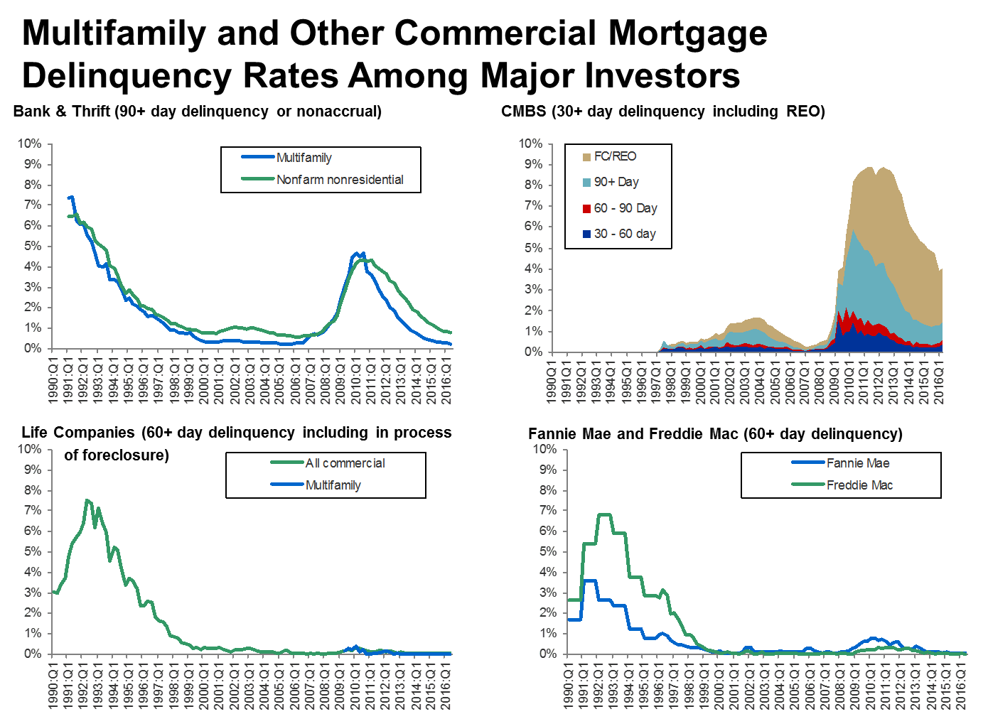
MBA CREF Research – Industry Analysis
Originations
Annual Originations Rankings
Annual Origination Volume Summation
Annual Report on Multifamily Lending
Quarterly Mortgage Banking Originations Survey
Servicing and Mortgage Debt Outstanding
Loan Maturity Volumes
Mortgage Delinquency Rates
Mortgage Debt Outstanding
Mortgage Servicer Rankings
Forecasts and Commentary
CREF Forecasts (Members Only)
CREF Outlook Survey (Members Only)
Commercial/Multifamily Quarterly DataBook
Commercial/Multifamily Database
Learn more at www.mba.org/CREFResearch or email CREFresearch@mba.org

Slide 10

MBA Education Overview
    Expert Instructors
    Dedicated Commercial/Multifamily Content
    Blended learning platforms
  Webinar
  Classroom
  Instructor guided online
  Self-study on-demand
    Leadership Development
    Corporate training services
Notes:
Webinar – Quick hit, 90-minute events
Classroom- Live, instructor led events around the country
Instructor guided online – Allows us to virtually bring leading industry expert instructors to you—the sessions are delivered in a virtual format and are interactive and participatory for all of those enrolled.
Self Study on Demand– web-based library of over 130 self-paced courses covering the full spectrum of Commercial Real Estate Topics

Slide 11
Questions?
Eileen Grey, Associate Vice President - Multifamily
egrey@mba.org

