Slide 1
San Francisco Industry Meeting
June 29, 2017
Tom Azumbrado, Regional Director, Multifamily West Region
Angela Corcoran, Production Director, Multifamily West Region

Slide 2
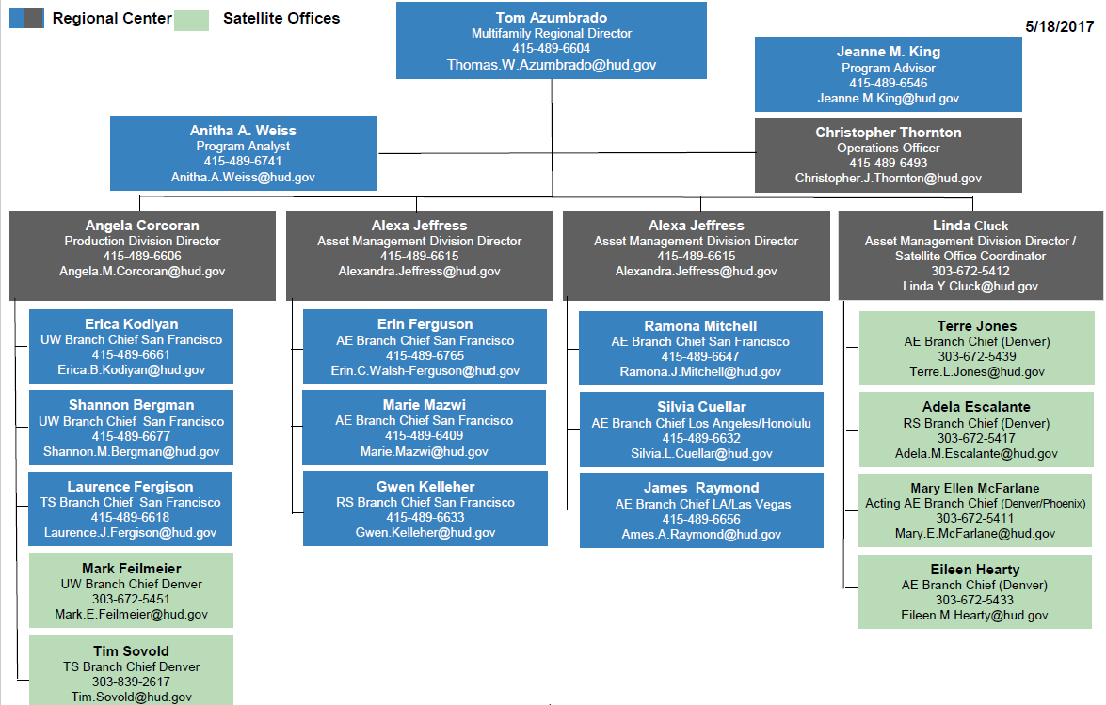
MF West Region Organizational Chart

Slide 3
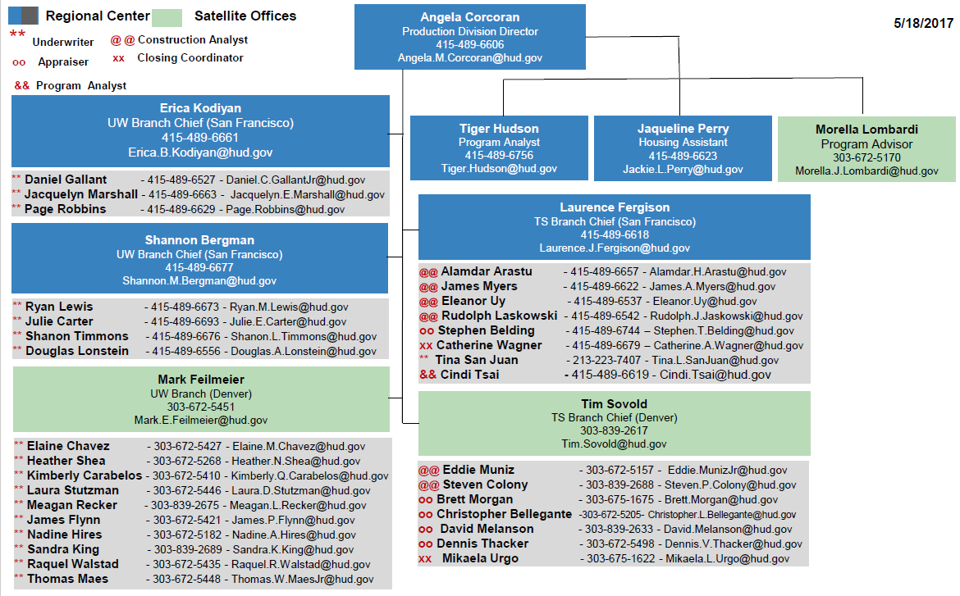
MF West Region Production Division

Slide 4
Post Transformation Activities
Past hiring
Continual staff training
Continuous improvements
Improve SOP
Improve communications/coordination
Updates from Transformation
How it went
What we’re doing now
What we expect to happen
Future staffing and hiring
Notes:
Ask Tom what he wants to say on this slide

Slide 5
Multifamily West Region Staffing
 | Current Staff Level | Authorized Staff Level
San Francisco Production | 21 | 29
Denver Production | 20 | 22
Production Total | 41 | 51
San Francisco AM | 55 | 59
Denver AM | 40 | 42
Asset Management Total | 95 | 101
San Francisco Operations | 4 | 6
Denver Operations | 2 | 2
Operations Total | 6 | 8
Regional Office | 3 | 3
Total | 145 | 163
145 employees on board
We are currently authorized to employ 163
Note: Original Transformation staff plan allotted 180 FTEs
Notes:
Edit to make numbers add – either increase authorized total or decrease AM

Slide 6
Multifamily West Region Staffing
Current Vacant Positions
PRODUCTION: 3 Underwriters
2 Appraisers
2 Construction Analysts
3 Program Assistants
ASSET MANAGEMENT: 3 Account Executives
3 Program Assistants
OPERATIONS: 2 Program Analysts
On Board Staff = 145
Vacant Positions = 18
Total FTE – 163
Original FTE –180

Slide 7
West Region Updates FY17
Accomplishments:
Single Underwriter Role
Consistency in the West Region
Better Timeframes
Challenges:
Shortage of Staff
Application Intake and Screening
Large Geographical Area, Site Visits
Davis Bacon and Environmental

Slide 8
Concept Meeting Requests FY17
California
30 Concepts
Washington
13 Concepts
Oregon
14 Concepts
Nevada
3 Concepts
Hawaii
0 Concepts
Alaska
9 Concepts
North Dakota
3 Concepts
South Dakota
0 Concepts
Montana
3 Concepts
Idaho
6 Concepts
Colorado
36 Concepts
Utah
20 Concepts
Arizona
32 Concepts
Wyoming
3 Concepts
Total
172 Concept Meetings

Slide 9
FY17 Application Submissions by Quarter

Slide 10
Applications in the Pipeline
221(d)(4)
Properties 33
223(f)
Properties 17
223(a)(7)
Properties 3
Miscellaneous
(2) 220s
213
(1) 241(a)
Total Applications in the Pipeline: 57
This does not include projects with Firms Issued, in Closing or in their Construction/Repair period.
Additionally we have eight (8) 221(d)(4)s and two (2) 223(f)s in Intake and Screening
Notes:
This is a count of applications that have not had an initial closing; checking validity with Bob

Slide 11
Timeframes of Firms Issued FY17
221(d)(4) NC/SR
Firms Issued 21
% on Time 76%
Average Processing Time
48 Days
223(f)
Firms Issued 73
% on Time 70%
Average Processing Time
46 Days
223(a)(7)
Firms Issued 18
% on Time 50%
Average Processing Time
34 Days
Total Firms Issued: 112

Slide 12
Closings FY 2017
221(d)(4) NC/SR
Properties 19
Units 3,190
Mortgage Amount $540,002,300
223(f)
Properties 65
Units 9,184
Mortgage Amount $918,355,700
223(a)(7)
Properties 25
Units 4,358
Mortgage Amount $364,662,800
Total Projects: 109
Mortgage Amount: $1,823,020,800
(Mortgage Amount FY16: $998,090,900)
Notes:
Checking with Bob – why are there more 223a7 closings than firm commitments

Slide 13
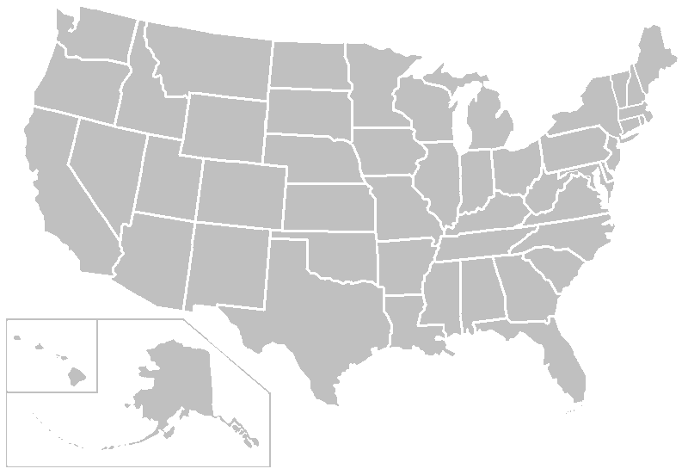
Closings by State 13 states, 109 projects, $1,863,878,800
state | closings | mortgage amt
Alaska | 1 | $3,162,700
Arizona | 8 | $177,288,000
California | 34 | $488,302,800
Colorado | 22 | $392,871,100
Hawaii | 0 | $0
Idaho | 9 | $$54,685,600
Montana | 2 | $25,434,500
North Dakota | 0 | $0
Nevada | 8 | $244,162,900
Oregon | 9 | $127,096,400
South Dakota | 4 | $4,153,400
Utah | 9 | $159,629,700
Washington | 9 | $176,054,400
Wyoming | 2 | $11,037,300
9
2
9
9
4
2
8
34
9
22
8
1
Notes:
The total here is 117 vs 109 because it includes risk-share and 241a

Slide 14
LIHTC’s FY17 Closings as of 06/19/2017 8 states, 23 projects, $315,882,900
LIHTC closings
state | closings | mortgage amt
California | 10 | $122,753,400
Colorado | 5 | $21,835,100
Idaho | 1 | $8,278,000
Montana | 1 | $8,353,000
Nevada | 1 | $20,440,000
Utah | 2 | $33,540,000
Washington | 2 | $92,683,400
Wyoming FY16 36 projects, $344,226 | 1 | $8,000,000

Slide 15
Underwriting Tips
Presented by HUD Underwriting Branch Chief, Shannon Bergman

Slide 16
General Underwriting Tips, Issues, and Suggestions
Foreign Nationals as Principals
Section 50 signatories
Preferred Equity Organizational Structures
Age restrictions
Land Value
Secondary Financing
Legal or Title issues
Waivers
Construction loan servicing
241(a) Green MIP

Slide 17
HEROS Environmental Reports and a few other things… Presented by HUD Technical Specialist Branch Chief Tim Sovold

Slide 18
HEROS Resources
HEROS Partner Worksheets:
https://www.hudexchange.info/resource/5119/environmental-review-
record-related-federal-laws-and-authorities-partner-worksheets/
HEROS Environmental Assessment Format:
https://www.hudexchange.info/resource/5173/part-50-environmental-
assessment-format/
MAP Guide:
http://portal.hud.gov/hudportal/documents/huddoc?id=4430GHSGG.pdf
HUD environmental website:
https://www.hudexchange.info/programs/environmental-review/
Online Training: “Environmental Training for FHA Programs”
https://www.youtube.com/watch?v=koGldiHziVI&list=PLDYbj6cykYZ_iPeN_
_vJfEQDI4c6m5MVY

Slide 19
HEROS – Related Laws & Authorities page

Slide 20
HEROS – Partner Worksheets

Slide 21
Resource Worksheets for HEROS
Air Quality
Airport Hazards
Coastal Barrier Resources
Coastal Zone Management
Endangered Species
Environmental Justice
Explosive and Flammable Facilities
Farmlands Protection
Flood Insurance
Floodplain Management
Historic Preservation
Noise Abatement and Control (CEST)
Noise Abatement and Control (EA)
Site Contamination
Sole Source Aquifers
Wetlands Protection
Wild and Scenic Rivers

Slide 22
MAP Guide Highlights
Project must comply with Part 55 if any part of the site or integral offsite development (e.g. ingress, egress, parking) is located within Floodplain.
Unless an exception applies, HUD will not approve projects in:
Floodways,
Coastal high hazard areas, or
Floodplains if community does not participate in NFIP (see Chapter 9.5.E.2).
New construction/major improvements: HUD strongly discourages
projects in the 100-year floodplain
Refinances/minor improvements: HUD discourages projects where lowest floor, life support facilities, or egress/ingress are more than 12” below base flood elevation.
HUD will consider history or evidence of flooding even if site is not in a FEMA-designated floodplain.

Slide 23
Reviews that HUD Must Complete
Tribal Letters and 30-day response period.
SHPO Correspondence in most states.
8 Step Process for Floodplains and Wetlands.
HUD develops both notices; borrower pays for publication.
Alert HUD at Concept Meeting.

Slide 24
The 8-Step Process
Step 1. Determine whether the
proposed action is located in 100-year
floodplain (or 500-yr for critical
action).
Step 2. Publish “Early Public Notice”
of the proposal to consider an action
in the floodplain or wetland (15 day
minimum comment period).
Step 3. Evaluate practicable
alternatives to locating the proposed
action in a floodplain or wetland.
Step 4. Identify the potential impacts
associated with occupancy and
modification of the floodplain or
Wetland.
Step 5. Design or modify the action
to minimize adverse impacts and
preserve the beneficial values of the
Floodplains.
Step 6. Reevaluate whether proposed
action is practicable.
Step 7. Publish “Final Public Notice”
of decision to identify why there is
“no practicable alternative,” and the
alternatives and mitigation measures
adopted (7 day minimum comment
period).
Step 8. Implement proposed action
with mitigation measures.

Slide 25
Hazardous Pipelines near projects…
MAP Guide Chapter 9.5.P.1.
Language in current guide is confusing.
HUD will allow language from 2011 MAP Guide to apply via Lender Waiver request:
“All parts of any structure must be at least 10 feet from the outer boundary of the easement for any high-pressure gas or liquid petroleum transportation
pipeline”
HUD retains right to disallow atypical pipelines – above ground or large capacity, for instance.

Slide 26
Other Hot Topics
Davis Bacon Wage Rates
Split Wage Decisions
GC and Subcontractor Oversight of Weekly Payroll Submissions
Green MIP Certifications
Initial Efficiency Scores on 221(d)(4) and 223f
Ongoing Monitoring Requirements and Audits

Slide 27
HUD CNA e-tool Prepared by Meagan Recker

Slide 28
Cna e-tool: Why?
2010 Interagency Rental Policy Working Group
2011 recommendation published: “creation of a single CNA template tool for use by entities that administer Federal rental housing.”
2012 HUD & USDA collaboration with the industry to create CNA e-Tool.
Benefits:
Automation & Standardization
Standard Nomenclature
Standard Data Inputs
Calculations
Life-cycle Cost Analysis
Database to support research & policy development
Notes:
Treasury, USDA, & HUD Working group to align policies and practices related to multifamily housing.
HUD & USDA teamed up to create tool for a more standardization across agencies.
Ultimately tool will increase efficiency and consistency with a more streamline process and standardization.
Standardize nomenclature, data, and calculations to ensure consistent product on applications which will result in more consistent and quick reviews by HUD.
Provide data for informed investment decisions by utilizing life-cycle cost analyst to save on utilities, operations, and maintenance cost. Works with EPA’s Energy Star Portfolio Manager to assist in achieving greater efficiency.

Slide 29
Cna e-tool: Implementation
When?
Voluntary submissions
can be made now.
July 1, 2017 DELAYED
OCTOBER 1, 2017
What?
All FHA MAP Applications
Asset Management requirements
10-year updates to CNA
TPA, PPC, Mark-to-Market
PHA will still use GPNA (Green Physical Needs Assessment)
Notes:
CNA e-Tool is live and Lenders can begin submitting CNAs through the submission portal. Participation is voluntary though September 30, 2017.
Beginning October 1, 2017 all CNAs must be submitted through the submission portal.
See ML 2016-26 & 2017-09
All MAP Applications including those for New Construction and Substantial Rehabilitation must include a CNA from the CNA e-Tool after 10/1/2017.
All CNAs required by Asset Management must be submitted through the e-Tool after 10/1/2017.

Slide 30
Cna e-tool: overview
https://portal.hud.gov/hudportal/HUD?src=/program_offices/housing/mfh/cna
Notes:
>Click on hyperlink to open webpage.

Slide 31
Cna e-tool: overview
4 Main Parts to the CNA e-Tool
Validation Engine
(Web Portal)
Flags
Submission Portal
(Web Portal)
Reviewer Tool
(Web Portal)
Assessment Tool
(Excel Template)
Notes:
>Point out each portion on tool on CNA webpage
Assessment Tool = data bank (replacement for the paper CNA)
Validation Engine = screening tool
Submission Portal = new application exhibit
Reviewer Tool = HUD’s review/approval tool

Slide 32
Cna e-tool: overview
Validation Engine
(Web Portal)
Flags
Assessment Tool & Validation Engine
are public access
Assessment Tool
(Excel Template)
Notes:
Lenders, Needs Assessors, Architect, and general public can access these.
NO LOGIN or USER ID REQUIRED

Slide 33
Cna e-tool: overview
Submission Portal
(Web Portal)
Need MID
Reviewer Tool
(Web Portal)
Need HID
Submission Portal & Reviewer Tool are
PRIVATE (restricted access)
Access issues? Email CNAaccess@hud.gov
Policy or how to issues? Email CNAeTOOL@hud.gov
Notes:
Submission Portal is only for use by Lenders.
-Need Assessors/Architects/3rd-parties cannot submit CNA
Don’t know your MID? Someone at you institution does.
**Access Issues contact CNAaccess@hud.gov**
**Other issues contact CNAeTOOL@hud.gov**
Reviewer Tool is only for HUD use. NO ONE ELSE CAN ACCESS

Slide 34
Cna e-tool: How It Works
Project Data
Input by Needs Assessor or
3rd Party Reviewer/Project Architect
Financial Data
Input by Lender
Assessment Tool
(Excel Template)
Notes:
Assessment Tool = data bank
-contains data on the property
-this is the replacement for the paper CAN
>Open Assessment tool from webpage.
Project data is entered under the grey tabs by the needs assessor (223f) or the architect/3rd-party reviewer (221d4).
Financial data is entered under the green tabs by the Lender.

Slide 35
Cna e-tool: How It Works
Validation Engine
(Web Portal)
Flags
Assessment Tool is uploaded to
Validation Engine which generates flags.
Assessment Tool
(Excel Template)
Notes:
Validation Engine = screening tool
-generates flags to point out actual or potential issues with the Assessment
Validation Engine saves for 4 days.

Slide 36
Cna e-tool: How It Works
S = Severe Flag
W = Warning Flag
I = Informational Flag
Validation Engine
(Web Portal)
Flags
Severe Flags must be cured before Assessment Tool can be submitted!
(e.g. Required field in the Tool has been left blank.)
Warning Flags should contain notes or comments from the Assessor and/or Lender as they indicate a discrepancy in the tool which should be justified.
(e.g. Replacement of a component planned in 2-3 years when EUL suggest replacement now.)
Informational Flag is to draw attention to an item which may or may not require comment.
(e.g. FHA compliance required will always generate an informational flag.)

Slide 37
Cna e-tool: How It Works
Validation Engine
(Web Portal)
Submission Portal
(Web Portal)
Reviewer Tool
(Web Portal)
Assessment Tool
(Excel Template)
Notes:
Submission Portal = new application exhibit
-Lender use web portal to submit CNA as part of application
-NO MORE PAPER CNAs submitted with the application
Submission Portal saves for 2 years.
Lender should request return of submission from HUD if they notice an error after submitting.
Reviewer Tool = HUD’s review/approval process
-Branch Chief will have “assigner” access and assign CNA to reviewer
-Underwriter/Construction Analyst will have access to CNA for review
-reviews flags, comments/notes from assessor/lender, can make own comments
-Reviewer will recommend approval or return to Lender
-Branch Chief will then give final approval or send to Lender for corrections
Future Benefits: Approved CNAs are held at HUD for use by AM.
At 10 year updates prior CNA can be downloaded.
Hopefully tool can be used to automate the 9250 (R4R releases)

Slide 38
Cna e-tool: Roles recap
Portion of e-Tool | Work | Completed By
Assessment Tool | Completes Grey Tabs (Project Data) | Needs Assessor (223f)
 |  | 3rd-Party Reviewer or Project Architect (221d4)
 | Completes Green Tabs (Financial Data) | Lender
Validation Engine | Submit Assessment Tool to Generate Flags | Needs Assessor/3rd-Party/Architect
 |  | Lender
Submission Portal | Submit Validated Assessment to HUD | Lender
Reviewer Tool | Review & Approve or Return Assessment | HUD Reviewer

Slide 39
Cna e-tool: Resources
https://portal.hud.gov/hudportal/HUD?src=/program_offices/housing/mfh/cna
Notes:
-Click on hyperlink to open webpage
-Open Assessment Tool Instructions
-Searchable PDF
*What is another resource for Lenders (& HUD)?

Slide 40
Cna e-tool: Resources
https://portal.hud.gov/hudportal/HUD?src=/program_offices/housing/mfh/map/maphome
2016 MAP GUIDE
Appendix 5G
Required attachments:
Section VII.D.2
Notes:
Appendix 5G provides tons of information on the e-tool and the submission process.
Draw attention to section that calls out Lender attachments.
- SEDI or SEP Required

Slide 41
Cna e-tool: EPA’s Portfolio Manager
223(f) or 223(a)(7)
221(d)(4)
SEP = 60+
SEP < 60
New Construction/ Gut Rehab
Substantial Rehab
ASHRAE Level II Energy Audit
(no implementation required)
SEDI = 60+
SEDI < 60
SEP < 60
SEP = 60+
Allowable if Gut Rehab of Historic Property
ASHRAE Level II Energy Audit
Implement All Cost Beneficial Improvements Identified in Audit
EXCEPTIONS:
Gut Rehab for properties that have a historic designation or located within and subject to the design requirements of a historic district.
Properties that are less than 20 units.
Properties that have already earned green certification, such as ENERGY STAR, LEED (silver, gold, or platinum), & Earthcraft for Multifamily.
Notes:
-Flow chart breaks down SEDI or SEP is requirements
-Exemptions are properties exempt from meeting the minimum score required, but should still submit the utility analysis report
See MAP Guide Appendix 5G. IV.
Townhome Eligibility
The ENERGY STAR score for Multifamily Housing is available only to properties with 20 units or more… Townhome-only and/or duplex-only communities are not eligible. The property is eligible as long as townhomes and duplexes combined are less than 50% of the total units.
ENERGY STAR certification for Multifamily Housing is available to properties with:
-2 or more units per building
-20 or more units per campus
-Greater than 75% occupancy rate
-ENERGY STAR score of 75 or more
Other notes about requirements:
-There is no minimum square footage
-Your occupancy rate must be greater than 75% to be eligible for ENERGY STAR -certification, but you can still get a score if your occupancy rate is 75% or lower
-Your occupancy rate does not affect your score
-If you have less than 20 units, you can't get a score. You will get an EUI in this case.
-Communities of single-family homes are not eligible
** This definition was updated in June 2017 to remove language about townhomes and duplex communities not being eligible.

Slide 42
Questions?
Volunteers for Prototype cases?

Slide 43
223(f) Tax Credit Tips
Presented by HUD Underwriting Branch Chief, Mark Feilmeier

Slide 44
223(f) TC Pilot Program - Update
The 223(f) TC Pilot Program for LIHTC transactions is no longer available.
We can grandfather in projects with the following characteristics:
Require a 3-year waiver;
Received a building permit by 09/30/2014; and
Meet other Section 223(f) Tax Credit Pilot requirements.
Other transactions may not be “grandfathered” in under the 223(f) TC Pilot.

Slide 45
2016 MAP Guide Chapter 14 - “Low Income Housing Tax Credit (LIHTC) and Other Tax Credit Program Guidance”
Incorporates changes from Ted Toon and Ben Metcalf memos from 2014/2015
Allows Equity Bridge Loans to be obligations by FHA Mortgagor Entity (with limits on recourse against project)
Relaxed “Pari-Passu” funding requirements
Relaxed secondary financing restrictions (e.g., recordation, compounding)

Slide 46
New FHA Tax Credit Equity Pay-In Schedule

Slide 47
New FHA Tax Credit Equity Pay-In Requirements
1st Minimum Installment is measured in Total Equity (20% of Total Equity)
2nd and 3rd Installments are measured in Net Equity (100% of Net Equity)
Net Equity
A portion of Total Equity usually does not fund construction or otherwise provide income-producing assets that initially enhance FHA’s guarantor position, and
FHA’s mission is not served by over-capitalizing a project with high-cost equity either earlier than is needed, or in amounts that provide minimal additional risk mitigation.

Slide 48
New FHA Tax Credit Equity Pay-In Requirements
Required for all LIHTC Transactions
Does not apply to equity derived from New Market or Historic Tax Credits.
Added as a Special Condition to Firm Commitment for all TC Projects
Waivers of the first 20% equity pay-in will not be considered.
In addition, bridge loans and other sources, such as publicly funded loans or grants, may not be used to fund the first 20% equity pay-in amount.
Waivers of subsequent equity pay-in amounts will generally not be approved either.

Slide 49
Just Released
2016 MAP Guide - FAQ on Affordable Transactions
Published 6/19/2017
Send any questions and/or comments to MAPGuide2016@hud.gov or to Elizabeth.h.arteaga@hud.gov

Slide 50
LIHTC/Affordable Transaction Processing
Each Office of Multifamily Housing region has a designated LIHTC team that is experienced in reviewing and processing affordable transactions.

Slide 51
LIHTC/Affordable Transaction Processing
Lender Narrative - The Tax Credit Program Pilot Lenders’ Narrative template can be used for all Tax Credit Projects and is available on HUD’s Tax Credit Pilot website at: http://portal.hud.gov/hudportal/HUD?src=/program_offices/housing/mfh/map/maphome/taxcredit
TC Wheelbarrow – A tax credit version of the “Wheelbarrow” or similar document set up to provide specialized information with respect to sources and uses of funds, draw schedules and other matters essential to analysis of LIHTC projects, must be submitted for all TC Projects in place of the standard Wheelbarrow. The TC Wheelbarrow and PDF of the training PPT for the new wheelbarrow is also available on the above noted website.

Slide 52
LIHTC/Affordable Transaction Processing
Assurance of Completion - A 10% non-mortgageable assurance of completion is acceptable if the project is “affordable” and the HUD underwriter agrees 10% is sufficient. (Incorporated into the 2016 MAP Guide, no waiver required)

Slide 53
Coming Soon…..221(d)(4) TC Pilot
Pending the approval by the new administration.

