Slide 1
Western Lenders Conference
Multifamily Production Update
September 19, 2018
Patricia Burke Acting Director, MF Production

Slide 2
Leadership Update
Ben Carson, Secretary
Pam Patenaude, Deputy Secretary
Janet Golrick, Associate Deputy Secretary
Brian Montgomery, FHA Commissioner and Assistant Secretary for Housing
Lamar Seats, Deputy Assistant Secretary for Multifamily Housing

Slide 3
MF HQ Staff Updates
New Multifamily HQ Leadership
Tom Bernaciak, Deputy Director of Production
Brian Murray, Acting Director of OAMPO
Tiffany Birdsong, Acting Director of OFSO

Slide 4
Basic FHA Multifamily Programs Endorsements (Closings) Actual FY 2017 and Projected Fiscal Year 2018 Annualized data as of 8/25/2018

Slide 5
221d4 New Construction/Sub Rehab – Endorsements (Annualized 2018 based on data to 8/25/18)

Slide 6
223f & A7s Refinancings – Endorsements (Annualized 2018 based on data to 8/25/18)

Slide 7
Firm Commitment Volume
 | Firm Commitments - Number of Projects |  |  | Firm Commitments - Volume of Projects ($MM)
 |  | Annualized |  |  | Annualized
 | 2017 | 2018 | % Change | 2017 | 2018 | % Change
FHA NC/SR Apts | 227 | 274 | 21% | $5,066.6 | $6,633.0 | 31%
223f Refi/Purchase Apts | 624 | 502 | -20% | $8,119.6 | $7,470.5 | -8%
223a7 Refi Apts | 169 | 61 | -64% | $2,172.8 | $833.7 | -62%
Subtotal | 793 | 563 | -29% | $10,292.3 | $8,304.2 | -19%
241a Impvmts Apts | 5 | 8 | 69% | $48.5 | $65.7 | 35%
HFA Risk Sharing | 132 | 109 | -18% | $1,718.1 | $1,230.7 | -28%
QPE Risk Sharing | 1 | 0 | -100% | $4.4 | $0.0 | -100%
Grand Total | 1,158 | 955 | -18% | $17,129.9 | $16,233.5 | -5%
Notes:
We’ve also been asked to look at Regulatory Reform. OMB had previously released Exec. Order and guidance on how agency are to reduce regulatory costs. This is commonly known as the “2 for 1” deregulatory process.
More info about each of the withdrawn 5 rules can be found on Reginfo.gov.

Slide 8
Firm Commitment Volume Relative % of 223f and 221d4
Notes:
We’ve also been asked to look at Regulatory Reform. OMB had previously released Exec. Order and guidance on how agency are to reduce regulatory costs. This is commonly known as the “2 for 1” deregulatory process.
More info about each of the withdrawn 5 rules can be found on Reginfo.gov.

Slide 9
LIHTC – FHA Production 221d4, 223f, A7, 241a and Other & Risk Share (excl. Health Care) Firm Commitments
Tax Credit Production – MF FHA Basic and Risk Share | FY16 | FY17 | FY18 (annualized based on YTD 8/25/18)
# of Projects | 322 | 372 | 335
$ Volume | $3.1 Billion | $3.8 Billion | $4.1 Billion
# of Units | 45,565 | 53,445 | 49,305

Slide 10
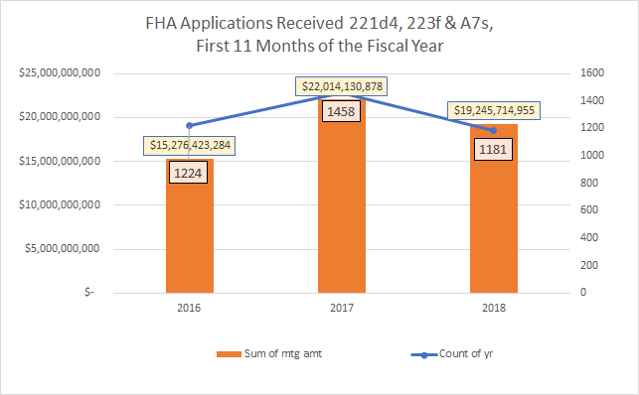
Incoming Pipeline Basic MF FHA programs – FY 2016 to 9/13/18
Notes:
Here are the numbers in terms of incoming pipeline.

Slide 11
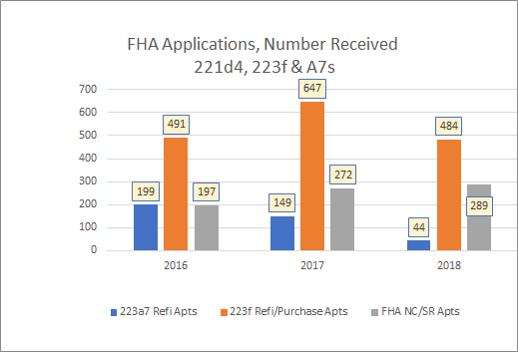
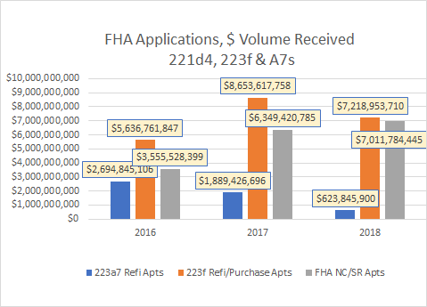
Incoming Pipeline Basic MF FHA programs – FY 2016 to 9/13/18
Notes:
Here are the numbers in terms of incoming pipeline.

