Slide 1
Six Degrees of Separation
From Kevin Bacon to Davis-Bacon

Slide 2
Moderator: Raelee Jones, Wells Fargo Bank
Panelists: Pat Burke, HUD HQ
Rebecca Clark, DOL
Rob Hazelton, Dominion Due Diligence
Sharon Walker, MBA

Slide 3
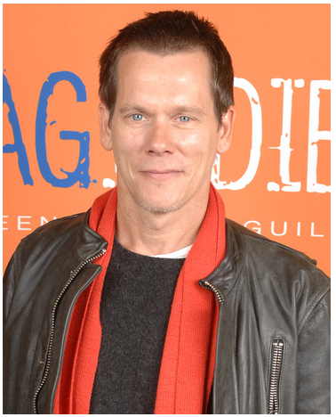

Slide 4
Questions?

Slide 5
Let’s Review:
From Kevin Bacon to Davis-Bacon

Slide 7
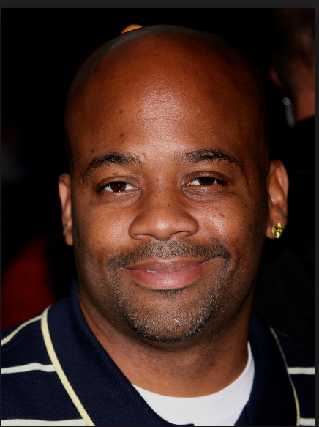

Slide 8
Damon Dash is a music producer and actor best known as
co-founder of Roc-A-Fella Records along with Shawn "Jay-Z" Carter
Dame Dash produced an independent film, The Woodsman,
staring Kevin Bacon

Slide 9
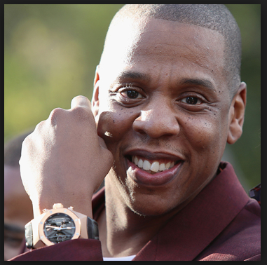

Slide 10
Jay Z grew up in Brooklyn, NY in the Marcy Projects, a public housing
Complex built and operated by the New York City Housing Authority in
1949.
As Davis-Bacon was enacted in 1931, the housing project was likely built
Using Davis-Bacon wages.
And, that is your connection from Kevin Bacon to Davis-Bacon.

