Slide 1
What’s Going On?
Richard K. Green
University of Southern California
September 9, 2019

Slide 2
Agenda
Big flashing yellow
Big picture on quantities and prices
A word on marriage
Housing finance
Externalities
Technology and Commercial Real Estate

Slide 3
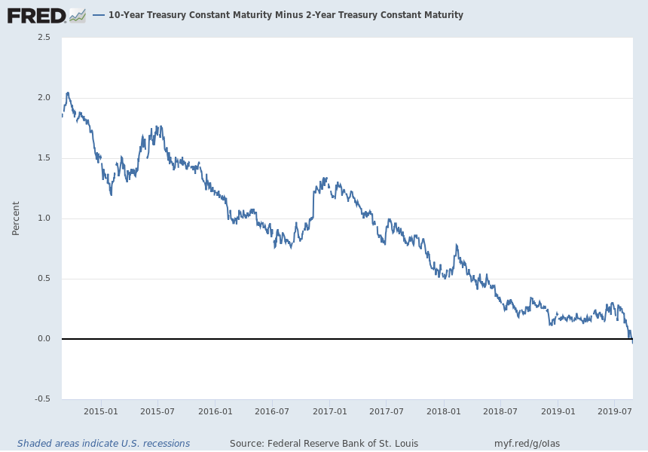
Notes:
Source:
Federal Reserve Bank of St. Louis
Release:
Interest Rate Spreads
Units:
Percent, Not Seasonally Adjusted
Frequency:
Daily
Starting with the update on June 21, 2019, the Treasury bond data used in calculating interest rate spreads is obtained directly from the U.S. Treasury Department.
Series is calculated as the spread between 10-Year Treasury Constant Maturity (BC_10YEAR) and 2-Year Treasury Constant Maturity (BC_2YEAR). Both underlying series are published at the U.S. Treasury Department.
Federal Reserve Bank of St. Louis,
10-Year Treasury Constant Maturity Minus 2-Year Treasury Constant Maturity [T10Y2Y],
retrieved from FRED,
Federal Reserve Bank of St. Louis;
https://fred.stlouisfed.org/series/T10Y2Y,
August 27, 2019.

Slide 4
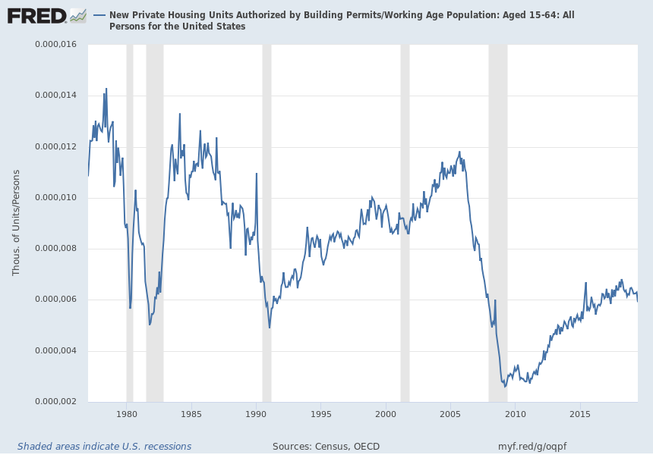
Notes:
Source:
U.S. Census Bureau
Source:
U.S. Department of Housing and Urban Development
Release:
New Residential Construction
Units:
Thousands of Units, Seasonally Adjusted Annual Rate
Frequency:
Monthly
Starting with the 2005-02-16 release, the series reflects an increase in the universe of permit-issuing places from 19,000 to 20,000 places.
U.S. Census Bureau and U.S. Department of Housing and Urban Development,
New Private Housing Units Authorized by Building Permits [PERMIT],
retrieved from FRED,
Federal Reserve Bank of St. Louis;
https://fred.stlouisfed.org/series/PERMIT,
July 17, 2019.
Source:
Organization for Economic Co-operation and Development
Release:
Main Economic Indicators
Units:
Persons, Seasonally Adjusted
Frequency:
Monthly
OECD descriptor ID: LFWA64TTOECD unit ID: STSAOECD country ID: USAAll OECD data should be cited as follows: OECD, "Main Economic Indicators - complete database", Main Economic Indicators (database),http://dx.doi.org/10.1787/data-00052-en (Accessed on date)Copyright, 2016, OECD. Reprinted with permission.
Organization for Economic Co-operation and Development,
Working Age Population: Aged 15-64: All Persons for the United States [LFWA64TTUSM647S],
retrieved from FRED,
Federal Reserve Bank of St. Louis;
https://fred.stlouisfed.org/series/LFWA64TTUSM647S,
July 17, 2019.

Slide 5
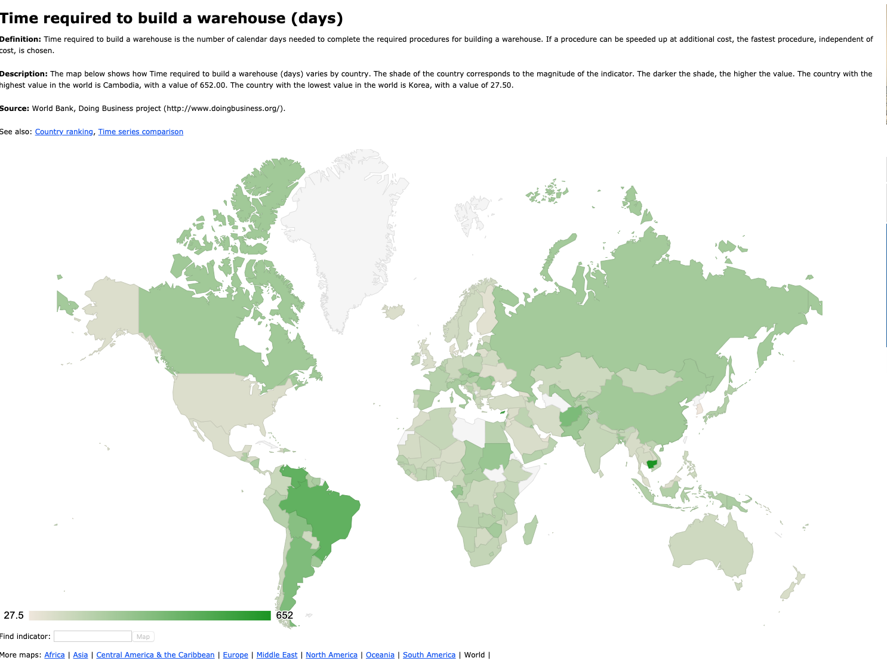

Slide 6
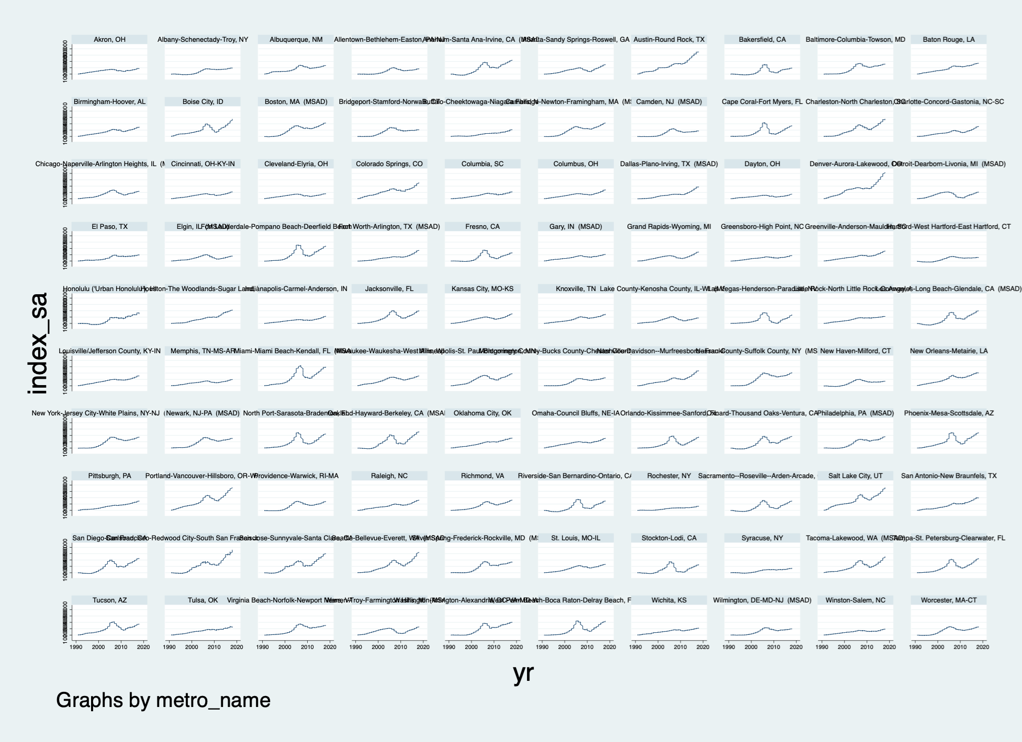

Slide 7
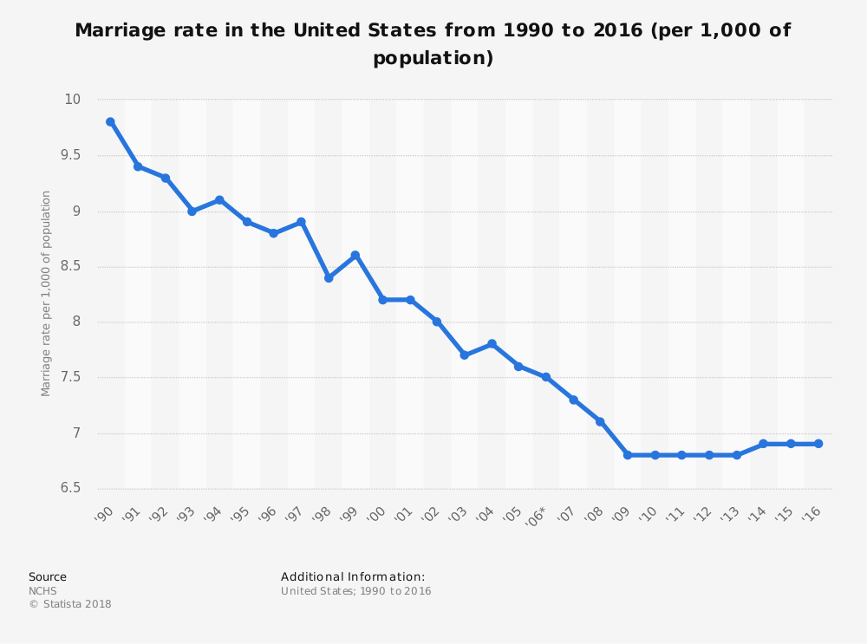

Slide 8
The Housing Finance System Through Time
($Billions)
Total mortgage debt outstanding
Source: Federal Reserve Economic Data and Urban Institute.
Note: Data as of Q2 2018.

Slide 9
Value of the US Housing Market
($Trillions)
Source: Federal Reserve Economic Data and Urban Institute.
Note: Data as of Q2 2018.

Slide 10
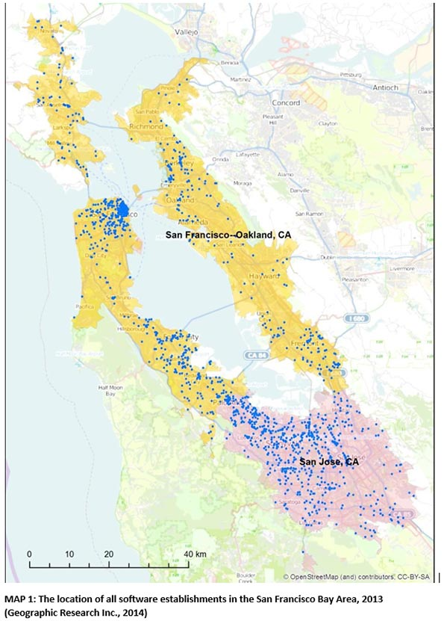
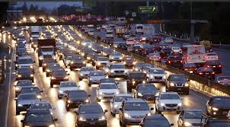
Externalities: How important?
Positive Externalities: Agglomeration
Negative Externalities: Congestion

Slide 11
Externalities
Agglomeration
Congestion and others
Economies of scale
Economies of scope
Production externalities
Consumption externalities
Transport
Public service provision more generally?
Pollution
Crime???
But: solution to transport?

Slide 12
We know urban externalities are large
This is why we have cities
Productivity differences are large across cities
Increasing returns to scale
How does one incorporate this into modeling?

Slide 13
How rapidly is technology changing demand for real estate? This is a profound challenge for thinking about the future of RE
Not just Amazon
Office space use is changing
Will people want different houses in the future?
Logistics is changing.

Slide 14


Slide 15


Retail’s response to the Amazon Effect
Old Big Box Target
New Small Format Target

Slide 16
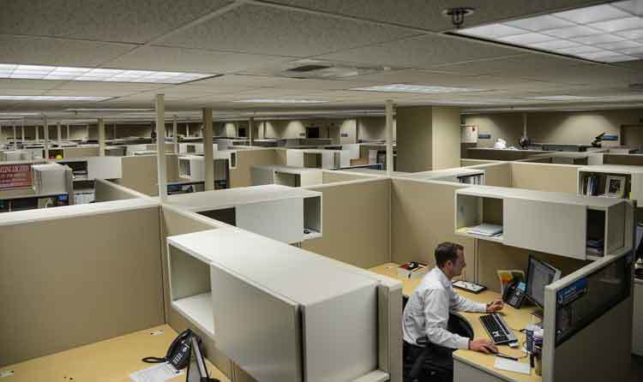

Office Space

Slide 17

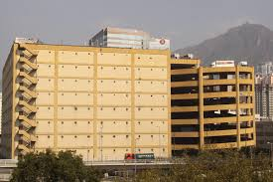
Logistics

Slide 18
Long Run
Educational Attainment
Weather
Air Traffic
Flooding
Aging

Slide 19
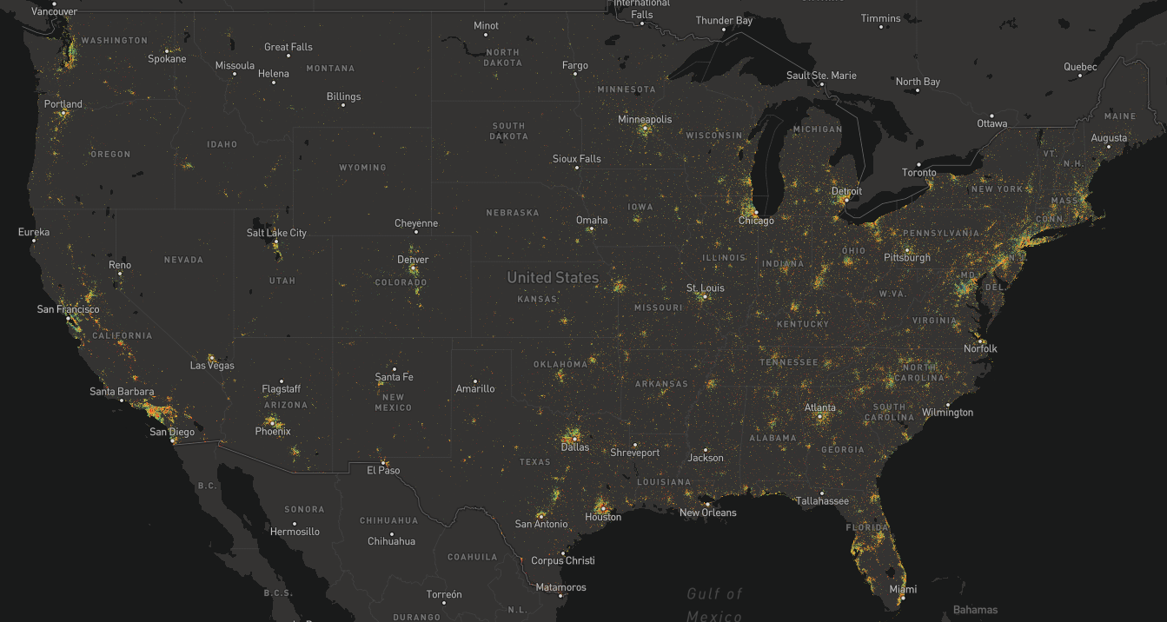
Source: Kyle Walker, TCU

Slide 21
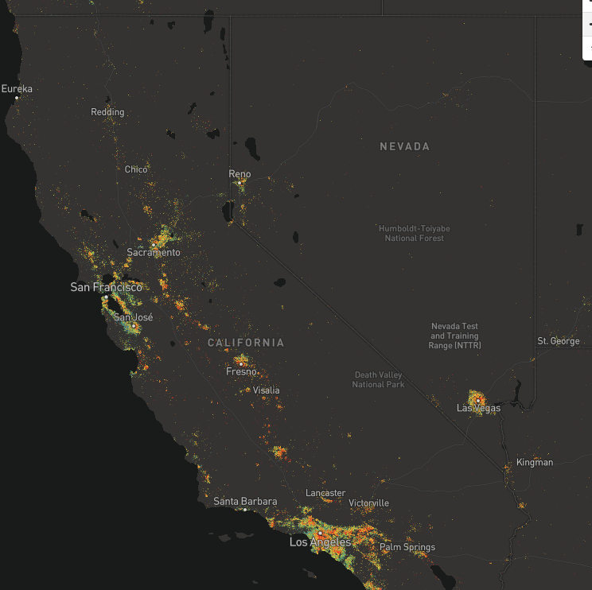
Source: Kyle Walker, TCU
Notes:
Source:
Federal Reserve Bank of St. Louis
Release:
Interest Rate Spreads
Units:
Percent, Not Seasonally Adjusted
Frequency:
Daily
Series is calculated as the spread between 10-Year Treasury Constant Maturity (https://fred.stlouisfed.org/series/DGS10) and 2-Year Treasury Constant Maturity (https://fred.stlouisfed.org/series/DGS2).
Federal Reserve Bank of St. Louis,
10-Year Treasury Constant Maturity Minus 2-Year Treasury Constant Maturity [T10Y2Y],
retrieved from FRED,
Federal Reserve Bank of St. Louis;
https://fred.stlouisfed.org/series/T10Y2Y,
June 5, 2018.

Slide 22
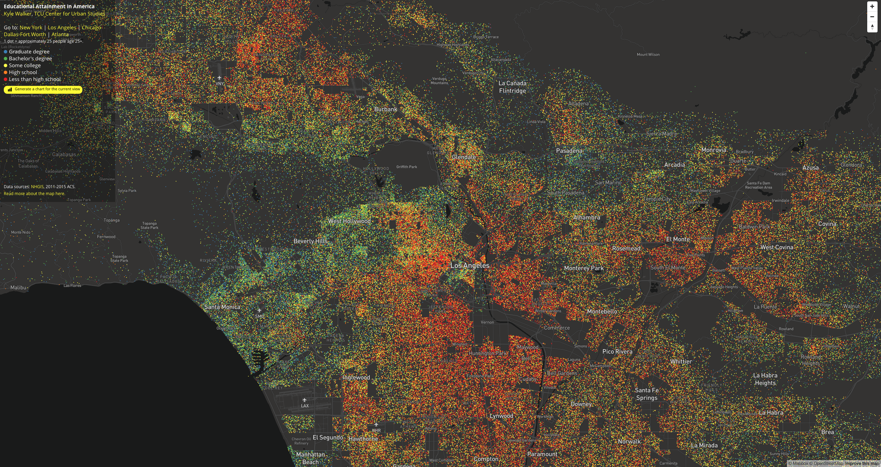

Slide 23
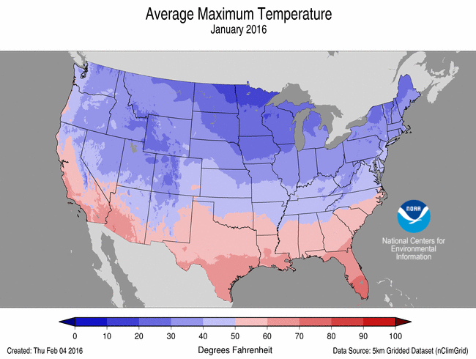

Slide 24
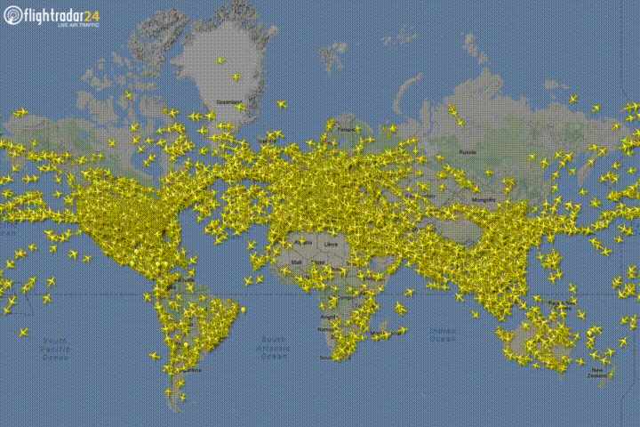

Slide 25
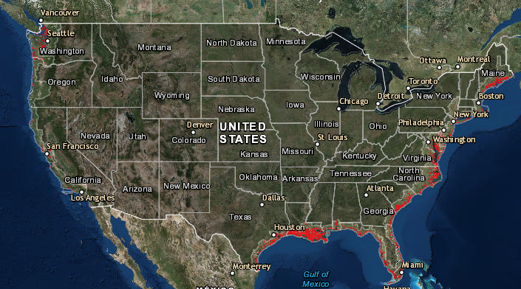
Notes:
Source:
Board of Governors of the Federal Reserve System (US)
Release:
Z.1 Financial Accounts of the United States
Units:
Percent, Not Seasonally Adjusted
Frequency:
Quarterly, End of Period
This series appears in Table B.101. For further information see the assistance provided in the guide to the Financial Accounts at http://www.federalreserve.gov/apps/fof/.The source series id is FL152090006.Q.
Board of Governors of the Federal Reserve System (US),
Households and Nonprofit Organizations; Net Worth as a Percentage of Disposable Personal Income [HNONWPDPI],
retrieved from FRED,
Federal Reserve Bank of St. Louis;
https://fred.stlouisfed.org/series/HNONWPDPI,
June 5, 2018.

Slide 26
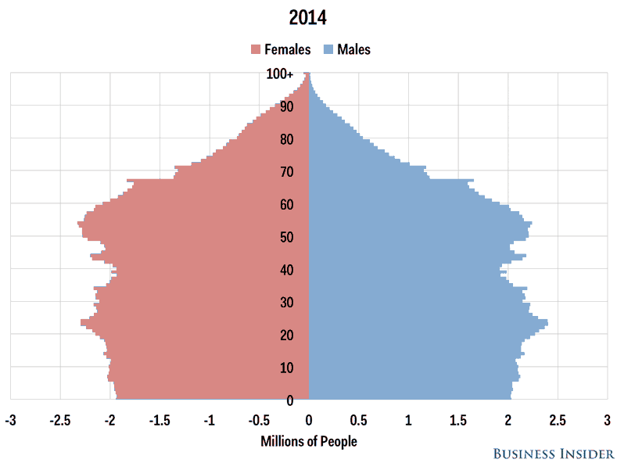

Slide 28
Finally: How Might This Affect RE?

