Slide 1
20th Annual WMAC Conference LIHTC & D4 Pilot Update
September 9, 2019
San Francisco, CA.
Erica Kodiyan, MF Underwriting Branch Chief, LIHTC Team Lead, West Region
On behalf of Elizabeth H. Arteaga, Housing Program Officer, HQ

Slide 2
HQ Updates
LIHTC Pilot Notice published 02/21/19
Go to https://www.hud.gov/program_offices/housing/mfh/map/maphome/taxcredit for latest Pilot Q&As
Memo from Pat Burke dated 03/22/19- Waivers for Chap. 14.13.D: Repayment of Def. Dev. Fees
Opportunity Zone Incentives Notice
2019 MAP Guide Revisions
Notes:
These notices have been issued this fiscal year.

Slide 3
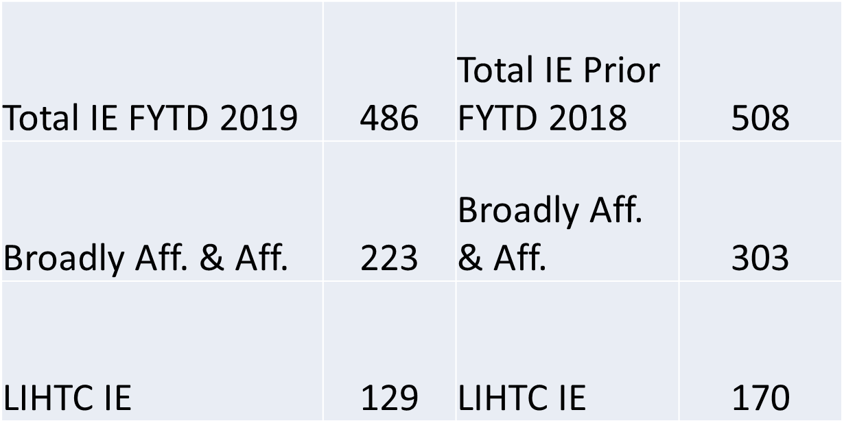
LIHTC Production #s FY 2019 1st & 2nd Qtrs.
Notes:
So where are we in terms of the pilot.
For the 1st and 2nd quarters, overall LIHTC is down from last year. Run thru the numbers above.

Slide 4
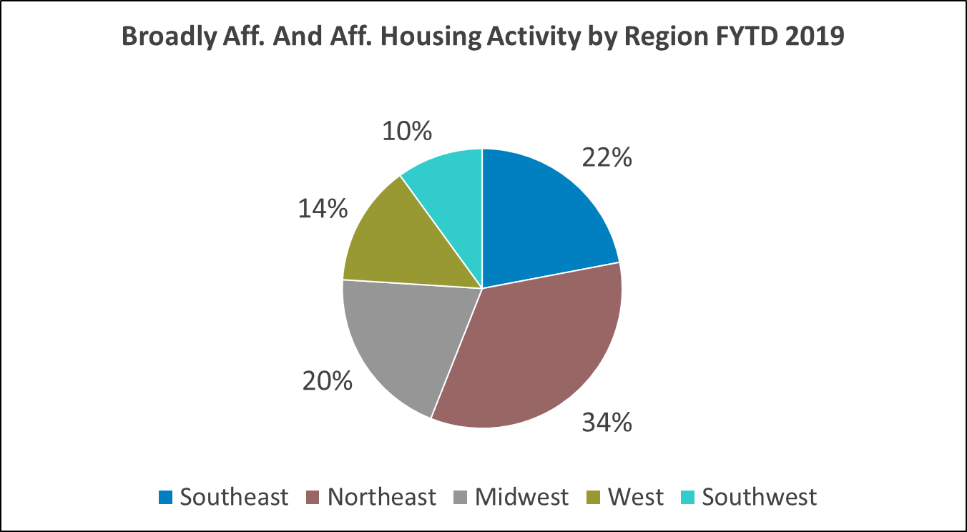
LIHTC Production #s FY 2019 1st & 2nd Qtrs.
Notes:
Broadly affordable includes LIHTC deals; affordable includes deals with inclusionary zoning or 10-90% LIHTC or Section 8.

Slide 5
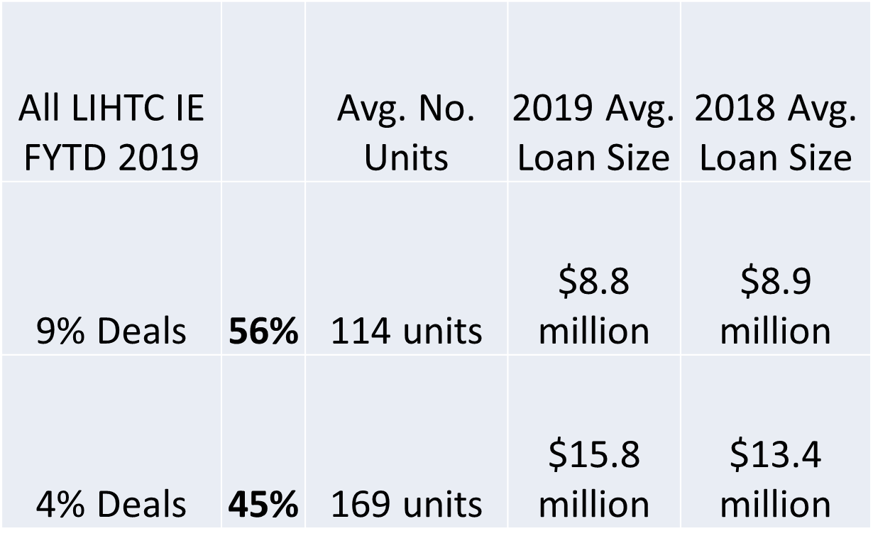
LIHTC Production #s FY 2019 1st & 2nd Qtrs.
Notes:
56% of the IE LIHTC deals were 9% with aver loan size of $8.8 M
45% were 4% deals with aver loan size of $15.8M

Slide 6
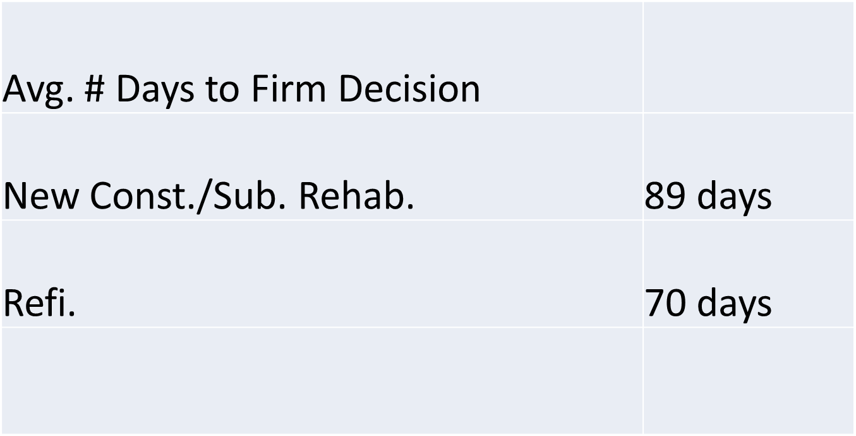
LIHTC Production #s FY 2019 1st & 2nd Qtrs.
Notes:
Still taking longer than we would like to get to a FC.

Slide 7
Initial Endorsements 2019 FYTD. All vs. LIHTC excludes Risk Share
 | No. of IE
All IE FYTD (excludes Risk Share) | 577
All LIHTC (excludes Risk Share) | 188 | 33% of total IE FYTD
 | $$$ Volume of IE
All IE FYTD (excludes Risk Share) | $9.87 BN
All LIHTC (excludes Risk Share) | $2.25 BN | 23% of total volume
NC/SR LIHTC FYTD | 99
Refi LIHTC FYTD | 89
Total | 188
4% LIHTC FYTD | 76
9% LIHTC FYTD | 112
Total | 188
Notes:
Nationally, 577 deals completed worth approx. $9.87Billion, 188 of which were LIHTC worth approx. $2.25Billion have been completed to date.
Nationally 99 of 188 were NC/SR LIHTC deals and 89 were REFI LIHTC.
Nationally 76 were 4% deals and 112 were 9% deals. These are to-date and not just the 1st and 2nd quarter.

Slide 8
LIHTC at HUD
1991-2013 7-8% of FHA Volume with LIHTC
MAP Guide Chp. 14
Feb 2019 D4 LIHTC Pilot Notice Published
Sept 2019 23% of FHA volume with LIHTC
Notes:
Timeline to help enable LIHTC be a meaningful product at HUD.
LIHTC is growing is an important insurance product we process to help support affordable housing.

Slide 9
LIHTC Pilot Status
13 active deals since February
1 – 9% NC; 4 - 9% SR, sect 8; 8 - 4% SR, sect 8
3 LIHTC Pilot Firms have been Issued:
Northeast- 1, Midwest- 1, West- 1
1 LIHTC Pilot deal has Initially Closed:
Midwest Region
Loan sizes from $1.72 to $17.7 million
Notes:
Not many deals: 13 active, 3 issued FC, 1 has closed.

Slide 10
D4 Pilots are Low Risk Deals
Extremely low foreclosure rates;
Many vested participants;
Low risk deals with LTC/LTV @ 45% in some cases;
Experienced Development Team Members;
Tax Credits are subject to Recapture
Notes:
Not every deals qualifies or the D4 pilot. Here is one way to look at some of the key areas where the risk has been reduced

Slide 11
Pilot Concept Meeting Outcomes
Notes:
Out of 15- 10 concepts were encouraged as expedited, 3 were shifted to standard and 2 were rejected and withdrawn

Slide 12
Early Deliverables at Concept
In the concept package include:
2530’s
MUTM rent approvals
AFHMP
Phase 1
Written SOW
Pilot Eligibility checklist
Prepayment approval
Tax credit investor/syndicator certifications
Notes:
The idea is process long lead items earlier in the concept meeting package. That is how we get to quicker processing.

Slide 13
Ineligible Projects
RAD projects- case by case basis.
Lender Question: RAD should be allowed for expedited processing if an RCC has been issued. Once an RCC is issued then there is less complexity. RAD could benefit from the 4% rehabilitation streamlining.
Historic Tax Credit/New Market Tax Credit deals
Projects involving adaptive re-use of non residential structures
Projects involving significant demolition
Projects involving gut rehab.
Projects with inexperienced Development Team Members

Slide 14
HUD LIHTC Web Page: https://www.hud.gov/program_offices/housing/mfh/map/maphome/taxcredit

Slide 15
The End
Thank you
ERICA KODIYAN| Branch Chief
HUD MULTIFAMILY – WEST REGION
U.S. Department of Housing and Urban Development
San Francisco Multifamily Regional Office | One Sansome Street, 12th Floor
San Francisco, CA 94104 | T: 415.489.6661 Email:erica.b.kodiyan@hud.gov
LIHTC Lead
Workload Share Lead

