Slide 1
Dodging Bullets in the Affordable Matrix
September 9, 2019
Western Mortgagee Advisory Council
San Francisco

Slide 2
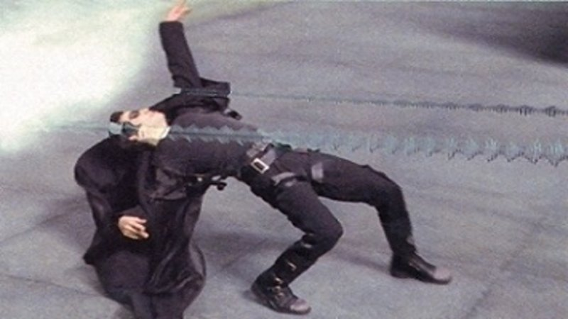
Just One Bullet?

Slide 3
Or Many?

Slide 4
Dodge Bullets (avoid delays) Like Neo By . . .
Wearing sunglasses and really cool trench coat.
Having a robust, detailed concept meeting to discuss issue early.
Having MUTM rents pre-approved before Firm Application; using Lender-ordered RCS.
Ensuring availability of bond volume cap.
Having subordinate debt commitment letter – or extremely high certainty award.
Discussing HUD Subordination Agreement early with subordinate lender(s).
Discussing Ground Lease Addendum early with Lessor.
Reviewing title policy for any restrictions that will remain after closing (e.g., City of LA age restrictions, ADA restrictions)

Slide 5
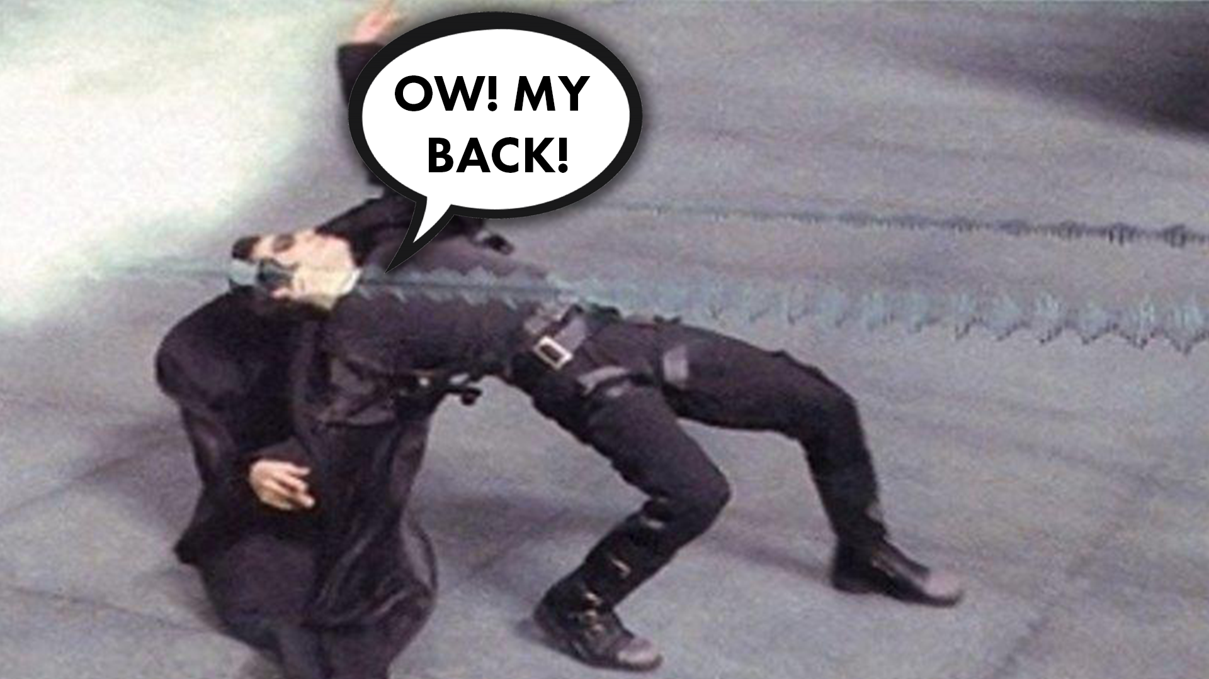
Dodge Bullets (avoid delays) Like Neo By . . .
9. Engaging HUD as a partner to discuss issues early.
10. Having a third-party Relocation Plan prepared for HAP projects.
11. Knowing environmental issues can even be a concern for preservation projects already in HUD’s portfolio.
12. Visiting chiropractor or massage therapist regularly.

Slide 6
Final Thought
“Neo, sooner or later you’re going to realize just as I did that there’s a difference between knowing the path and walking the path.”
-- Morpheus

