Slide 1
Map/Fast Track
Then & Now
A Most Excellent Adventure

Slide 2
1993 – Delegated Processing
In the early 1990’s, after co-insurance, HUD authorized the Delegated Processing program, whereby HUD Field Offices could contract with an approved firm to process and underwrite, subject to HUD’s review and approval.
All of the contractors were also FHA Lenders.
Each application was bid on by pre-approved contractors and would go through a selection process.
Delegated Processors were given timelines, such as 30 days for SAMA, 45 days for Feasibility, 30 days for firm.
Total timing (Contractor and HUD) was anticipated at 45 days for SAMA, 75 days for Feasibility, and 60 days for firm.
HUD still did Environmental Reviews
Third Party Reports and Borrower responses could extend timing.
HUD often ended up Re-Doing the Delegated Processors work.

Slide 3
1998 – Fast Track 2.0 (Seattle)
In the mid-1990’s, Delegated Processing was set aside, and the Portland and Seattle Field Offices set about creating “Fast Track”.
The concept was:
  HUD provided a detailed checklist
  Lenders could get 3rd Party Reports from approved providers more quickly than HUD could go through its contracting procedures
  Advertised much faster turn around by HUD when package was accepted and, in some instances, offered refund of application fee if a decision was not reached in 90 days.
Fast Track spread throughout the country
Each Region / Field Office had their own version of Fast Track, including checklists, etc.
In the Late 1990’s, Seattle created Fast Track 2.0, which promised faster turn around times than the original
In addition to typical fast track items, FT 2.0 required the Lender to provide:
  a lender narrative
  specific analyses in specific format
  (rent and expense grids, etc.)
  an appraisal review checklist
  (signed by appraiser and lender)

Slide 4
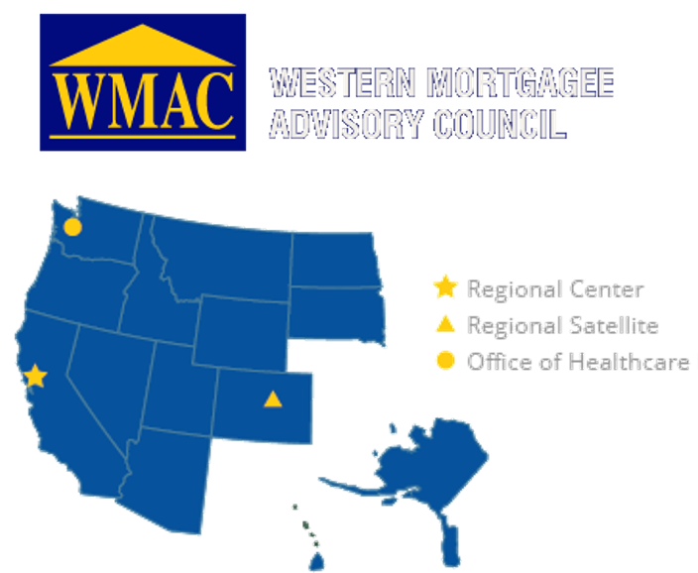
1999 – WMAC Formed
In 1999, Todd Marans, Tom Peters, and John Taylor worked together with Watt Taylor to form WMAC, the first regional HUD lender association
It was primarily created to
  Improve communication between HUD and Lenders in the Western regions
  Attempt to create continuity of best practices between San Francisco, Denver, Seattle and LA
WMAC worked with John Patterson and others at HUD and held its first conference in Las Vegas.

Slide 5
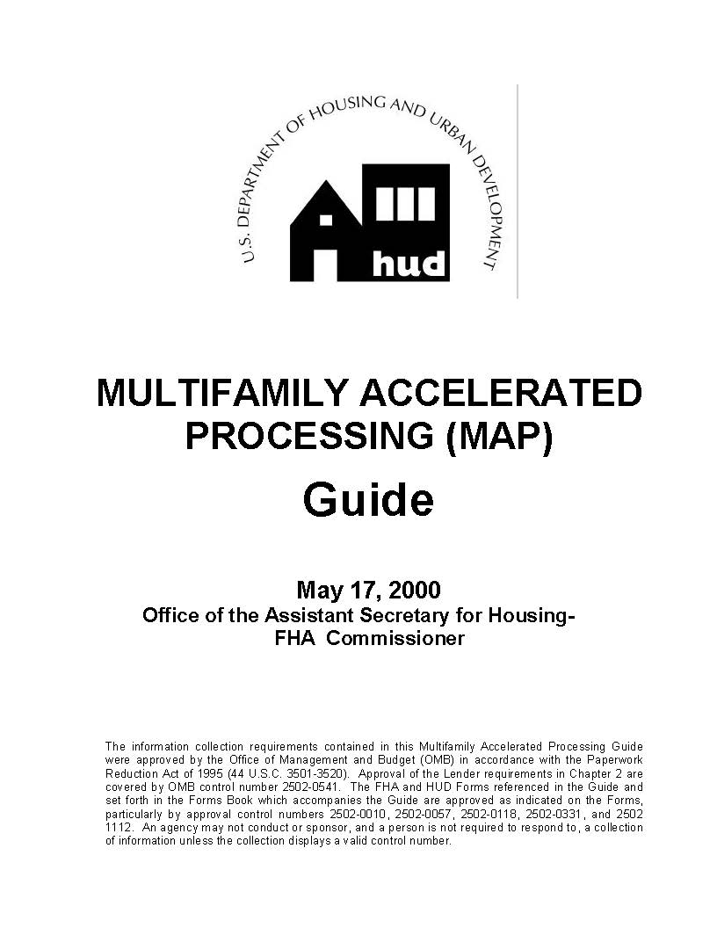

2000 – MAP Is Introduced
Issued May 17, 2000
Consolidates local Fast Track programs into a National “accelerated” program.
Lenders provided training sessions at Regional Centers across the Country.
To be approved, underwriter’s just need to attend about a 2-day training.
The Lender mantra became
“Review, Don’t Redo!”
MAP was Optional…there was still TAP
Covered programs included: 221(d), 223(f), 232

Slide 6



2000 – MAP is Introduced
The MAP Forms Book with instructions was also published May 17, 2000, and distributed to HUD multifamily offices and MAP Approved Lenders has not been revised. It is not available on the web.

Slide 7
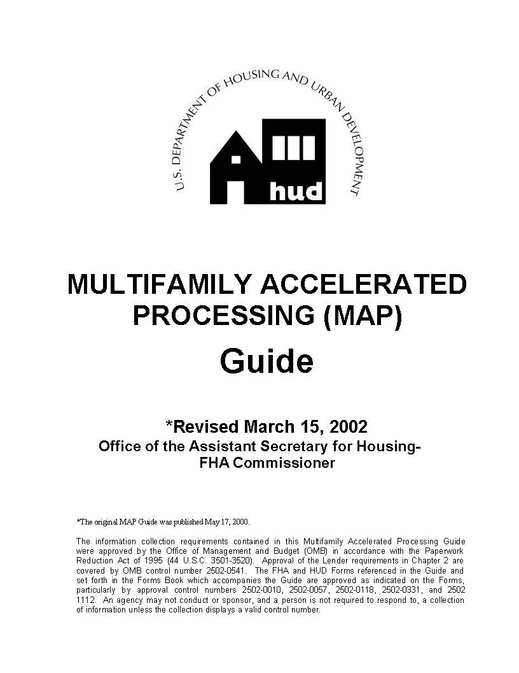
2002 – MAP, RevisED
March 15, 2002, HUD introduced their first revisions to the MAP Guide
  Introduces LQMD (now AMCOD)
  Environmental section is much more robust
    Vapor Encroachment introduced
  Several clean ups, clarifications and lessons learned added.
Covered programs included: 221(d), 223(f), 232
MAP becoming more mainstream for Lenders
HUD has MAP Teams and TAP Teams
MAP deals are given priority

Slide 8

2010 – Risk Mitigation Notice
Housing Notice 2010-11
Lowered LTV and LTC
Increased DSCR
Increased Vacancy
Real Estate Owned Analysis
Concentration of Principal Risk limits
50% cash back hold back
Underwriter Site Inspection/Lease Audit requirement
Operating Deficit / Working Capital modified

Slide 9
2011 – MAP Guide Revision
Major Re-Write
Incorporated Risk Mitigation
Deleted Section 232
Added Sections 231, 223(a)(7), and 241(a)
Introduces Concept Meeting
New Inspection requirements

