Slide 1
Extreme Decision-making Lessons from the “Heroic Era” of Antarctic discovery When Your Life Depends on It
Presented by David Hirzel
© 2019

Slide 2
Many decision-making lessons can be learned from the experiences of the early Antarctic explorers.
Here are five compelling questions that you may want to answer .
How well have you prepared?
Who’s in charge?
Who’s on your team?
Will the results be worth the effort?
What is your higher purpose?

Slide 3
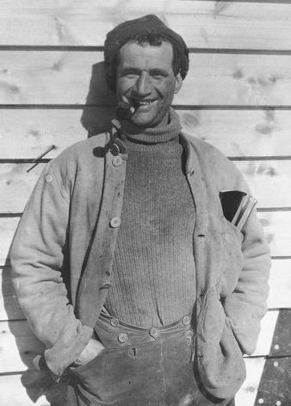
“Antarctic Circle”
South Pole Inn
Antarctic Symposium 2015
Mary Crean O’Brien
Tom Crean
Brad Borkan

Slide 4
Antarctica:
The South Pole

Slide 5
Why go? Nothing there but ice and -94.7 °C (-135.8 °F) cold. . . .

Slide 6
. . . unending toil and hardship. . .
Colin O’Brady: First man to cross (Dec. 26, 2018)

Slide 7
Women in the Antarctic 1947 and ever after
Jennie Darlington
and Edith Ronne
First women to overwinter

Slide 8
Why were the early explorers driven to go to Antarctica? The twin lures of science and discovery during the “Heroic Era” (1900-1916) of Antarctic Exploration
Discovery
The reality
Science
The idea
Geography
Geomagnetism
Meteorology
Geology
Locate, survey, and map unexplored lands
Locate the South Geomagnetic Pole
Understand climate and global weather systems
Define the underlying structures of the earth

Slide 9
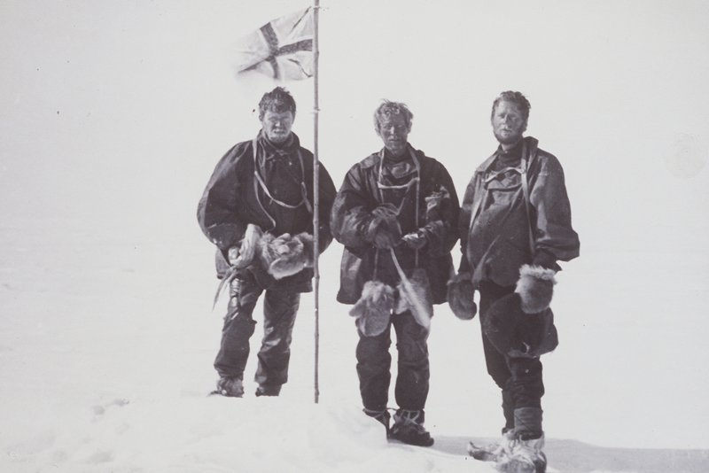
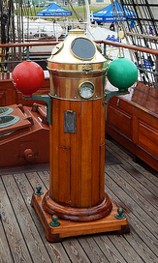
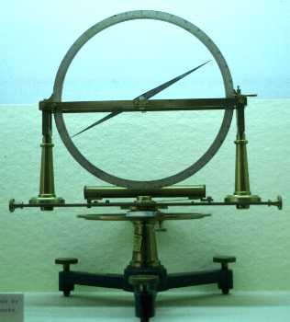
Science:
The idea
Discovery:
The reality

Slide 10
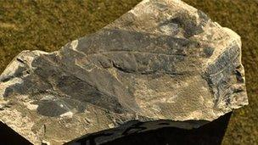
Scott’s Glossopteris discovered in 1912
Tectonic Plates as we understand them today
Discovery: The reality
Science:
The idea

Slide 11
What does this have to do with the work of WMAC?
Science—Design, Finance, Construction
The idea: “Housing”
Discovery
The reality: “Home”

Slide 12
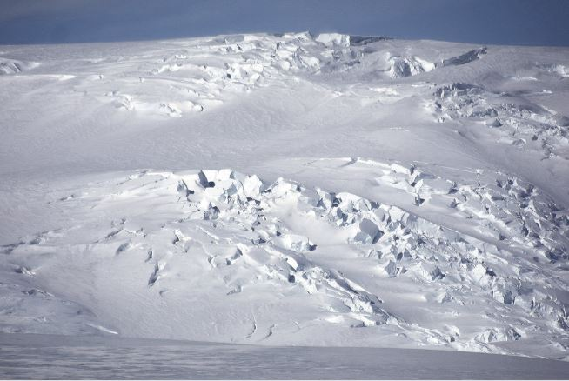
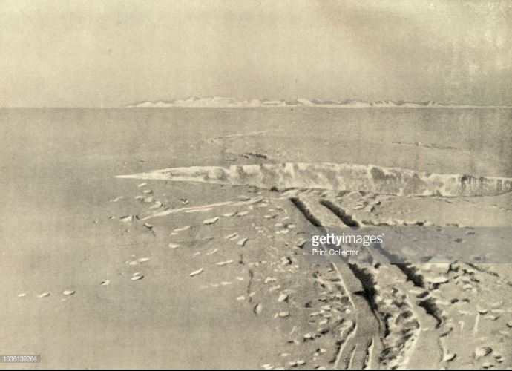
Back to the Antarctic: Land of perpetual ice, always in motion

Slide 13
The financial world is always in motion.
What do you see as the extremes in your daily environment?

Slide 14
It’s your call. . . .
Decision making in extreme environments.

Slide 15
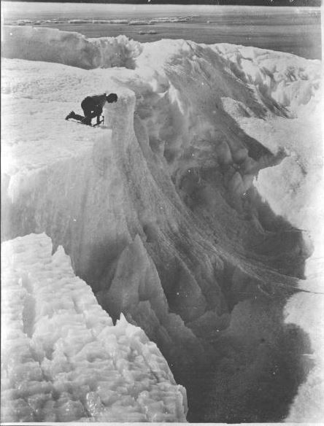
2 | How strong is your will to survive? Where does inspiration come from?
. . . but you can’t make it alone.

Slide 16
You may not be clinging onto a rope deep in an icy, frozen crevasse in the Antarctic in the early 1900s, but sometimes modern life can seem that way. Inspiration can come from unexpected places.

Slide 17
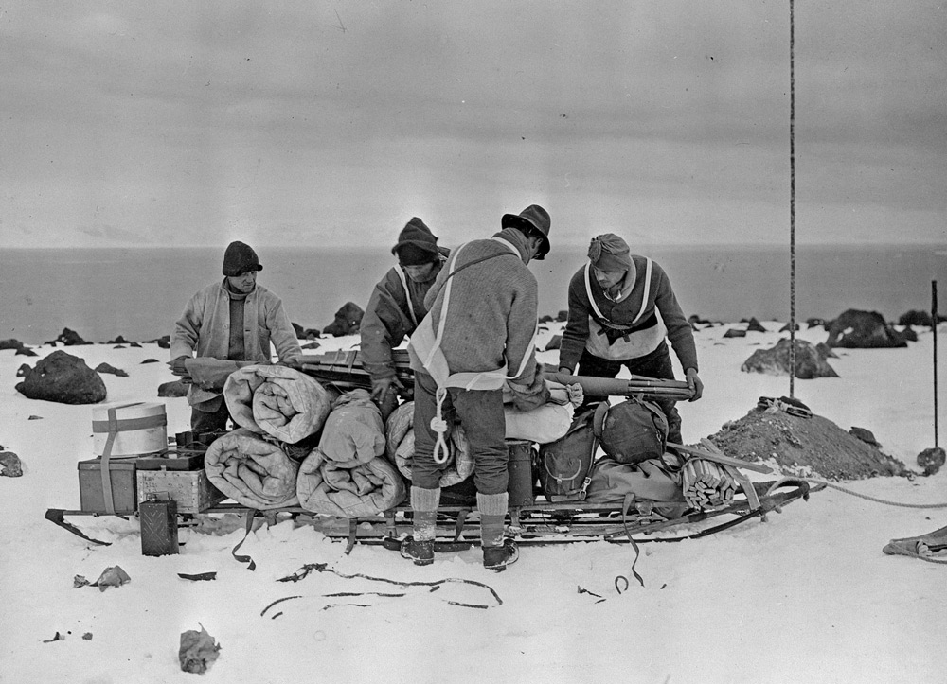
How well have you prepared?
Question #1
The art of knowing your needs before they arise.

Slide 18
How do you get everything to where it needs to go?
Some of Amundsen’s 52 dogs en route to the South Pole
December 14, 1911

Slide 19
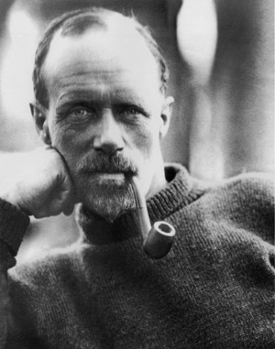
Question #2
Who’s in charge?
The surprising importance of the deputy leader.

Slide 20
Three small boats overloaded with 28 men and their gear, five days over the heaving sea in freezing weather. It’s a miracle they made it.
Or is it a matter of leadership where it is most critical?

Slide 21
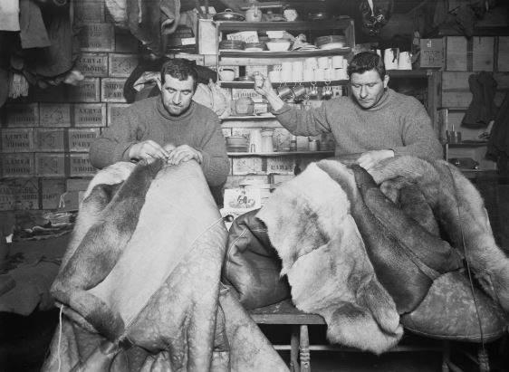
Question #3
Who’s on your team?
Choosing the best from the best available.

Slide 22
Ultimate teamwork
The Winter Journey, 1911

Slide 23
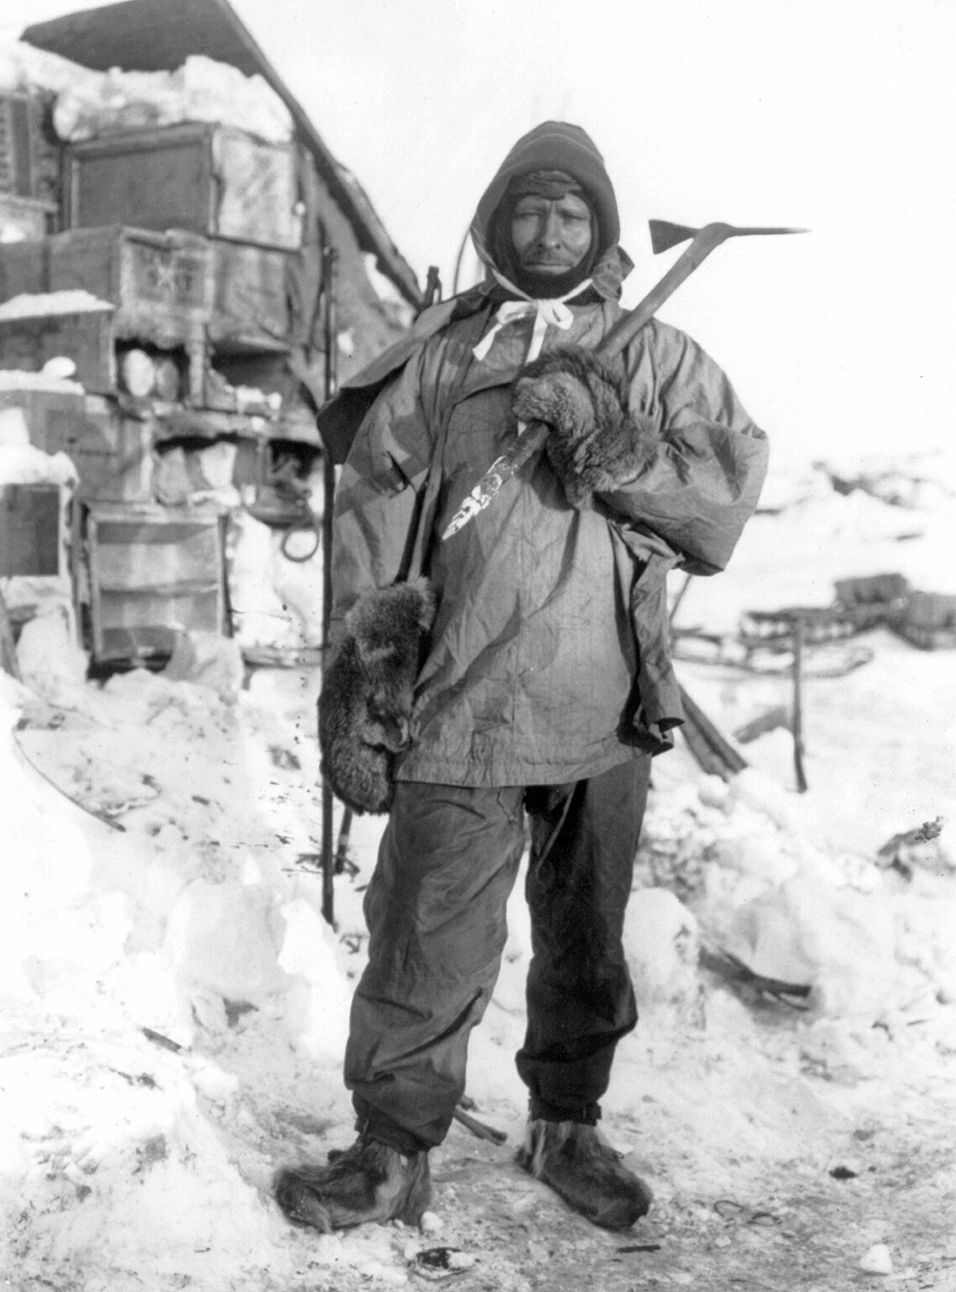
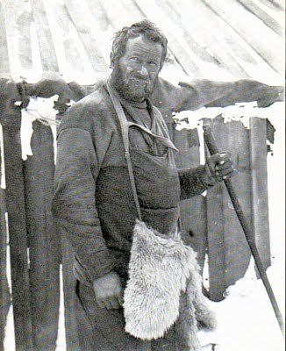
Your team:
Dependable
Versatile
Highly skilled
Dedicated
Self-initiating

Slide 24
.
Three questions so far. . .
How well have you prepared?
Who’s in charge?
Who’s on your team?
Which one relates most to your work, and why?

Slide 25
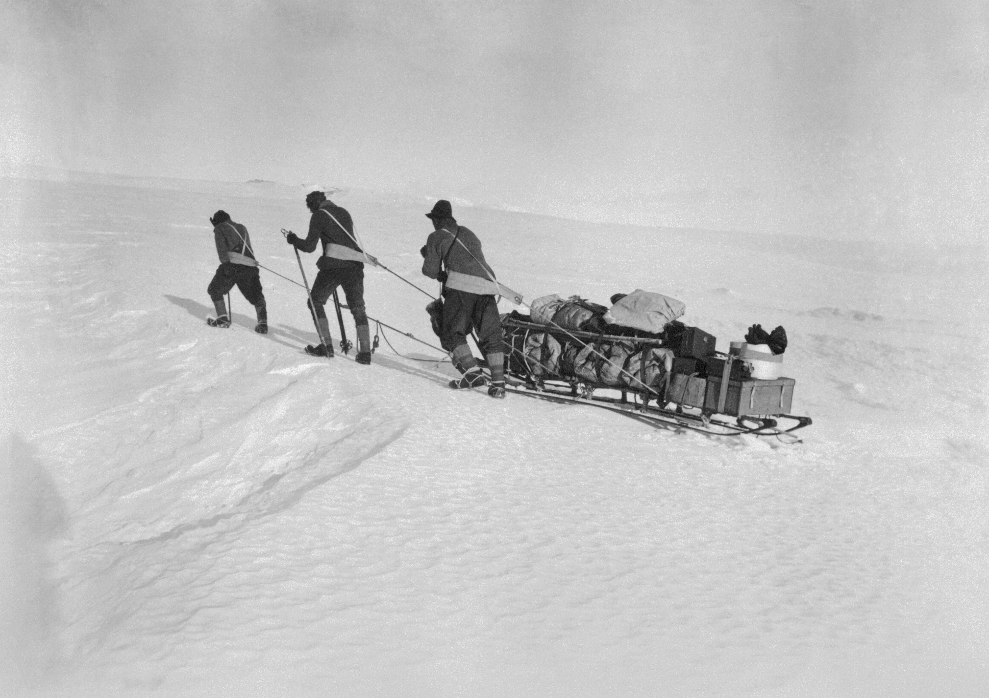
Question #4
Will the results be worth the effort?
Going the distance to find out.

Slide 26
Shackleton’s Grand Plan for an Antarctic Crossing.
The Goal
The Idea

Slide 27
You may have to reframe the image of success.

Slide 28
The new goal: “Now we’re going home.”

Slide 29
“Now we are going home”

Slide 30
Sometimes you have to just go for it.

Slide 31
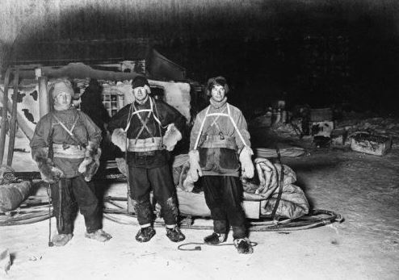
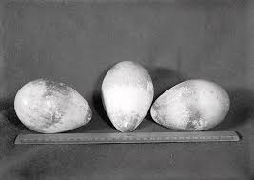
Question #5
What is your higher purpose?
Why go?

Slide 32
Is it just about reaching a goal?
Amundsen at the Pole
December 14, 1911

Slide 33
0r is there something more?
Cape Evans In Winter (1910)
—Edward A. Wilson

Slide 34
.
In summary, let’s review the five compelling questions you may want to answer in your own work.
How well have you prepared?
Who’s in charge?
Who’s on your team?
Will the results be worth the effort?
What is your higher purpose?

