Slide 1
KeyBank:
Ed Foulon- FHA Platform Manager
Bryant Scogin-Deputy Chief Underwriter
HUD:
Erica Kodiyan- Branch Chief, San Francisco
Shannon Bergman- Branch Chief, San Francisco
Mark Feilmeier-Branch Chief, Denver
Case Studies in risk, with a 1999 Twist
-WMAC 2019

Slide 2
HUD 223(f)
HUD received a 92013-SUPPs indicating 10 pending judgements, legal actions, suits or bankruptcy claim.
No pending litigation against the Mortgagor, its Principals or the Subject were presented by Lender.
1999 brought the demise of Napster when the record industry filed a lawsuit about free music file loading.

Slide 3
Solution:
Lender explained the discrepancy between the narrative and forms.
A detailed history of pending litigation, including dollar amounts, amounts covered by insurance, and timing of pending claims was provided.
Title and pending litigation were reviewed prior to closing.
Consequences of non-disclosure of this type could result in loss of Underwriter’s MAP certification and Lender subject to MACOD notification
Firm Commitment Issued!

Slide 4
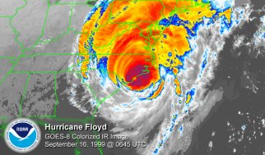
HUD 221(d)(4)
The entire site is in a flood plain and it was not practical to raise the site above the Base Flood Elevation (BFE).
Garage ingress/egress is located below the BFE.
Hurricane Floyd was the sixth named storm, fourth hurricane, and third major hurricane in the 1999 Atlantic hurricane season.

Slide 5
Solution:
Pedestal design to allow for flooding
Residential evacuation plan included a separate ingress/egress is separate from the garage ingress/egress, so residents could reasonably evacuate, on foot.
Resident leases include flood zone notification and recommends personal property insurance.
Firm Commitment Issued!

Slide 6
The Matrix debuts on March 31, 1999
HUD 221(d)(4)
Key principals offer financial strength, but no multifamily development experience.

Slide 7
Firm Commitment Issued!
Solution:
An experienced GC, Architect and Management Agent, with comparable experience, were hired.
An experienced Partner, with 5-10% interest, was added. Partner was subject to mortgage credit review.

Slide 8
The second Austin Powers Movie was released on June 8th, 1999.
HUD 223(f)
While all of the units would eventually be renovated, only 30% of the development has been completed.
Underwriting was based on 100% renovated rents.

Slide 9
Solution:
Leases were structured in a way that at lease expiration, the resident is only offered a renovated unit at a higher market rent.
Unit turnover was typically 10 units a month. Lender demonstrated that at worst-case scenario where 10 units were down at any given moment, the Subject would still achieve breakeven debt service.
18 month debt-service reserve escrow held until certified rent rolls shows the Subject achieves underwritten NOI for three consecutive months.
Firm Commitment Issued!

Slide 10
Jerry Seinfeld topped the 1999 Forbes’s Celebrity-Pay list with a staggering earnings of $267 million.
HUD 223(f)
The expenses used for determining the valuation were 14% less than actual expenses.

Slide 11
Solution:
Cap rate was adjusted upwards to be more in line with proforma.
Valuation expenses were adjusted to be more in-line with historical operations.
Resulted in reducing loan amount mortgage $12.5MM to $9.4MM.
Firm Commitment Issued!

Slide 12
The 6th season of friends aired on September 23rd 1999.
HUD 223(f)
Underwritten repair costs were $37k per unit where the program threshold was $40k per unit.
Threshold could be reached or exceeded due to unforeseen change orders.

Slide 13
Solution:
Elective repairs were reduced to reduce the risk of cost overruns that would exceed the programmatic limits for a 223(f).
Owner cannot use cash to pay change orders in order to side-step requirements.
Programmatic limits are based on Scope of Work, not source of funds.
Firm Commitment Issued!

Slide 14
Office Space was released on February 19, 1999, in only 1,740 theatres, grossing $4.2 million on its opening weekend.
HUD 223(f)
Market-rate refinance application, utilizing a 7.0% Vacancy and Collection Loss for Underwritten NOI.
T-12 operating statements indicated a 10.0% average vacancy for the Subject.

Slide 15
Solution:
Increased underwritten Vacancy and Collection Loss (VCL) from 7.0% to 10.0%.
Firm Commitment Issued!

Slide 16
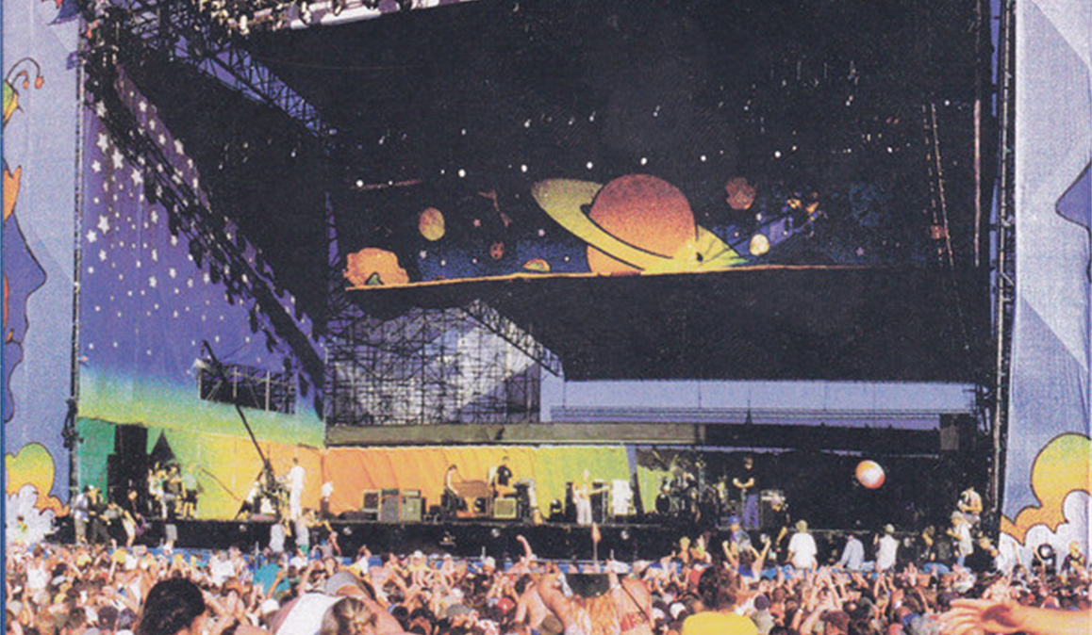
HUD 221(d)(4)
Substantial rehabilitation of an age-restricted project that was 53% occupied.
Subject was located in a rural market with approximately 3,600 residents. The nearest metropolitan area was about 200 miles away.
Over 400,000 concertgoers descend upon Rome, New York (pop. 34,950) for Woodstock 1999.

Slide 17
Rationale:
The high vacancy rate was considered too difficult to overcome, as the small population limits the amount of eligible households.
Application Rejected!

Slide 18
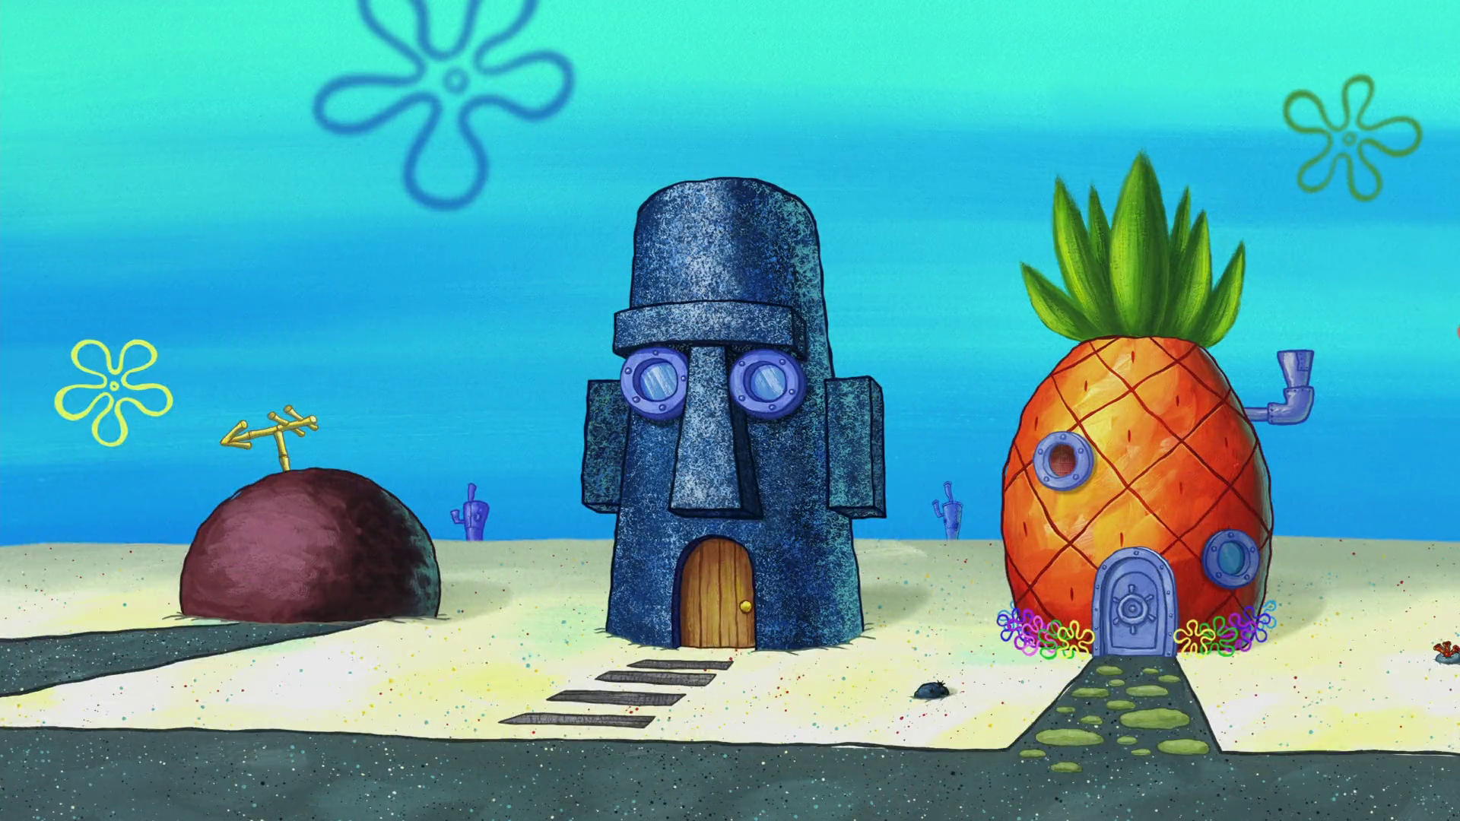
HUD 221(d)(4)
Appraiser did not make appropriate adjustments to market comparables.
Minimal downward adjustments for rent comparables in far superior locations.
Appraiser also did not make adjustments for square footage differences below 125 square feet. Market indicated adjustments after 50 SF difference.
Spongebob Squarepants debuts on May 1, 1999

Slide 19
Solution:
Rents were reduced by an average of $134 per unit, and were within a reasonable range of the comparables.
Mortgage was reduced from $10,600,000 to $9,815,000.
Firm Commitment Issued!

