Slide 1

Market Study & Appraisal
Presented by:
Scott Thurman, Greystone Funding
Dave Melanson, Denver HUD
Rebecca Arthur, Novogradac
Mary Ann Barnett, BBG

Slide 2
221(d)(4) Market Study & Appraisal
Agenda
Market Study
  Data Needs
  Considerations
  Components of a Market Study
Appraisal
  USPAP Refresher
  Data Needs
  Limited Scope of Appraisal
  Summary of (d)(4) vs (f)
Reviewing the Reports

Slide 3
Market Study
Determining the market need for the project

Slide 4
Market Study Data Needs
Site Information
Planned unit mix
Developer’s Pro Forma Rent Schedule
Description of project quality
Description of Target Market
Description of any Rent and/or Occupancy Restrictions
Concept Letter from HUD
The more you can provide, the better the report and analysis.

Slide 5
Market Study Considerations
Why are there never any “bad” market studies?
Opportunity to make changes to development scheme / work with developer to develop a good product that will meet needs (price level) of market
Site specific: Micro vs. Macro
Why / how market studies are different – different intended users & intended use – why HUD studies can be different than investor studies/lenders/ state LIHTC agency studies
Due to the requirements of HUD MAP program - Market Studies vs. Appraisals are different firms – different views on the market – also the intended use/purpose is to ensure the deal works in a macro sense (not in infringe on other HUD Insured deals) whereas state agency might focus on public policy initiatives or investors focus on maximizing income
Appraisal is focused on rent & income
Market study for HUD is focused on supply/demand, and the proposed rent in relation to supply/demand VERSUS other studies the rent is much more incorporated within the study.

Slide 6

Components of a Market Study
Description of Project
Primary Market Area (PMA)
Economy
Demographics
Supply Analysis
(Existing and Proposed)
Demand Analysis
Findings & Conclusions

Slide 7
Primary Market Area
Area the majority of tenants will be drawn from

Slide 8
What Makes a Good PMA
Based on Census Tracts or other logical data units (Zip Codes, etc.)
Observes Neighborhood Boundaries
  Look for This When in the Field
Subject is generally at the Approximate Center of the PMA
  Can be skewed by natural boundaries
Some Analysts Use County-Based Data (like EMAD).
  Depends on the Area if This Makes Sense
  Should Then Cut to Finer Neighborhood Data
  Narrow Down the Competitive Set

Slide 9
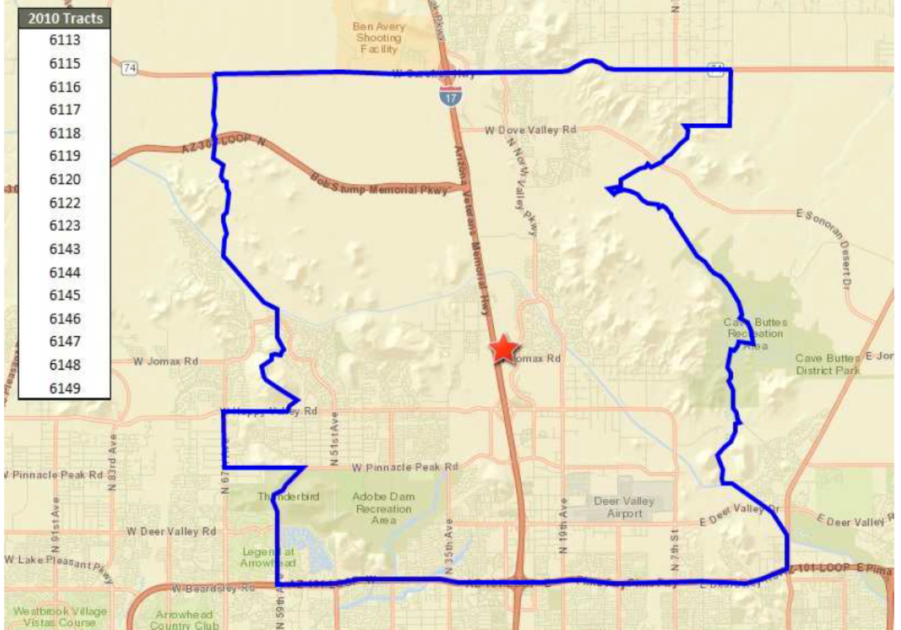
Well Drawn PMA
Example is based on Census Tracts

Slide 10
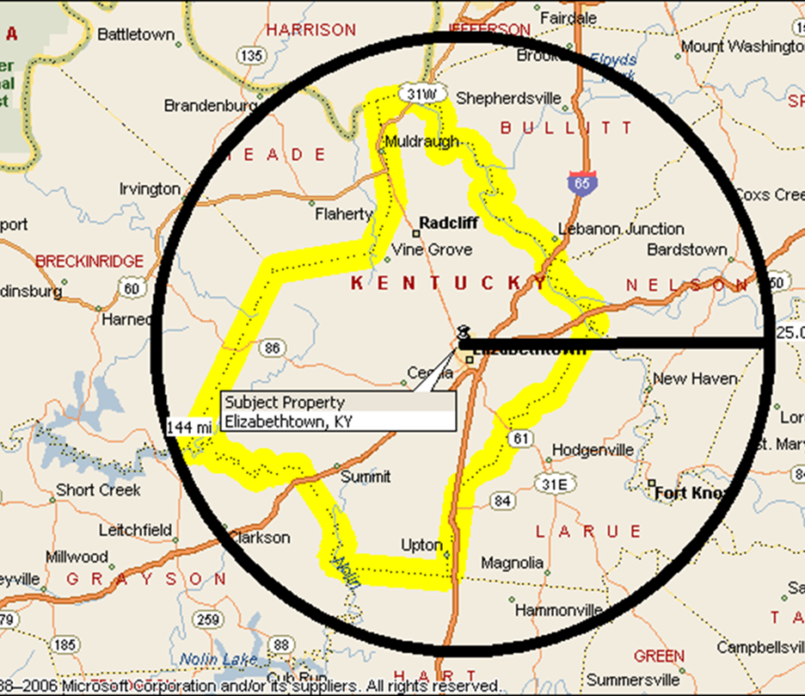
Poorly Drawn PMA
The Primary Market Area (PMA) is a 25 Mile Ring
  1,963 square miles
  All or most of 4 counties & Parts of 8 Others (nicked another state)
  Illogical Commuting/Living Pattern
  Attempted to Bring in Comps from a Much Larger Market
Circles/Rings Are Suboptimal PMAs
  Can Be Used But Not Preferred

Slide 11

Economic and Employment Factors
MAP Guide: “The market study must include a thorough description of the current and forecast economic characteristics and conditions of the PMA, county, "micropolitan" or metropolitan area (whichever is applicable).”
Employment factors primary focus
  Jobs growth/loss
  Diversity of employment
  Anticipated Changes

Slide 12

Demographics
MAP Guide: “The market study must include a thorough description of the current and forecast demographic characteristics and conditions of the PMA and a comparison secondary market including a detailed explanation of all significant trends and changes.”
  Growth over next 5-years
  Past & Expected Building Trends
  Trends in HH Size and Income

Slide 13
Supply Analysis - Existing & Proposed
Existing - competitive rental inventor
  Vacancy levels, including trends
  Absorption experience
  Rents, including trends
  Impact of single family / condominium rentals (“shadow inventory”)
  Identify FHA-insured properties in the PMA
Proposed – rental units in pipeline, under construction, in planning
Maps – important visual context

Slide 14
Demand Analysis
Testing demographics with current and proposed rental units

Slide 15
FOCUS: New Renter Households
Absolute Key to Every Analysis
New Renter Households Should be the Vast Majority of Total Demand
No Other Source of Demand Should Be Close in Impact
Other Sources of High Demand Are a Warning Sign
  Only Acceptable In Unusual Cases
  Resort Towns or College Towns
New Renter Households are Drawn from Primary Market Area (PMA)
Notes:
At least Two Thirds of All Demand. Likely well more.

Slide 16
Net Demand
Key Calculation for the Market Study
All Sources of Demand
  Less . . .
All Sources of Competitive Supply
  Results In . . .
Net Demand
Answers the Question: Is there demand for the subject project and the competition coming online during the forecast period (the next 3 years)?

Slide 17

Proper Extraction of Demand
3 Yr. Forecast
Acceptable CINCH Rate
Using All HHs. Okay
Notes:
Breaks out Income by Tenure (Income of Renter HHs) elsewhere. Not necessary here as looking at All Renter HHs.

Slide 18
Proper Look at Supply & Then Net Demand
Pent Up Demand
New Supply 5% Vacancy
Total Supply
Net Demand
Notes:
Note small effect of vacancy/occupancy when applied to new units entering the market.

Slide 19
Capture Rate
NCHMA: The percentage of age, size, and income qualified renter households in the primary market area that the property must capture to fill the units.
Calculate: Divide the total number of units at the subject property by the total number of qualified renter households in the PMA.
  Subject Units / Qualified Renter Households in PMA (x 100 as a %)
Answers the Questions: What percentage of qualified households will the subject have to capture?
MAP Guide: “Capture Rate is defined as the percentage of qualified households in the PMA that the property must capture to fill the units and achieve stabilized occupancy. Qualified Household is defined as households that meet any applicable age and household size restrictions and are within any limiting income eligible band….”

Slide 20
Penetration Rate
NCHMA: The percentage of age and income qualified renter households in the primary market area that all existing and proposed properties, to be completed within six months of the subject, and which are competitively priced to the subject that must be captured to achieve the stabilized level of occupancy.
Calculate: Divide the total number of competitive units (existing and to be completed – including the subject property) by the qualified renter households in the PMA.
  Subject & Competitive Units / Qualified Renter Households in PMA (x 100 as a %)
Answers the Questions: What percentage of qualified households will the competitive set (including the subject property) have to capture?

Slide 21
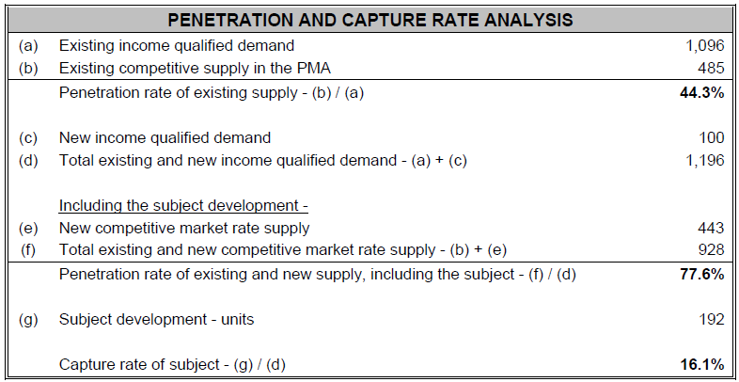
Capture & Penetration Rates

Slide 22
All Renters vs. Income Qualified Renters
When Calculating Demand
Some Analysts Use All Renter Households
  Their Inventory/Supply Estimates Follow Suit
Some Analysts Use Income Qualified Renter Households
  Their Inventory/Supply Estimates Reflect Competitive Units
  Have to Work to “Sculpt” the Appropriate Inventory
All Analysts Later Shift to Income Qualified Renter Households
  Measure Affordability
  Calculate Capture & Penetration Rates
Notes:
I’m not here to settle this argument.

Slide 23
Income Qualified Renter Households
Must Derive & Calculate this in the Proper Order
  Segment Renter Households by Income (Income by Tenure)
  Extract Just Households that are Income Qualified
Incorrect Procedure
  Take All Qualified Households (both owner and renter)
  Then Apply the Percentage of Renter Households in that Market
Doing So Overstates Income Qualified Demand
Demographic Data Suppliers Can Provide this Segmentation
  The market analyst may need to order a Custom Report
  American Community Survey Data can help to parse the data

Slide 24
Affordability Test
Percentage of Income that Can be Applied to Rent
  The Best Analysts (& MAP Guide) use Gross Rent or Rent + Utilities
The Best Analysts Use 30% - 33% of Income
  Or 3 x Rent = Required Income
Some Analysts Use 40% of Income
  Or 2.5 x Rent = Required Income
  Potential for Overburdened Renter Households
Number of Renter Households for which the Rent is Affordable Feeds to the Capture and Penetration Rates
Notes:
Affordability feeds to the Capture Rate.
HUD is not in the business of creating rent burdened households.
Doing so is contrary to HUD’s mission.

Slide 25
Upper Level of Income
Best Analysts Limit the Upper Level of Income for Potential Renters
  Often $150,000 or 3 Times the Lower Income Limit
Some Analysts Go “To Infinity and Beyond . . .”
  Even Though Small, this Overstates Demand in Most Markets
  The Highest Income Group Is Less Likely To Rent a Standard Apartment
Notes:
Not done by the Best in the Business.
Again, all residential real estate has an Income Band of sorts.

Slide 26
Forecast Period – Should Be 3 Years
Accurate Pipeline Projections are Only Available for 3 Years
When a Longer Forecast Period is Used
  Supply Decreases in Years 4 & 5 (the information is not yet available)
  Demand Outstrips Supply in Years 4 and 5
  So . . . Net Demand is Overestimated
If Project Size or Market Issues Require a Longer Forecast Period:
  Must analyze the current 3 year pipeline and recent historical trends
  And then . . .
  Make logical forecasts of new supply for any years after the first 3
Notes:
Too often a longer forecast is done only because there is insufficient Net Demand using a 3 year forecast.

Slide 27
Units Removed from Inventory
Units Removed from Inventory (the Supply)
  Units Lost or Converted to Other Uses, including the for sale market
Measured via HUD’s Components of Inventory Change or CINCH
CINCH Rate is About 0.27% of All Supply for the Western Region
  Somewhat Less for Green Fields Areas (often less than 0.2%)
  We Have Seen this Several Times Higher
  Markets with high rents and tight market conditions are unlikely to lose units except as they are demolished for newer, more dense projects
Units Removed from Inventory IS a Component of Net Demand
  But must tie in reasonably to the area CINCH Rate
Notes:
One of the best analysts in the Utah market discounts units removed from inventory as minimal.
In Colorado HUD often uses 1/3 to 1/2 of the CINCH Rate for Greenfields areas (0.08% to 0.15%)

Slide 28
In-Migration
In-Migration on top of the household growth already estimated
  Possible, but rare
  Must present absolutely convincing evidence
Often Not an Additional Source of Demand
  Just What is Already Included in the Demographic Estimate
Anecdotal Evidence is Not Acceptable (such as): “Eight of the surveyed properties attract 40% to 85% of their tenants from outside Longmont, with an average of nearly 60% coming from outside the city. The newer surveyed Class A and B properties were more likely to attract higher proportions of renters from outside the area.”
Notes:
Any project, likely almost anywhere can make similar claims.
“Noise in the numbers” – Not additional demand.

Slide 29
Can the Analyst Modify HH Growth Data?
Yes, But the Analyst Has to be an Absolute Master of the Data
  Prove their case tracking historical data
  Beyond the cost & time constraints for most analyses
An Analyst Who Has the Data: “[T]he 1.9 percent annual increase in demand for rental units (2000-2018) is too conservative to apply in today’s market . . . Unfortunately the American Community Survey is of little help in assessing demand. The survey shows an increase in rental housing from 2014 to 2016 of only 308 units. Clearly, their estimation technique is faulty; the 308 units is equivalent to one good sized apartment community developed in a two year period.”
Proceeds to Show Definitive Data Supporting Higher Growth
Notes:
This is for Salt Lake City.

Slide 30

Finding & Conclusions
The conclusion of the market and project evaluation
  Strengths & Weaknesses
  Concluded
    Demand for Subject
    Occupancy
    Absorption
    Rental range

Slide 31
Appraisal
Determining the rents, expenses, and land value

Slide 32
221(d)(4) Appraisals
New Construction
USPAP Refresher
Appraisal Data Needs
Limited Scope of 221(d)(4) Appraisals
  Income
  Expense
  Land Value
  Cost Approach
Summary of differences vs. 223(f)

Slide 33
USPAP Refresher
  USPAP guides appraisers in ethics and business management
    Don’t be misleading
    Be impartial
    No predetermined values
    Recordkeeping rules
    No contingent fees based on a predetermined outcome
    Maintain confidential information/conclusions
    Maintain written work file even if oral value given
    Competency is required
    Define scope of work

Slide 34
USPAP Refresher
  USPAP does not give directions on how to appraise
    Does not tell how many comps to use
    Does not guide on cap rate application
    Does not give inspection requirements
    USPAP does, however, give guidance that Reliance Letters are not allowed, client confidentiality is required, and that appraisals should not be misleading

Slide 35

Appraisal Data Needs
Developer’s Operating budget
Planned unit mix
Site Survey/Legal Description
Developer’s Development budget
Building plans (as much detail as available at time of appraisal)
Planned payroll schedule
Land purchase contract
Utility support for expenses projected

Slide 36
Two Stages of the Appraisal
Pre-Application
Firm Application
Income
Expenses
Land Value
Income
Expense
Cost Approach

Slide 37
Pre-Application Is Key for Valuation
When the Valuation Issues Get Worked Out
  Appraisal
  Market Study
  Environmental
Don’t Let These Wait Unit Firm Application (Headaches for All)
Firm Application Should Be Very Similar to the Pre-Application
  Slight Uptick in Income is Expected
  Expenses Should Change by a Similar Amount
  Little if Any Change in Land Value

Slide 38
221d(4) Market Rate Valuation Scenarios
Not a value based program but is cost based so no Market Value is provided
Net Operating Income “As complete and stabilized, unencumbered (market scenario)”
Market Value “as is” or “as if vacant” – land valuation
Include 92273 rent grids
Include 92274 expense form
Include 92264 form with land sales, income/expense, and cost figures along with subject and local information summarized

Slide 39
Income Determination
Forces impacting NOI
Reliant on Market Data
Supply
Demand
Location
Quality/Appeal
Age
Condition
# of units
Extras (amenities, finishes)
No history or rent roll to rely on
Look to comparables for rental support
Stand alone operations (always)
Expectations of Market Changes?
Make adjustments for physical differences based on market and direct comp data
Central 60% for adjusted rent not required any longer
Remember – not all amenities or finish differences generate income change

Slide 40
Rents
The Best Rent Comparables Available
  Comp Selection is Absolutely Key
  If Nearby Comps Are Not Used, Explain Why
    HUD Reviewer Will Ask . . .
  Differences Need to Be Noted and Adjusted For (Not Just Explained)
    Location (Especially When Area is Untested)
    Size (Trend is for Smaller Units – Still Need to Account for this in Rent Comps)
    Parking (Not Everybody Ubers . . .)
    Balconies
    Air Conditioning (Certain Markets)
  When 4 out of 5 Comps Have the Amenity, the Project Likely Should Too!

Slide 41
Locational Issues
When There is No Competition in the Subject Neighborhood
  Location is Untested (Common)
    Downward Adjustments Apply
    Probably More than a Nominal $25 or $50
  Location is Desirable and is Supply Constrained (Far Less Common)
When There are Comps Available in the Subject Neighborhood
  Why Going to Farther Neighborhoods for Comps?

Slide 42
Size & Amenity Issues
Which Units at the Comps are Used for the Subject?
  Should be the Most Common and Similar in Size
  Only 1 or 2 of Such Units at the Comp is a Warning Sign
  More Similar Units at the Comp is also a Warning Sign
Parking Versus Transit Oriented Development (TOD)
  Self-Driving Cars Are Not Yet . . .
  TOD is Typically Less than ½ Mile from Commuter Train or Light Rail
  Parking Ratios Less than 1:1 Require a Site that is TOD
    Parking Ratios of 1:1 or Less are Not Common Except in Densely Developed Cities
    In Denver, Even Projects at Union Station (Key Transit Nexus) have 1:1 Parking Ratios

Slide 43
Adjusting the Rents
Forget About the Central 60%
  Central Tendency is a Statistical Term
  Has Little application to the Small Set of Comparables Typical of an Appraisal
  Removed from the 2016 MAP Guide. It now states “The appraiser should select the final rent estimate based on the comparables that are the most similar to the subject in location, size, style and desirability. . . Often the best comparables are those that require the least amount of adjustment.”.
Generally, Do Not Adjust for Occupancy
  Can Adjust When the Comp’s Occupancy Rate is Less than the Subject’s
  Use Only When the Differences are Significant, Long-term, and . . .
  Are Not Accounted for in Other Adjustments.

Slide 44
Estimating Vacancy
Broad Market Surveys are Good Background But . . .
Occupancy Rates at the Rent Comparables is Key
Reflect Long-Term Occupancy Rates
  Anticipated Changes in the Rental Market
  Supply Pipeline
Appraiser Concludes to Market (Section 7.7, Item G) “The estimate of occupancy should be based on the actual occupancy of the subject without regard to programmatic constraints . . .”
  Cannot be less than 7% for the Underwriting

Slide 45
Ancillary Income
Recurring and reliable (Allowed if supported by market)
  laundry facilities
  equipment rental
  vending
  cable, etc.
Short term lease premiums (Allowed with parameters)
Corporate lease premiums (Allowed, with parameters)
Pool, Pet Fees/Rent (Allowed if supported by market)
Ineligible for value or maximum allowable mortgage amount
  Interest income
  Non-recurring and non-regular (forfeited deposits)

Slide 46
Ancillary Income (or Other Income)
Based on Market Data
  Other Income Per Unit Based on Comparables in the Market (Rent Comps)
  What is the Usage/Utilization/Subscription Rate at the Competition?
  Can’t Assume Every Tenant Takes It
Will Expenses Increase Because of the Income Stream?
  Washers & Dryers Breakdown and Need Replacement
Is the Income Long Term in Nature?
  HUD is Concerned About Telecom Related Income
  Technologies and Preferences Change
  HUD Loans are 40 Years . . .

Slide 47
Expenses
Real Estate Taxes – Biggest scrutiny and risk factor today
  What is practice in state?
  What is practice in local district?
    What drives reassessment – scheduled or sale?
    % of market value?
    Income Approach or Sales Approach?
    Some other method of assessment
Assume stand alone operations
Need consistent categorization of line items
Do expenses make sense in relation to each other and the expected operation?

Slide 48
Expenses
Need at lease 3 expense comps that are relevant
Disclose at least 1 comp name/location
Disclose others to HUD directly if requested (copy client as all data sent between appraiser and client is considered confidential)
Match building type, tenant type, location, physical characteristics in best case scenario
Bracket the subject in as many characteristics as possible
Sources for expense comp data?
  Comparables
  State agencies
  Brokers – offering memorandums
  Agency securitization data
  Other?

Slide 49
Expense Comps
Critical for 221(d)(4) more so than a 223(f)
  No project history
HUD Reviewers Often Request the Identity of the Comps from the Appraiser
  This is Not an Option for Lenders
  Just Know What to Expect
  Section 7.8, Item E-2 of the 2016 MAP Guide states “Confidential expense data sources must be disclosed to HUD review appraiser upon request (and subject to confidential requirements similarly imposed on licensed HUD review appraisers).”

Slide 50
Expenses & the 92274
PUPA is Significantly Preferred Over Any Other Unit of Comparison
  Others Are Just Not Very Helpful
Concentrate on the Totals & Subtotals
  The 92274 is Often Modified to Show Subtotals
  Properties Account for the Same Expenses Differently
Little Emphasis on Individual Line Items Unless:
  Something is Way Out of Line
  Totals & Subtotals Don’t Make Sense

Slide 51
Frequent Expense Issues
Real Estate Taxes
  Subject Will be Newest and Among the Best Properties
  Real Estate Taxes are Average or Below
Comps are Dissimilar Style
  Garden vs. Midrise
Comps Not in Similar Market
  College Town vs. Maintenance

Slide 52
Expense Ratios
Good, Quick Guide to Reasonableness
  For Newer Properties in Most Western Markets the Newest & Best Properties Operate in the low to mid 30% Range
  Anything Below That Turns on the Warning Lights
  Holds True Year After Year
  Holds True in High Rent Markets (everyone’s costs are higher)
  Expenses Grow at Properties Age

Slide 53
Land Value
Value “As Is” vs. “Fully Improved”
  “As Is” – Means What You Think
  “Fully Improved” – Doesn’t Mean What It Does to Appraisers:
    The value of the site ready to be built on
    If the site has unusual topography, or if roads or utilities must be brought to the site, it is appraised as if these improvements were already done
  If No Unusual Site Conditions, the Value “As Is” and the Value “Fully Improved” are Likely the Same
If Improvements on Site, Subtract Demolition Costs from Land Value

Slide 54
Land Value
Prior Sales of the Subject Site Should be Reported AND Considered
  USPAP Requires this for Sales Within the Past 3 Years
2016 MAP Guide 3.10 B-5-ii For Large Loans greater than $25 million: “. . . the HUD review appraiser may not recognize an increase in the appraised value above the borrower’s acquisition cost plus the direct costs incurred for property improvements, unless the borrower has owned the property for 3 years or longer as of the date of application.”
HUD is Cautious About Land Banking
  More Site Than Needed for Proposed Project – Allowing for Future Expansion

Slide 55
Land Value – Choice of Sales Data
Try to get:
  Most recent date of sale (this is relative to size of market and product type)
  Most similar location (city v. suburban)
  Most similar zoning (assume MF highest and best use)
  Most similar density/size
  Avoid REO sales
  Try to bracket subject in most ways
Want reasonable adjustments, but adjustments are OK

Slide 56
Land Value – Comparable Adjustments
Adjustments are based on:
Paired sales to derive adjustments – best but not always feasible
Market indications to derive adjustments – most typical
Discussion with market participants - typical
Calculations to derive adjustments (cost to cure, etc.)
  No maximum % of adjustment
  per USPAP, MAP Guide, market standards

Slide 57
Cost Approach
Section 7.6, Item H-1 states “The map lender’s Appraiser must present analyze and support the cost approach based on the plans, specifications and development costs using either a subscription cost service such as Marshall & Swift, the lender’s third party cost analyst or a direct comparative analysis of recently completed similar developments.”
  Best Practice . . .
Compare the Lender’s Construction Analyst’s Detailed Cost Estimate with Either Construction Cost Comps or With Marshall & Swift

Slide 58
Commercial Income & Expenses
Why does HUD Restrict Commercial Space?
  Not HUD’s Primary Business – More Risk
Appraisal Should Present Detailed Commercial Income and Expense Data on Par with What is Presented for the Residential Units
  Photos
  Maps
  Comp Sheets
  Expense Comps
  The Works . . .

Slide 59
Affordable Projects
Affordable with LIHTC or Similar Rent Restrictions
Don’t Just Assume the Maximum Rents are Achievable
  In Many Markets LIHTC Rents are Below the Maximum Rents
  Appraiser Needs to Survey the Market to Prove What is Achievable
Expenses Are Typically Higher
  Administration Particularly

Slide 60
(d)(4) vs 223(f)
221(d)(4) – new construction
223(f)
Based on Market Data, but not performance of subject
No Market Value conclusion
  Determines Expected NOI
  Determines Land Value
  Provides Cost Approach
Based on Market Data and the performance of subject
Provides Market Value conclusion using 2 or 3 approaches to value
  Sales Comparison
  Income Capitalization
  Cost Approach (if <10 yrs. old)
Reconciles value indications into a single OPINION of value.

Slide 61
Reviewing Appraisals & Market Studies for a 221d4
Dave Melanson
for WMAC
September 2019

Slide 62
Review from a HUD Appraiser’s Perspective
I Can Only Give You My Review Process
Reviewing is Not the Same as Agreeing
  I Usually Don’t Agree with All Aspects of a Report
  Full Agreement is Unnecessary and Requires a Much Higher Standard
Instead, I Focus On:
  Are the Data, Analyses, & Methodologies Appropriate?
  Are the Opinions & Conclusions Reasonable/Credible?

Slide 63
Read the Reports - Carefully
Market Study
  Personal Preference is to Read The Market Study First
Appraisal
  Contrast the Rent Comps vs. Those in Market Study
From the First Page to the Limiting Conditions & Certifications
  Comp Sheets if in the Addenda
  Scan the Remaining Addenda

Slide 64
Use Checklists to Review
Checklists I have Developed for My Own Use
  Not Perfect – Constantly Upgrading/Changing
  Not What Others Use
Keep Me Consistent
Slow Me Down for Important Points
Serve as Reference for Later
  Allows Me to Go Through Just Once
  Overall Much Faster Than Constantly Going Back and Forth

Slide 65
A Good Report
Written to be Understood
Demonstrates An Understanding of Property and Market
Discloses Key Problems & Issues Up Front
Contains the Right Amount of Data & Analysis
  Targeted Data & Succinct Analysis Means “I Know the Answer”
  Junk Data & Lots of Verbiage Means “I Have No Idea What the Answer Is”
    The More Nervous They Are, the More They Talk
Often Know If the Report is Good Before Halfway Through
  You Can Feel the “Push” or the Lack Thereof

Slide 66
Warning Signs
Firm Application Has Significantly Higher NOI or Land Value
  Not Enough Time Has Passed for Substantial Changes in Market
Changing Appraisers or Market Analysts from Pre-App to Firm
  Changing Them Causes HUD Reviewers to Start from a Position of Doubt
  Unless they are Dead . . . Use the Same Appraiser or Market Analyst
    Get HUD Buy-In to the Change Beforehand (No Surprises)

Slide 67
Internal HUD Expense Data
HUD has Internal Expense Data on FHA Insured Properties
  iREMS for Individual Properties, Year by Year
  OPiiS for Groups of Properties or Multiple Years
  Both Pull from Audited Financial Statements
Unfortunately, HUD Cannot Share This Data with Appraisers or Lenders
  But HUD Reviewers Will Look At It When They Have Questions
  Especially in a New Market

Slide 68
iREMS Data for Multiple Properties

Slide 69
OPiiS Data – Multi-Year for Single Property

Slide 70
Field Review

Slide 71
Subject Site & Neighborhood
See the Subject Site
  Often Twice – At the Beginning and at the End
Drive the Neighborhood
Check for Both Positives and Negatives
  Environmental Issues

Slide 72
See the Comps
From Both Appraisal and Market Study
  Visit About 95% on Average
Rent Comps - First & Foremost
  Set the Competitive Position of the Subject
  Go In When One is Particularly Important/Similar
Commercial Rent Comps if Applicable
  Same Issues & Tests as for Rental Comps
Land Sales
Expense Comps

Slide 73
After Seeing the Comps
How Do They Compare to the Subject?
  Location
  Visibility & Access
  Amenities
  Quality
In General
  Do They Make Sense?
  Are they the Best Available (Are there Others Nearby)?
  Are They Competitive With the Subject?

Slide 74
Check Against Other Data Sources
If I Have Doubts . . .
CoStar
  Great for Comp Info
REIS
  Great for Market Info
Properties I Saw in the Field
  Why Were They Excluded?

Slide 75
Underwriting Considerations
You Choose the Appraiser and Market Analyst
  You Can and Should Review their Work Products Before Submitting Them to HUD
  You Can Always Be More Conservative than Your Third Parties (Lower Rents, Higher Expenses, Slower Absorption, etc.)
  But Do Not Underwrite More Liberally than Your Third Parties
Choose the Third Parties Wisely
  A Few Weeks or Dollars Saved Getting a Lesser Analyst Will Often Prove to Be Both Time Consuming and More Expensive in the End
Consult with HUD When You Have Questions
  David.Melanson@HUD.Gov
  Cell (502) 599-3319

Slide 76
Presenter Information
Scott Thurman, Senior Managing Director, Greystone Funding Company, LLC.
Scott.Thurman@Greyco.com
Dave Melanson, Senior Review Appraiser, HUD West Multifamily
David.Melanson@hud.gov
Mary Ann Barnett, MAI, Managing Director, BBG
Mbarnett@bbgres.com
Rebecca Arthur, Mai, Partner, Novogradac Consulting LLP
Rebecca.Arthur@novoco.com

