Slide 1
Environmental Issues – Best Practices
Western Mortgagee Advisory Council
September 11th, 2019 – San Francisco
Multifamily West Region

Slide 2
Disclaimer
Information contained herein is for guidance only. Applicable federal laws, authorities, and regulations take precedence over guidance material and should be consulted as necessary to achieve full compliance.
HUD cannot attest to the accuracy of information provided by web sites external to HUD. Access to these sites does not constitute an endorsement by HUD or any of its employees, of the sponsors of the site, or the products presented on the site.

Slide 3
Time-Sensitive Environmental Procedures
Section 106 – Historic Preservation
HUD Noise Regulations
Floodplain/Wetland Management+
USFWS – Endangered/Threatened Species
Contamination
Issues that must be addressed, but not necessarily considered “Long Lead Time Items.”

Slide 4
In General…
When there are environmental issues that could injure people, residents, other living things slow down. Please. Thank you!
Ex: Floodplains, toxics, Radon, asbestos, LBP
Slow down for all unresolved issues, generally.
Be cognizant of holistic issues.
We are always learning new things -- HEROS
HEROS has made us all “step-up.”

Slide 5
Tips and Tricks to Work with HUD MF Production
Early dialog with HUD, preferably at concept meeting
Fully disclose “Warts and All”…
Narrative should fully address each recommendation by 3rd Party Consultant – especially if not following a recommendation
Read, read, read those reports and recommendations
At firm stage, a Phase II should not be a condition – it should already be completed…
Maps/diagrams/sketches to be clearly labelled so we can all identify the subject parcel☺
Call us if you have a potential deal breaker!

Slide 6
Tips and Tricks to Work with HUD MF Production (HEROS)
HEROS to address environmental compliance findings
HUD Production staff (not only VAL) now much more involved and informed than ever
Input data directly into HEROS to expedite
Assign HEROS to Larry or Tim and confirm rcvd
Lender should review consultants HEROS report prior to HUD review
Ensure that HEROS summary and “radio buttons” reflect issues and mitigants.
Slow down if issues as these may delay the project, and can sometimes lead to rejection of project.

Slide 7
Section 106 – Historic Preservation
Section 106 of the National Historic Preservation Act (NHPA) requires Federal agencies to consider the effects of Federally funded projects on historic properties.
Mission Delores Est. 1776 – San Francisco
Historical Properties can include prehistoric Native American habitation sites, historical farmstead sites, standing structures, or other man-made features such as earthworks, old roadbeds, or cemeteries.
Ferry Building Est. 1898 – San Francisco
Section 106 process seeks to incorporate historic preservation principles into project planning through consultation between a Federal Agency and other parties with an interest in the effects of the Federal action on historic properties.

Slide 8
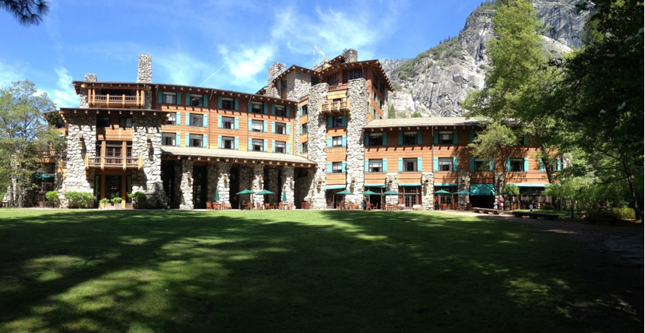
Section 106 – Historic Preservation
Consult the National Register of Historic Places database, existing state and local inventories, local historical and preservation offices and/ or organizations, and local planning departments for properties identified as listed in or eligible for the National Register.
The Majestic Yosemite Hotel (fka Ahwahnee Hotel) Est. 1927 – California

Slide 9
Section 106 – Historic Preservation
In any event where ground disturbance activities (refers to any work or activity that compacts or disturbs the ground within the project area) are planned; the following agencies MUST be contacted:
State Historic Preservation Office (SHPO) play a critical role carrying out many responsibilities in historic preservation. Surveying, evaluating and nominating significant historic buildings, sites, structures, districts and objects to the National Register is one such key activity.
https://www.nps.gov/subjects/nationalregister/state-historic-preservation-offices.htm
Tribal Historic Preservation Officer (THPO) advises Federal agencies on the management of Tribal historic properties and strives to preserve their Tribes' cultural heritage and preservation programs. THPOs perform a variety of important functions in their communities.
The Tribal Directory Assessment Tool (TDAT) helps identify Tribes with interest in the area. All consultation with THPO’s are conducted by HUD
SHPO, THPO’s, and any other agencies/groups consulted are afforded 30-days to respond with comments after receiving a COMPLETE package. 36 CFR § 800.3(c)(4)
Depending on staffing, a response might take longer than 30-days to receive.

Slide 10
Section 106 – Historic Preservation
Area of Potential Effects (APE) – the geographic area or areas within which an undertaking may directly or indirectly cause alterations in the character or use of historic properties, if any such properties exist. 36 CFR 800.16(d)
The APE may be different for different kinds of effects.
Above-ground properties should consider the “view-shed” whereas the subject could visually impact historic places and, or neighborhoods, etc.
Archaeological properties should consider the project area where direct physical ground disturbance will occur (the project footprint).
There is a single APE for the project, but it is defined differently for above-ground resources and archaeological resources.
The APE should include:
All areas of potential direct or indirect effects;
All alternative locations;
All locations where ground disturbance may result;
All locations where the undertaking may be visible or audible;
All locations where the activity may result in changes in traffic patterns, land use, public access, and all areas where there may be indirect as well as direct impacts.

Slide 11
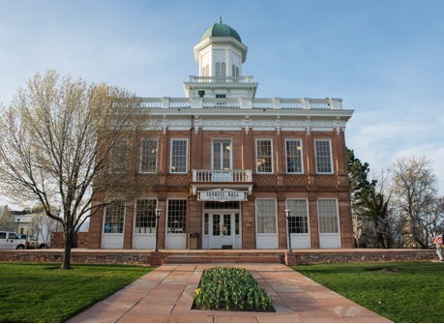
Section 106 – Historic Preservation
Documentation –Sufficient information including but not limited to; the proposed development activities, current and historic use information, any existing improvement details, photographs, maps, etc.
Each SHPO has their own requirements of delivery, and the exhibits included to provide a complete package.
The HUD West Regional staff has a great working relationship with the SHPO’s we serve. Consult with HUD at the Concept Stage to determine if your proposal will have an ‘adverse effect’ on historic properties and discuss the appropriate steps.
Council Hall Est. 1864 – Utah
The Rosson House Est. 1894 – Arizona

Slide 12
Section 106 – Historic Preservation
Additional studies are also requested if discoveries were made in the general area previously, or in some cases where there is little to no data available. These reports have many names but are typically referred to as;
Archaeological Report (Class I Assessment)
Cultural Resource Survey
Historical Inventory Study
These reports provide an in-depth investigation into whether or not historic properties are present. Typically, these surveys consists of four tasks:
Literature and Records Search
Fieldwork
Testing & Analysis
Reporting
Union Station Est. 1914 – Colorado

Slide 13
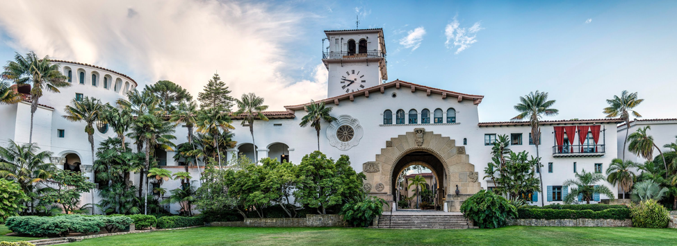
Section 106 – Historic Preservation
Results of the assessment:
If HUD makes a finding of “No Historic Properties Affected”, and consultation with SHPO/THPO resulted in no objections, the proposed activities are in compliance with the National Historic Preservation Act and Section 106 process is complete.
If an ‘Adverse effect’ is found, the process moves to the next step – resolving adverse effects and further consultation will be required.
Santa Barbara Courthouse Est. 1929 – California

Slide 14
Section 106 – Historic Preservation
Additional steps are necessary to ensure ALL potentially interested parties are provided an opportunity to comment on the undertaking. SHPO is a great source in identifying other potentially interested parties, which can include:
Native American Tribes and Native Hawaiian Organizations who attach religious and cultural significance to historic properties that may be affected
Representatives of local governments with jurisdictions
Applicants for Federal assistance
Individuals and organizations with a demonstrated interest in the undertaking - Historic Societies; Local Historical Official; Community Organizations; Preservation Groups; Individual Property Owners / Stakeholders, etc.
Advisory Council on Historic Preservation (ACHP) - responsible for issuing the Section 106 regulations and overseeing compliance with Section 106. The ACHP generally does not participate in Section 106 consultation for individual projects, but has the right to do so, and can submit comments at any time.
A 30-day review period is required by SHPO/THPO and the ACHP. Work must be done with consulting parties to try to avoid, minimize or mitigate adverse effects. Resolution of adverse effects generally results in a Memorandum of Agreement that spells out how the adverse effects will be minimized and/or mitigated. If adverse effects cannot be satisfactorily mitigated, HUD may disapprove a project.

Slide 15
Section 106 – Historic Preservation
A draft Memorandum of Agreement (MOA) could include a number of mitigation types, some include:
Historic Property Report/Inventory Study – Documents the historic details of properties slated for demolition, or documents the historic properties present in an area. This report is then archived for public viewing.
Monument/Memorial – An area dedicated to the historic property/properties affected at the proposed redevelopment.
Aesthetic/Façade Design – Construct visually details where the development conforms to historic properties in the area.
Artifact Curation and Collections Plan – Details the site disturbance, collection methods, and final destination (Tribes, Universities, Museums, etc.) of historic artifacts.
These reports are contracted with the developer/sponsor and typically require a state certified archaeologist where your proposal resides.
Once completed, ALL consulting parties must be satisfied with the mitigation which will be included as a Special Condition to the Firm and reviewed for compliance at final closing.

Slide 16
Section 106 – Historic Preservation
Best Practices:
Begin Early - Concept Meeting
HUD can help the Lender get the Request for Project Review package to the SHPO before Pre-App by: 1) reviewing the package; 2) concurring with or amending HUD’s determination (i.e., No Properties Affected); 3) identifying deficiencies with the package; and 4) providing a letter to the SHPO, on HUD letterhead, requesting the SHPO to allow HUD to authorize the Lender’s EP to complete the Section 106 process with the SHPO (which all SHPOs in the West Region will do).
Sufficient Documentation:
Conceptual drawings and photo simulations, if warranted, to depict the proposed project’s appearance in the vicinity of the historic property.
Proper APE selection to properly assess affects of Historic Properties.
Minimize the effects.
Consider historical/archaeological consultant certified in the state if an adverse effect is anticipated.

Slide 17
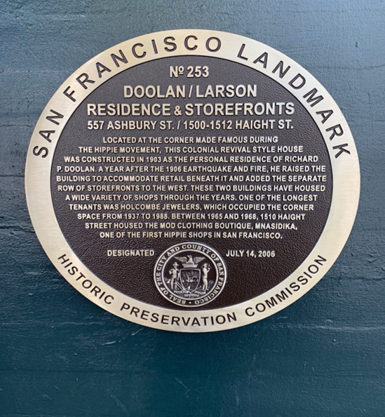
SHPO/Historic Preservation San Francisco “Flavor”

Slide 18
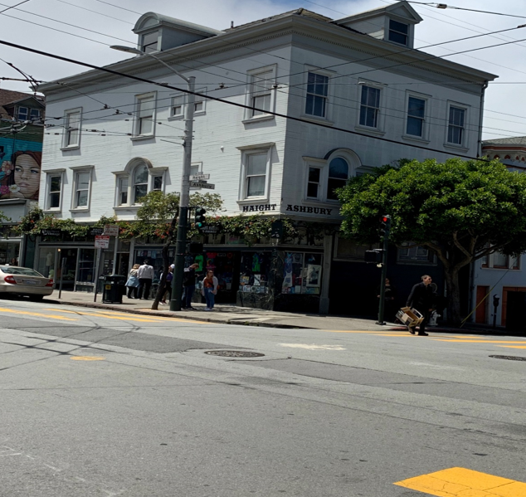
Iconic Historic Haight Ashbury Building, San Francisco

Slide 19
SHPO & Tribal Clearance
Washington State SHPO requests a HUD cover letter with ALL consultation requests. Consult with a Branch Chief prior to submission
Don’t touch the site after Concept Meeting... AND…don’t alter the site before Concept to avoid Section 106 compliance problems...
Don’t demolish/alter old buildings without clearance.
Historic and Contamination issues.
Cultural Resource Study may be required by SHPO or American Indian Tribes.
May require Historical Documentation by qualified consultant or construction monitoring.

Slide 20
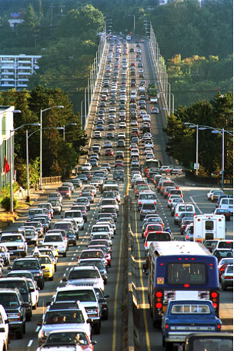
Noise Abatement and Control 24 CFR Part 51, Subpart B
A Noise Analysis MUST be conducted for ALL new construction applications to assess if your proposal requires noise attenuation features to achieve environmental compliance. Subpart B (Noise Abatement and Control) of 24 CFR Part 51.
It is HUD's general policy to provide minimum national standards applicable to HUD programs to protect citizens against excessive noise in their communities and places of residence.

Slide 21
Noise Abatement and Control 24 CFR Part 51, Subpart B
The Noise Guidebook – The guidebook provides information on HUD's noise policy. Assessment guidelines, attenuation, regulations, and major policy questions can be found in the guidebook.
https://www.hudexchange.info/resource/313/hud-noise-guidebook/
DNL Calculator – The web-based calculator is typically used to aid in site planning, and document compliance.
https://www.hudexchange.info/environmental-review/dnl-calculator/
Sound Transmission Classification Assessment Tool (STraCAT) – Automates and streamlines the completion of Figure 19 in the Noise Guidebook. STraCAT is intended to assist in reporting the noise mitigation performance of wall and window systems.
https://www.hudexchange.info/stracat/
https://www.hud.gov/sites/documents/ENV_USERGUIDE_STRACAT.PDF
Barrier Performance Module – Automated noise barrier evaluation worksheet which reports the amount of noise reduced by a particular design. Can be used with the DNL Calculator.
https://www.hudexchange.info/environmental-review/bpm-calculator/

Slide 22
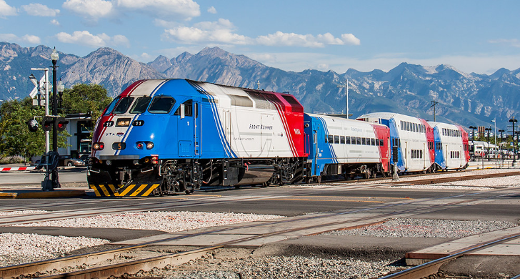
Noise Abatement and Control 24 CFR Part 51, Subpart B
Is your site located within 1,000 feet from a major road; 3,000 feet from railroad tracks (including light-rail); 15 miles from an airport?
The distance from the nearest building to the noise source should be considered a Noise Assessment Location (NAL), where sound levels are measured.
Additional NAL’s should include community gathering spaces such as a pool, and/or outdoor recreation area, etc.

Slide 23
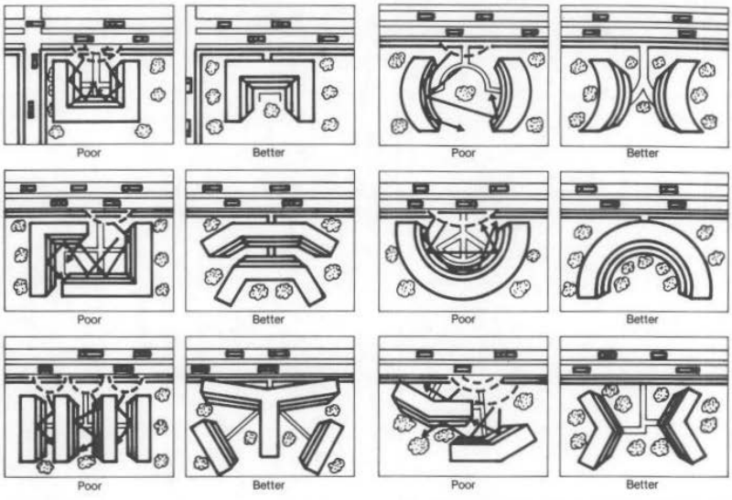
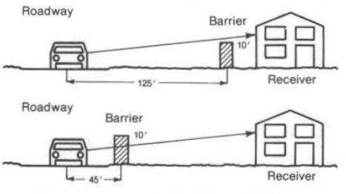
Noise Abatement and Control 24 CFR Part 51, Subpart B
Site planning should consider the noise impacts and minimize noise levels for safety, and long-term marketability. Placement of buildings, accessory buildings, and or barriers can help minimize noise levels. Additional planning information can be found in the HUD Noise Guidebook.

Slide 24
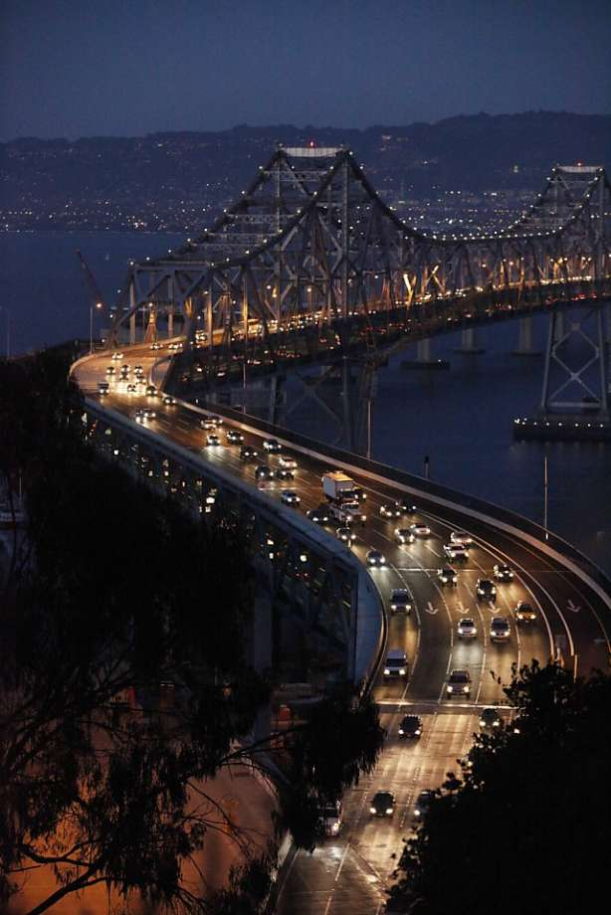
Noise Abatement and Control 24 CFR Part 51, Subpart B
Roadway Noise Hazards – State or local traffic data should be used when estimating the 10-year Day-Night-Level (DNL).
Measurements are required for cars, light trucks, and heavy trucks. Additional items required for calculation include:
Effective Distance
Distance to Stop Sign
Average Speed
Average Daily Trips (ADT)
Night Fraction of ADT
Road Gradient (%)

Slide 25
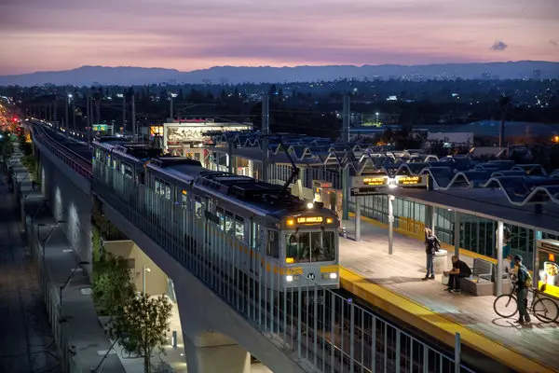
Noise Abatement and Control 24 CFR Part 51, Subpart B
Railway Noise Hazards – The Federal Railroad Administration (FRA), public transportation authorities, or on-site field data should be used when estimating the 10-year Day-Night-Level (DNL).
Measurements are required for electric and diesel engines. Additional items required for calculation include:
Effective Distance
Average Train Speed
Engines per Train
Railway Cars per Train
Average Train Operations (ATO)
Night Fraction of ATO
Railway Whistles or Horns
Bolted Tracks

Slide 26
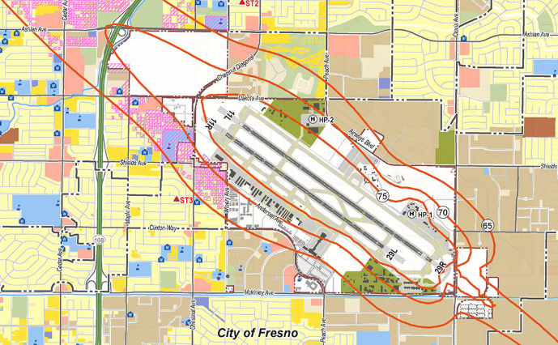
Noise Abatement and Control 24 CFR Part 51, Subpart B
Airport Noise Hazards – Noise contour maps should be available for public viewing. The Federal Aviation Administration (FAA) and the Airport Authority are great sources to determine if your site is affected by air noise.
Highlight where the site lies on the contour map and include the corresponding DNL in the overall noise calculation.

Slide 27
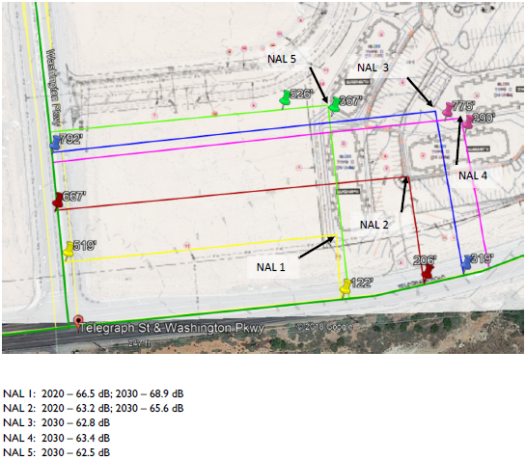
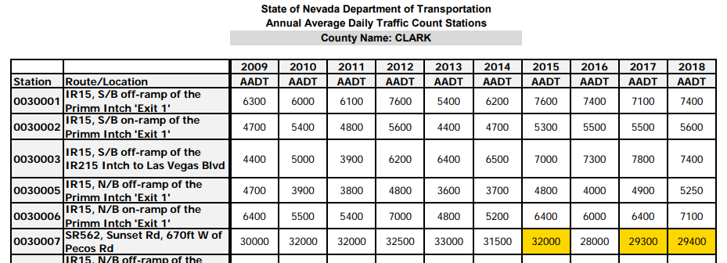
Noise Abatement and Control 24 CFR Part 51, Subpart B
NALs should be mapped with measurements to visually assess the affected location and its distance to the noise source.
All data used to estimate the 10-year noise levels must be included in the report for HUD verification and upload into the HUD Exchange for archiving.

Slide 28
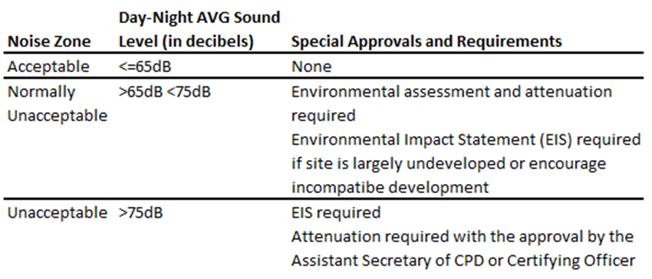
Noise Abatement and Control 24 CFR Part 51, Subpart B
Exterior noise goals - For the purposes of this regulation and to meet other program objectives, sites with a day-night average sound level of 65 decibels and below are considered acceptable and allowable.
Interior noise goals - It is a HUD goal that the interior auditory environment shall not exceed a day-night average sound level of 45 decibels.
Attenuation measures to meet these interior goals shall be employed where feasible.
Noise Applicability Standards
If site planning and design did not achieve acceptable results, mitigation using enhanced construction materials will be required to achieve acceptable interior noise levels.

Slide 29
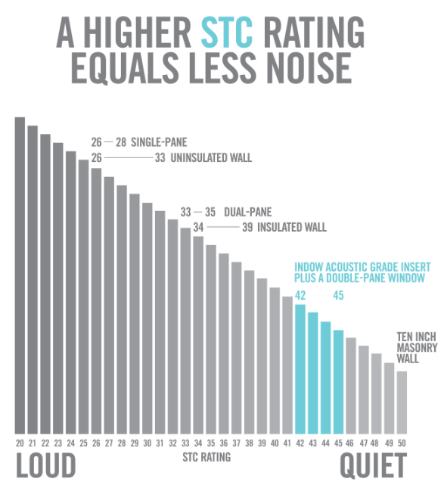
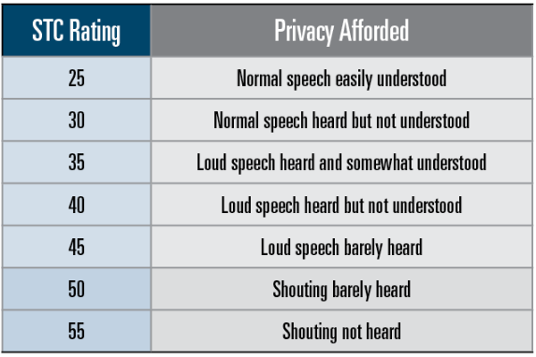
Noise Abatement and Control 24 CFR Part 51, Subpart B
Window, Wall, and Door components have a Sound Transmission Class (STC) rating that can reduce noise intrusion. Each of these components are entered into Figure 19/STraCAT; where the results will indicate whether the proposed materials meet the noise attenuation requirements.
Sound Transmission Class (STC) - is an integer rating of how well a building partition attenuates airborne sound.

Slide 30
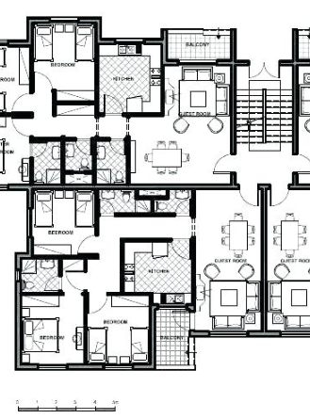
Noise Abatement and Control 24 CFR Part 51, Subpart B
When mitigation measures are required for noise compliance, HUD staff must review the building plans and specifications to ensure the materials recommended in the Figure 19/STraCAT worksheets are designed, planned, and budgeted.
Sample firm invitation conditions:
Half-size project plans and specifications and related product cut-sheets with the windows' and doors' Sound Transmission Class for the unacceptable areas.
The StraCAT attached was acceptable and required 26.9 STC of attenuation.
Certification from the Architect of Record that exterior wall assemblies will provide a composite Sound Transmission Class of thirty-six (36) STC of attenuation. Note that Architect Letter is attached.
An Operations and Maintenance plan that provides regular inspection and replacement of door and window seals for any dwelling unit with a private balcony.
Sealing of all holes, gaps and spaces in exterior walls, including penetrations for pipes, hose bids, ducts, electrical conduit, etc., with a permanently pliable caulk or a permanently resilient gasket material.
Inclusion of back-draft dampers or acoustical baffling on all exhaust vents.
Mechanical ventilation that allows for operation in closed-window and -door conditions in all seasons.

Slide 31
Noise Abatement and Control 24 CFR Part 51, Subpart B
Loud Impulsive Sounds – Nearby activity that creates additional noise outside of Air, Road, and Rail. Examples: explosions, sonic booms, artillery firing, industrial operations, etc. +8 decibels to the combined DNL – 24 CFR 51.103(b)
Balcony Spaces Notice CPD-16-19: Balcony Policy:
For new construction projects in Unacceptable and Normally Unacceptable noise areas (in accordance with 24 CFR 51.101(a)(3)) and major or substantial rehabilitation that results in a change of land use, bedrooms and studio apartments may have direct access to balconies if:
1. The interior noise levels have been mitigated to not exceed a day-night average noise level of 45 decibels as documented by the Sound Transmission Classification of the dwelling unit’s exterior walls factoring in fenestration.
2. Appropriate ventilation is provided by a mechanical ventilation system and not by opening doors or windows, and
3. An Operations and Maintenance plan is in place that requires periodically inspecting seals and repairing or replacing building components when their performance diminishes.

Slide 32
Noise Abatement and Control 24 CFR Part 51, Subpart B
51.105 Exceptions –
Acceptable threshold may be shifted to 70 dB in special circumstances.
(a) Where it is determined that program objectives cannot be achieved on sites meeting the acceptability standard of 65 decibels, the Acceptable Zone may be shifted to Ldn 70 on a case-by-case basis if all the following conditions are satisfied:
The project does not require an Environmental Impact Statement and noise is the only environmental issue.
The project has received a Special Environmental Clearance and has received the concurrence of the ECO.
The project meets other program goals to provide housing in proximity to employment, public facilities and transportation.
The project is in conformance with local goals and maintains the character of the neighborhood.
The project sponsor has set forth reasons, acceptable to HUD, as to why the noise attenuation measures that would normally be required for new construction in the Ldn 65 to Ldn 70 zone cannot be met.
Other sites which are not exposed to noise above Ldn 65 and which meet program objectives are generally not available

Slide 33
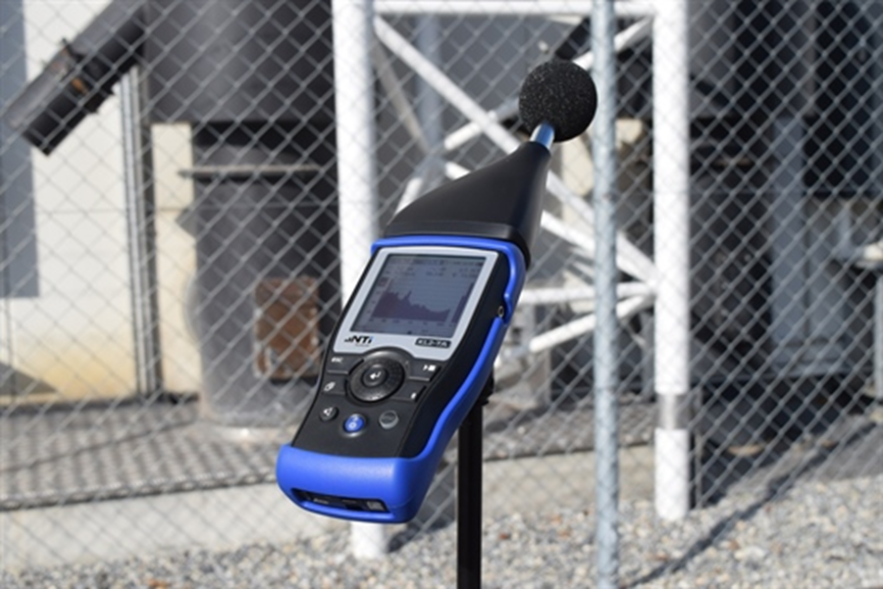
Noise Abatement and Control 24 CFR Part 51, Subpart B
Consult with HUD prior to using other methods to estimate noise levels. A waiver MUST be granted prior to acceptance. An assessment using the HUD Noise Guidebook should also be conducted to compare the results.
Other Methods – The noise calculator provides an accurate estimate of projected 10-year noise levels in HUD insured programs. In rare circumstances, where traffic data is not available, unreliable or certain site characteristics are present that make the calculation less reliable.
Where measurements should be taken - Noise assessment locations (NAL) should be identical to locations used for calculations from the HUD Noise Guidebook.
When measurements should be taken – Avoid testing when unusual conditions are present (i.e. road construction, traffic diversion). Do not test during Holidays, during extreme weather conditions, or other unusual times. Testing should be conducted over several days.
The Use of Noise Measurements HUD Noise Guidebook Chapter 7

Slide 34
Noise Abatement and Control 24 CFR Part 51, Subpart B
Noise Best Practices –
Site planning and building configuration should consider the effects of noise.
Discuss possible noise issues at Concept Stage.
Evaluate noise from any roadway within 1,000 feet of the project site for which traffic data is available and where it may be suspect of being a noise generator.
Noise Reports should include maps with visual measurements, and all data used in the report.
HUD ONLY accepts noise calculations using the HUD DNL Calculator, a web-based application which includes air, rail and traffic noise.
Consult with HUD prior to using other methods to estimate noise levels.
74.9 DNL will get close scrutiny by HUD… HUD will want to verify data, assumptions, and calculations.
https://www.hudexchange.info/programs/environmental-review/noise-abatement-and-control/

Slide 35
Some like it loud…

Slide 36
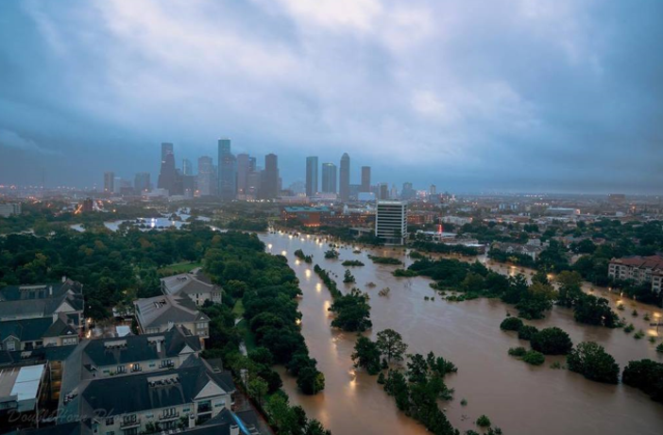
Floodplain Management - 24 CFR Part 55
Floodplain Management requires Federal activities to avoid impacts to floodplains and to avoid direct and indirect support of floodplain development to the extent practicable. The Federal Emergency Management Agency (FEMA) designates floodplains as geographic zones subject to varying levels of flood risk. Each zone reflects the severity or type of potential flooding in the area.
Houston TX. August 2017

Slide 37
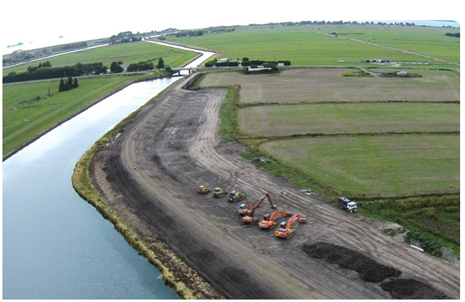
Floodway

Slide 38
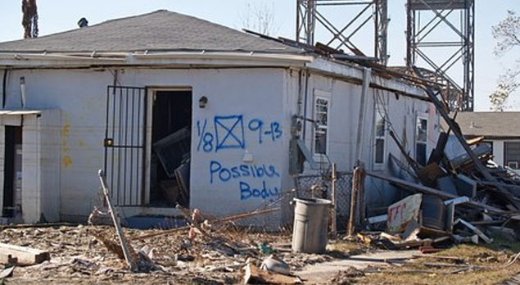
Flood Aftermath

Slide 39
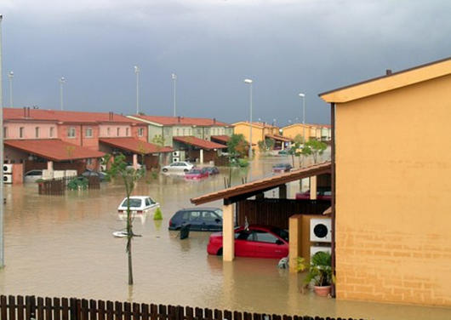
Floodplain (ingress/egress?)

Slide 40
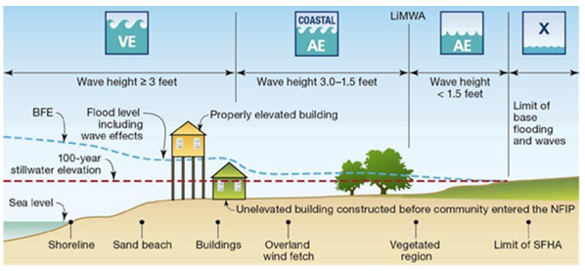
Floodplain Management - 24 CFR Part 55
The land area covered by the floodwaters of the base flood is the Special Flood Hazard Area (SFHA) on National Flood Insurance Program (NFIP) maps. The SFHA is the area where the NFIP's floodplain management regulations must be enforced and the area where the mandatory purchase of flood insurance applies.
The SFHA includes Zones A, AO, AH, A1-30, AE, A99, AR, AR/A1-30, AR/AE, AR/AO, AR/AH, AR/A, VO, V1-30, VE, and V.

Slide 41
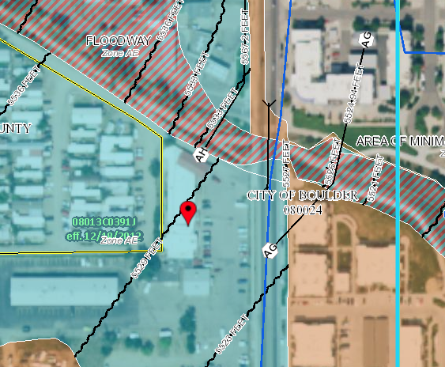
Floodplain Management - 24 CFR Part 55
100-year floodplain aka 1% annual chance floodplain (§ 55.2(b)(9))
Areas with a 1% chance of flooding each year if maps are functioning perfectly
26% chance over a thirty-year mortgage
FEMA designated as Zone A*

Slide 42
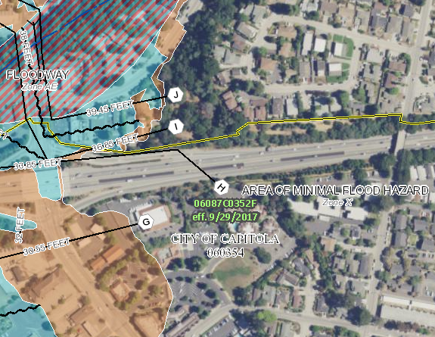
Floodplain Management - 24 CFR Part 55
500-year floodplain aka .2% annual chance floodplain (§ 55.2(b)(4))
Areas with 0.2% annual chance of flooding (6% chance over a thirty-year mortgage)
FEMA designated as Zone B or Zone X (shaded)

Slide 43
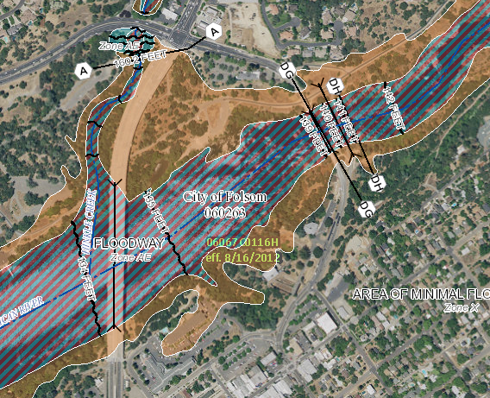
Floodplain Management - 24 CFR Part 55
Floodway (§ 55.2(b)(5))
The portion of the floodplain which is effective in carrying flow, where the flood hazard is generally the greatest, and where water depths and velocities are the highest.
FEMA designated as Zone AE (hatched).
STOP - No HUD assistance may be approved for use in a floodway, except:
Functionally dependent uses
Floodplain function restoration activities
Activity excepted under 55.12(c)
Functionally Dependent Use - A use which cannot perform its intended purpose unless it is located or carried out in close proximity to water. Typically in multifamily programs an example of FDU are bridges for ingress/egress purposes.

Slide 44
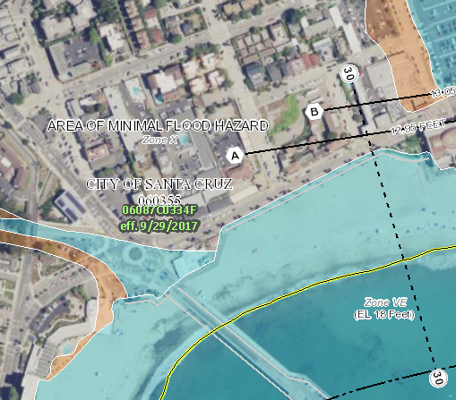
Floodplain Management - 24 CFR Part 55
Coastal High Hazard Area (§ 55.2(b)(1))
The area subject to high velocity waters, including hurricane wave wash and tsunamis.
FEMA designated as Zone V.
STOP - New Construction is not allowed.
Chapter 9 of the MAP Guide also prohibits projects involving rehab as well (9.5.E.2).
Any activities must be designed for location in a Coastal High Hazard Area under §55.1(c)(3).

Slide 45
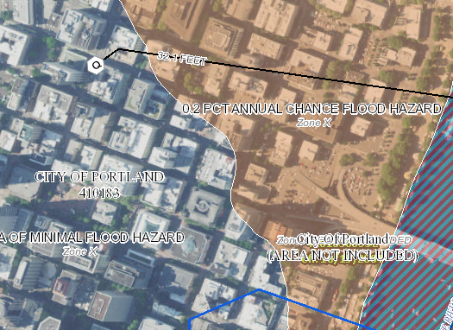
Floodplain Management - 24 CFR Part 55
The areas of minimal flood hazard, which are the areas outside the SFHA and higher than the elevation of the 0.2 percent annual chance flood, are labeled:
Zone C
Zone X (unshaded)
If located in either of these zones, provide a FEMA firm in the report and state the project is in compliance with Floodplain Management regulations.

Slide 46
Floodplain Management - 24 CFR Part 55
Preliminary flood maps MUST be reviewed along with any current FEMA maps to ensure that the most up to date flood information is made available.
§55.12(c)(7): Part 55 does not apply to a site in which an incidental portion is situated in an adjacent floodplain, but only if:
Proposed activities do not occupy or modify the floodplain;
Provisions are made for site drainage that would not have an adverse effect on the floodplain; and
A permanent covenant or comparable restriction is placed on the property’s continued use to preserve the floodplain.
For Multifamily Projects: HUD does not consider improvements to be incidental
In other words, if any improvements (buildings, roads, parking lots, sidewalks, etc.) are located in the floodplain, the property does NOT qualify for the Incidental Floodplain Exception in §55.12(c)(7) and thus is subject to the requirements of Part 55.

Slide 47
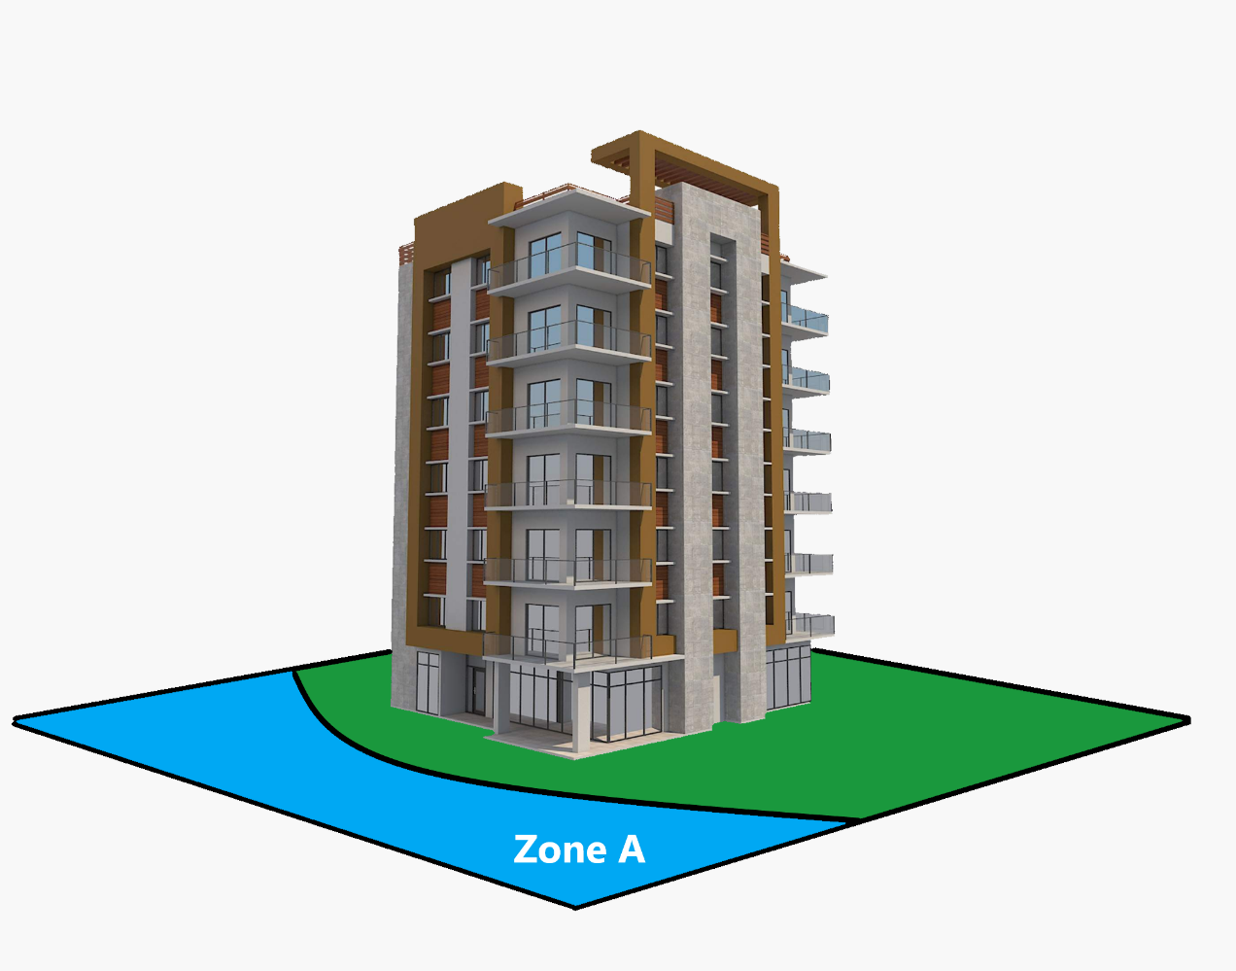
Floodplain Management - 24 CFR Part 55
A portion of the site contains 100-year floodplain
Floodplain is incidental
The project may proceed by either:
Meeting all of the conditions in §55.12(c)(7), or
Completing the 8-Step Process

Slide 48
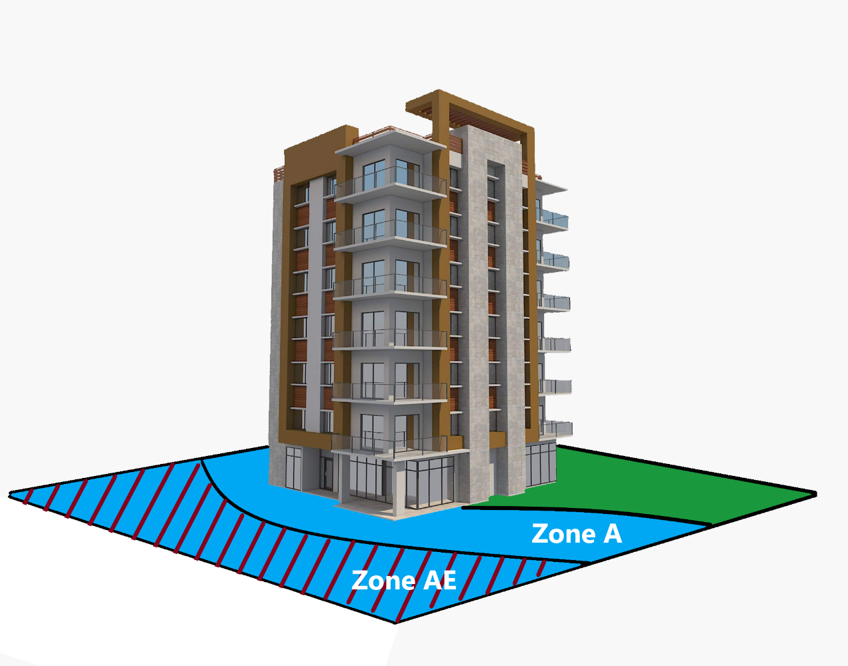
Floodplain Management - 24 CFR Part 55
A portion of the site contains a 100-year Floodplain and a Floodway
Floodplain is NOT incidental
The proposal is considered unsafe and not a suitable development for the agency. The project must be REJECTED.

Slide 49
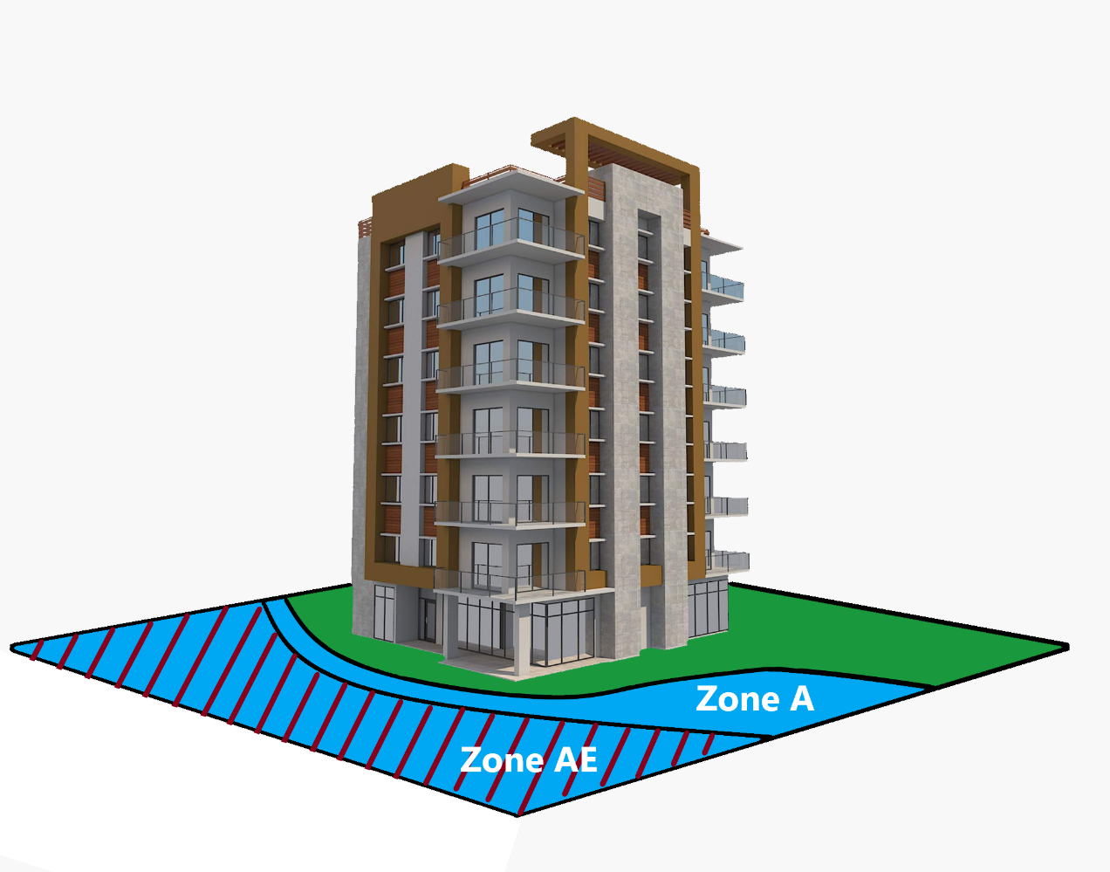
Floodplain Management - 24 CFR Part 55
A portion of the site contains a 100-year Floodplain and Floodway
Floodplain is incidental
The project may proceed by meeting all the conditions in §55.12(c)(7).
When floodways are involved, the floodplain (including the floodway) cannot be raised with fill and cannot be otherwise occupied or modified. CLOMR’s or LOMR’s that involve these activities are also prohibited.

Slide 50
Floodplain Management - 24 CFR Part 55
A portion of the site contains a 100-year Floodplain
Floodplain is NOT incidental
When improvements such as parking lots, sidewalks, etc. are planned to occupy the floodplain, Part 55 (8-Step Floodplain Management Process is required.
Careful planning and consideration should be taken to limit any development in the Floodplain.

Slide 51
Floodplain Management - 24 CFR Part 55
Project must comply with Part 55 IF ANY part of the site or integral offsite development (e.g. ingress, egress, parking) is located within the floodplain
Unless an exception applies, HUD will not approve projects in:
Floodways,
Coastal high hazard areas, or
Floodplains if community does not participate in NFIP (see Chapter 9.5.E.2)
HUD will consider history or evidence of flooding even if site is not in a FEMA-designated floodplain
MAP Guidance States: Such sites in the applicable floodplain according to the best available data will not be considered for mortgage insurance unless one of the following steps is taken:
A Conditional Letter of Map Amendment (CLOMA) or of Map Revision (CLOMR) removing the entire site from the applicable floodplain has been obtained from FEMA, or
HUD must conduct an 8-step decision making process to determine if there may be extraordinary circumstances which lead to the conclusion that there are no practicable alternatives to the project site being in the floodplain.
HUD is solely responsible in ensuring the 8-Step process is carried out, making the final determination.

Slide 52
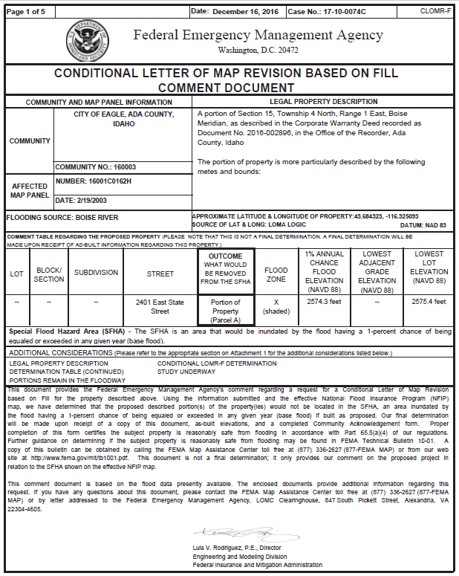
Floodplain Management - 24 CFR Part 55
A Conditional Letter of Map Amendment (CLOMA) or of Map Revision (CLOMR) removing the entire site from the applicable floodplain has been obtained from FEMA prior to submission of the pre-application or, prior to Firm Commitment. If the borrower has a CLOMA or CLOMR, HUD approval for a Firm Commitment will be conditioned on the borrower:
Meeting the requirements of the CLOMA or CLOMR;
Obtaining a Final Letter of Map Amendment (FLOMA) or MAP Revision (FLOMR) removing the entire site from the applicable floodplain prior to Final Endorsement; and,
Maintaining flood insurance on any building during the construction period until the FLOMA or FLOMR is issued.
Obtaining a CLOMR or CLOMA provides a greater reduction in risk to the property by minimizing the potential adverse impacts to lives and the property structures.

Slide 53
Floodplain Management - 24 CFR Part 55
The 8-Step Process – Part 55
Step 1. Determine whether the proposed action is located in 100-year floodplain (or 500-yr for critical action).
Step 2. Publish “Early Public Notice” of the proposal to consider an action in the floodplain or wetland (15 day minimum comment period).
Step 3. Evaluate practicable alternatives to locating the proposed action in a floodplain or wetland.
Step 4. Identify the potential impacts associated with occupancy and modification of the floodplain or wetland.
Step 5. Design or modify the action to minimize adverse impacts and preserve the beneficial values of the floodplains.
Step 6. Reevaluate whether proposed action is practicable.
Step 7. Publish “Final Public Notice” of decision to identify why there is “no practicable alternative,” and the alternatives and mitigation measures adopted (7-day minimum comment period).
Step 8. Implement proposed action with mitigation measures.
*The 5-Step Process is used for refinance and sub-rehab applications where the action has already been identified, and public notices are not required.

Slide 54
Floodplain Management - 24 CFR Part 55
Floodplain Management Best Practices –
Direct or indirect funding of floodplain development should be avoided when practical alternatives exist.
Consult with HUD early, preferably at Concept stage to discuss any necessary steps for floodplain compliance.
FEMA Flood Insurance Rate Map must be included in the environmental report with the subject site delineated to confirm flood hazards.

