Slide 1
221(d)(4) New Construction/Substantial Rehabilitation Identity-of-Interest
You have an Identity-of-Interest if …
There is any financial interest of the Borrower in the General Contractor/Architect, or vice versa.
Any officer, director, stockholder, or partner of the Borrower is also an officer, director, stockholder, or partner of the General Contractor/Architect.
Any officer, director, stockholder, or partner of the Borrower has any financial interest in the General Contractor/Architect, or any officer, director, stockholder, or partner of the General Contractor/Architect has any financial interest in the Borrower.
The General Contractor/Architect advances any funds to the Borrower.
Notes:
How do you know if you have an I-O-I?
- Essentially, if the BWR and/or a key financial or operational participant of the BWR (such as a partner or manager) is also a key financial or operational participant in the GC or ARCH, you may have an I-O-I and will need to do some additional research.

Slide 2
221(d)(4) New Construction/Substantial Rehabilitation Identity-of-Interest
You have an Identity-of-Interest if …
The General Contractor/Architect supplies and pays, on behalf of the Borrower, the cost of any architectural services or engineering services other than those of a surveyor, general superintendent, or engineer employed by a General Contractor/Architect in connection with its obligations under each respective contract.
The General Contractor/Architect takes stock or any interest in the Borrower entity as payment for services.
Any relationship (e.g. family) existing which would give the Borrower or General Contractor/Architect control or influence over the price of the contract or the price paid to the subcontractor, material supplier or lessor of equipment.
There exists or comes into being any side deals, agreements, contracts, or undertakings entered into or contemplated, thereby altering, amending, or canceling any of the required closing documents, except as approved by the Secretary.

Slide 3
221(d)(4) New Construction/Substantial Rehabilitation Identity-of-Interest: General Contractor
Sponsor Profit and Risk Allowance (SPRA) or Builder and Sponsor’s Profit and Risk Allowance (BSPRA) are allowances included in the mortgage calculation in lieu of a Developer’s fee.
Recognized as both a source of funds and a use of funds.
Electing to use BSPRA effectively increases the cost-limited mortgage amount (Criterion 3), but requires an identity-of-interest be established with the General Contractor
Notes:
Looking first at the implication of a GC’s I-O-I:
No I-O-I → SPRA
I-O-I → BSPRA
- SPRA and BSPRA are allowances in lieu of Developer’s Profit that allows for a higher replacement cost on which the cost-constrained mortgage amount is calculated.
BWR and GC can choose to establish an I-O-I to use BSPRA using the criteria discussed earlier
Examples coming up later

Slide 4
221(d)(4) New Construction/Substantial Rehabilitation Non-Profit Developer’s Fee
Nonprofit Borrowers may earn a Developer fee on a new construction or substantial rehabilitation project
If a Developer fee is recognized, BSPRA may not be utilized.

Slide 5
221(d)(4) New Construction/Substantial Rehabilitation BSPRA vs. SPRA
SPRA does not require an identity of interest between the Borrower and the General Contractor
Calculated at 10% of architect's fees, carrying and financing charges, legal, organizational, and audit expenses.
Builder’s Profit is allowed.
BSPRA requires an established identity-of-interest between the Borrower and the General Contractor.
Calculated at 10% of the estimated cost of on-site improvements, structures, general requirements, general overhead, architect's fees, carrying charges and financing, legal, organizational and audit expenses.
Builder’s Profit is not allowed.
For substantial rehabilitation projects, SPRA/BSPRA is 10% of these costs excluding the as-is value of the existing structure.

Slide 6
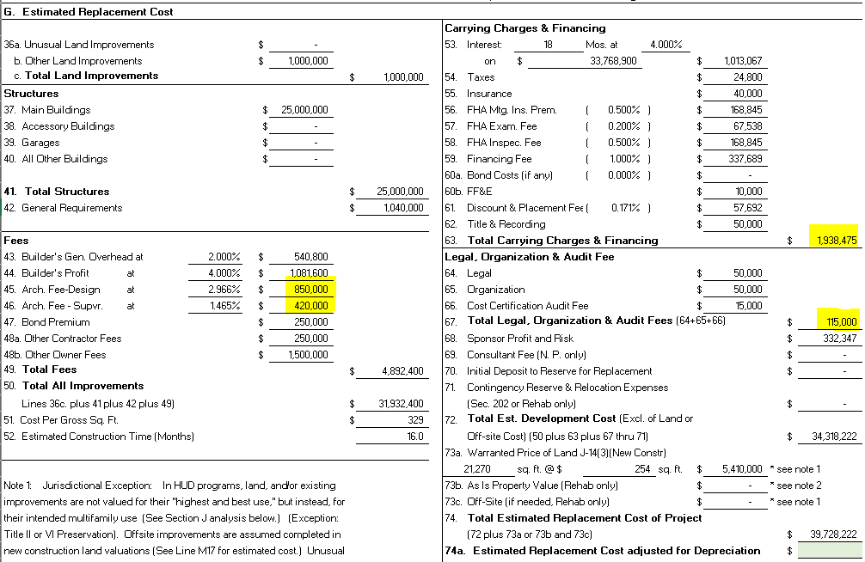
221(d)(4) New Construction/Substantial Rehabilitation BSPRA vs. SPRA
SPRA
$1,270,000 | Architect’s Fees
$1,938,475 | Carrying Charges and Financing
$115,000 | Legal, Organizational, and Audit Expenses
$3,323,475 | TOTAL
$332,347 | SPRA 10%
$33,768,900 | Loan Amount

Slide 7
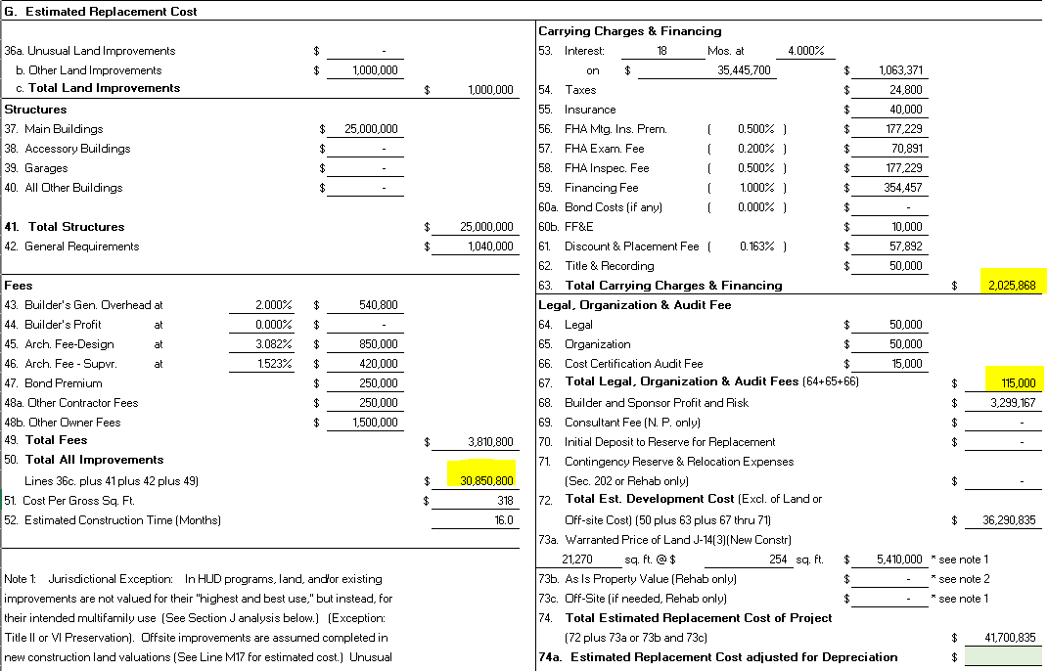
221(d)(4) New Construction/Substantial Rehabilitation BSPRA vs. SPRA
BSPRA
$30,850,800 | Improvements, Structures, General Requirements, General Overhead, Architect’s Fees
$2,025,868 | Carrying Charges and Financing
$115,000 | Legal, Organizational, and Audit Expenses
$32,991,668 | TOTAL
$3,299,167 | BSPRA 10%
$35,445,700 | Loan Amount

Slide 8
221(d)(4) New Construction/Substantial Rehabilitation 50/75 Rule
No General Contractor’s fee (general overhead and profit) will be allowed when:
More than 50% of the total Construction Contract sum is subcontracted to a single subcontractor, material supplier, or equipment lessor, or
75% or more of total Construction Contract sum is subcontracted to three or fewer subcontractors, material suppliers and equipment lessors.
This rule applied regardless of whether or not there is an identity-of-interest between the Borrower and the General Contractor.

Slide 9
221(d)(4) New Construction/Substantial Rehabilitation Identity-of-Interest Design Architect
The Project Architect may have an identity-of-interest with the Borrower or General Contractor
If this is the case, the Project Architect cannot administer the construction contract.
In all cases, an independent architect with no identity-of-interest will provide general administration of the construction contract.

