Slide 1
The Nuts & Bolts of Servicing a 221(d)(4) Construction Loan
Lena Nazarian, Love Funding
David Jasso, Leetex Group
Reference: HUD MAP GUIDE, CHAPTER 12 & APPENDIX 12 – CONSTRUCTION PERIOD

Slide 2
Overview
Initial Closing/Pre-construction Conference
Construction Starts
Draws & Inspections
PTO’s (Permission to Occupy)
100% TRIP Report (Final Completion)
Submission of Cost Certification(s)
Issuance of MIM (Maximum Insurable Mortgage)
Submission of Final Closing Package
Final Endorsement Closing

Slide 3
Key Players
Borrower/Owner (Mortgagor)
General Contractor
Supervisory Architect
HUD Inspector
Lender (Mortgagee)
HUD

Slide 4
Pre-Construction Conference
The pre-construction conference (“pre-con”) is typically held on the same day as initial closing; if not possible, will occur shortly before or after initial closing.
Lender has ensured that four (4) “master” sets of drawings and specifications have been signed by all authorized agents; one is contractor’s “job set” and stored on site to be used to build the project.
The pre-con is conducted by the HUD Inspector, HUD Construction Analyst or other HUD designee.
Required Attendees: Owner, Contractor, Supervisory Architect, Lender, HUD Representative(s), Bonding Agent, if applicable.
Purpose: To explain general contract administration, role of attendees during the construction period, and procedures for all construction related matters (including Davis-Bacon labor standards compliance & reporting*) through final completion.
*During the pre-con, HUD will indicate who on the Office of Davis-Bacon and Labor Standards staff will review the project for labor standards compliance. Most HUD regions require a follow-up meeting on site (or a conference call) with the Contractor and subcontractors to inform all parties of wage reporting requirements in the Elation system, and about worker interviews that will be conducted during site inspections. Davis-Bacon & Labor Standards clearance is a condition of final endorsement closing.

Slide 5
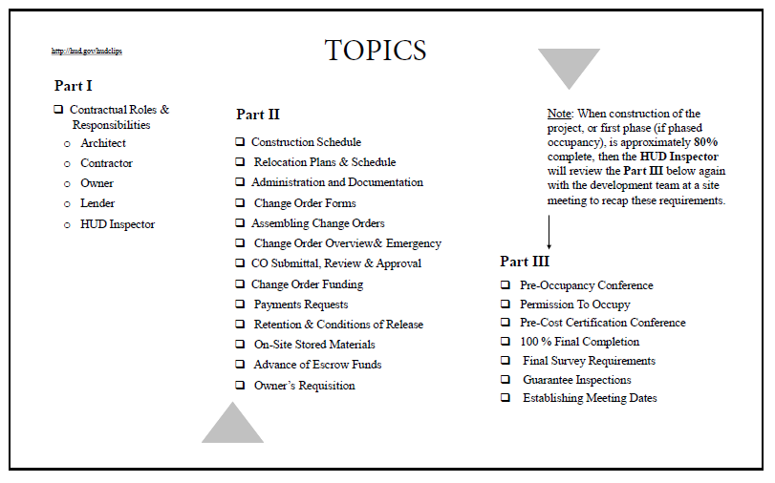
Pre-Construction Conference: Sample Topics Covered

Slide 6
Construction Draw Processing & Monitoring
Contractor, Architect, Owner and HUD Inspector schedule a monthly draw meeting at the site to review construction payment application.
Contractor prepares Contractor’s Requisition, form HUD-92448, monthly for work in place, along with updated construction progress schedule and reviews with Architect and HUD Inspector.
Contractor, Architect and HUD Inspector approve and execute HUD-92448
Contractor provides copy of executed HUD-92448 to Owner for preparation of Owner’s Application for Advance of Mortgage Proceeds, form HUD-92403.
Owner submits executed HUD-92403, executed HUD-92448 and all supporting documentation to Lender for review and processing.
Lender reviews/approves monthly draw submission, orders title date down, ensures no liens then funds draw and provides copy of approved draw package to HUD.
After each site visit, HUD Inspector issues TRIP (inspection) report to HUD.
HUD reviews acceptability of TRIP report and provides copy to Lender.
Lender may approve all interim draws after initial endorsement; any contractor’s requisition that includes retainage reduction requires HUD approval.
HUD approves final draw as part of final endorsement closing.

Slide 7
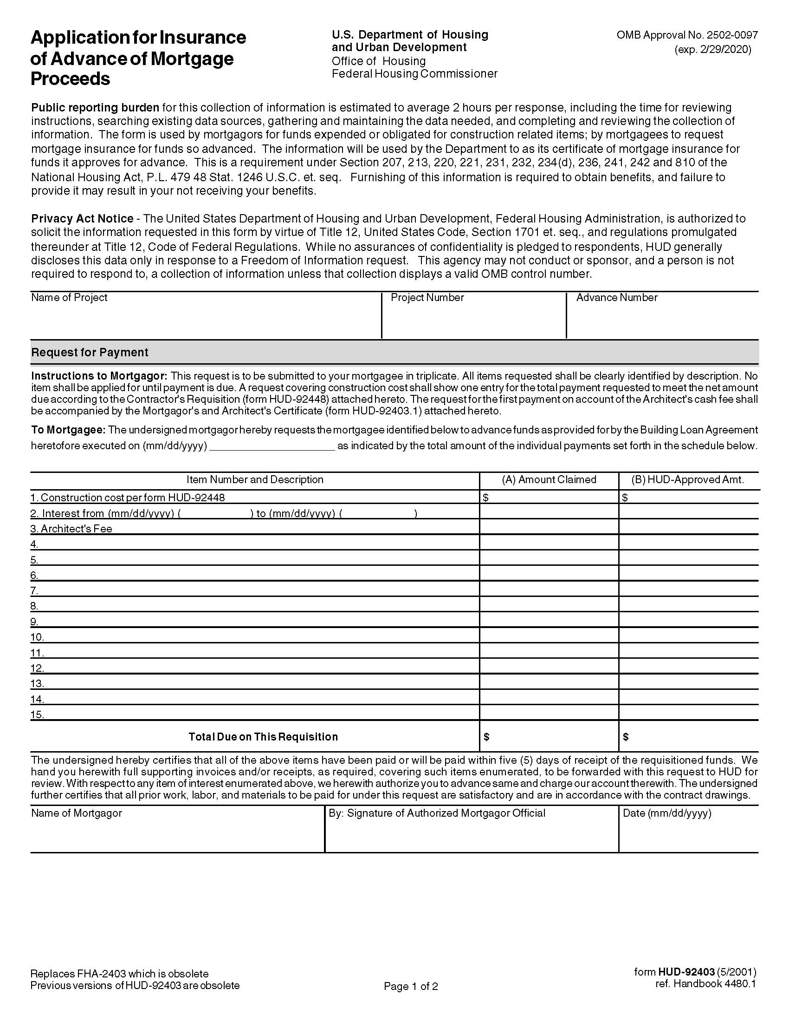
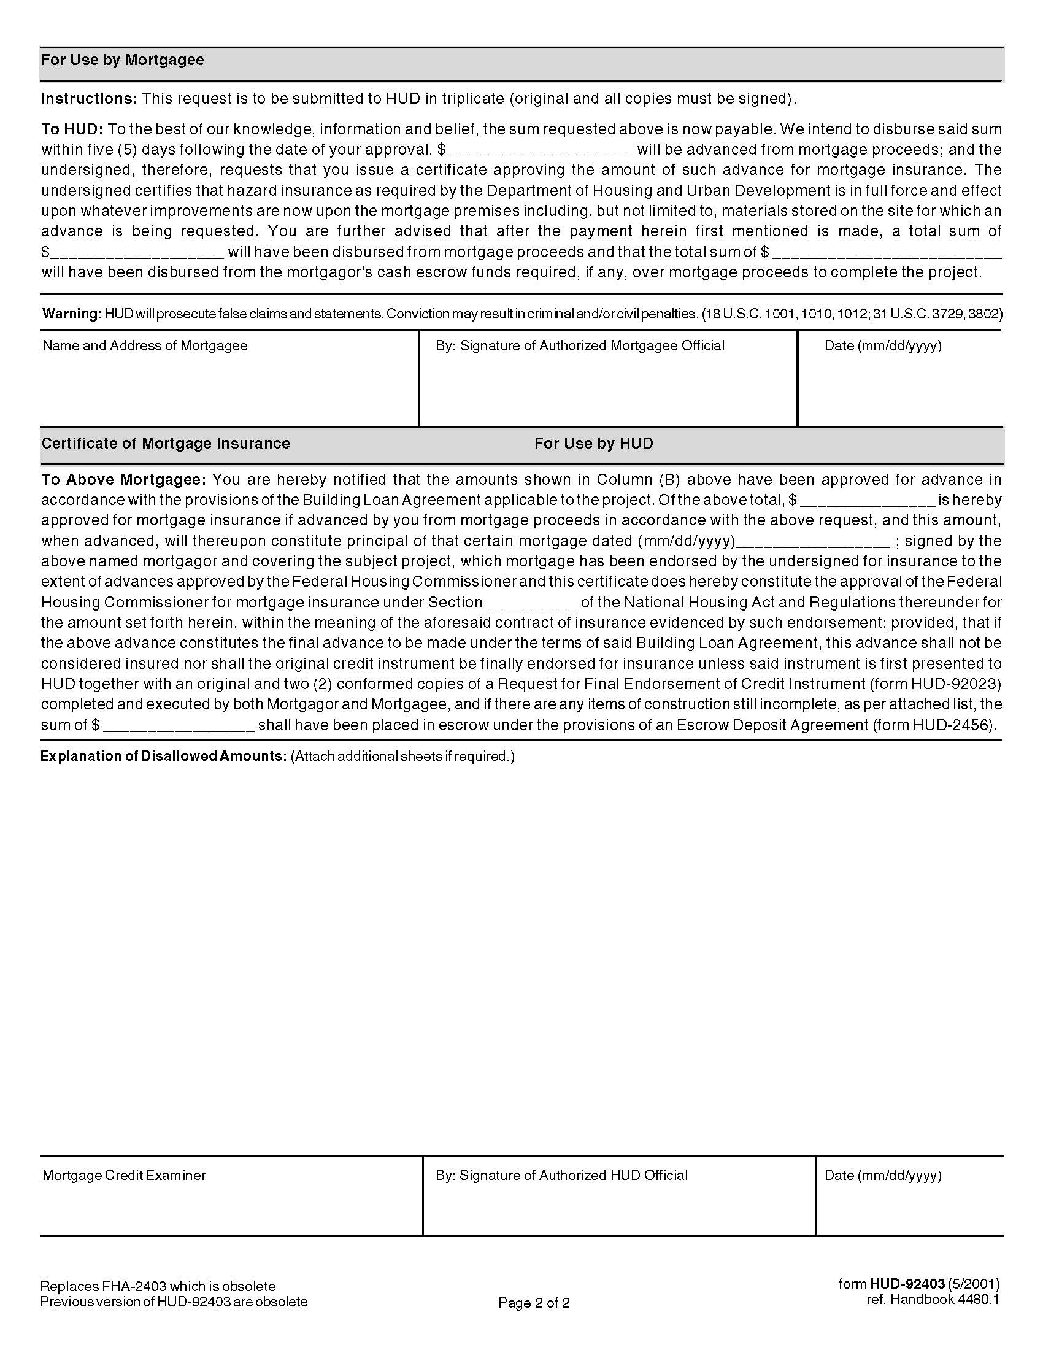
Form HUD-92403 Application for Insurance of Advance of Mortgage Proceeds
Notes:
When allowed per the construction contract, explain process and requirements for HUD approval.

Slide 8
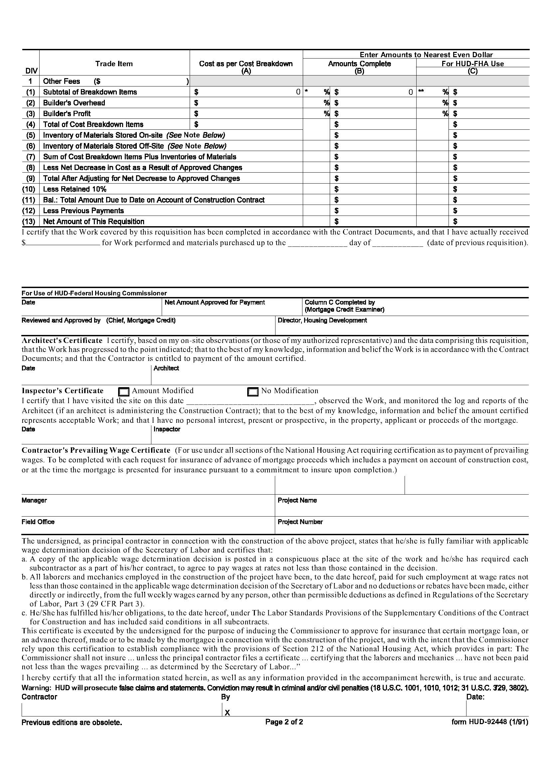
Form HUD-92448 Contractor’s Requisition Project Mortgages
Notes:
When allowed per the construction contract, explain process and requirements for HUD approval.

Slide 9
Change Orders & Classifications
All changes to construction drawings & specifications and requests for time extensions must be submitted on form HUD-92437, Request for Construction Changes on Project Mortgages, and include supporting documentation, along with a letter from the Architect classifying the change as one of the following:
Necessary Latent (hidden) conditions; changes in building codes, ordinances, etc. after initial closing; architect’s/engineer’s omissions; damage to completed construction.
Betterment Economically justified by increasing net income, reducing long-term maintenance and/or operating expenses or otherwise enhances the mortgage security.
Equivalent Substitution, if specified item is no longer available or it reduces contract price; must provide equal or better utility and performance.
Time Extension Delay is beyond Contractor’s control and documented or associated with an approved change order; accompanied by Surety’s written consent, if applicable.
The HUD-92437 must be initialed by the HUD Inspector and signed by the Borrower, Contractor, Architect & Lender then submitted by the Lender to HUD for approval.
Notes:
Define each and discuss supporting requirements, discuss when a change order is or isn’t required

Slide 10
Change Order Funding & Contingency
Lender ensures that there is adequate funding for all proposed change orders.
Payment for approved and completed change order work is billed separately using form HUD-92464M, Request for Approval of Advance of Escrow Funds.
HUD-92464M includes certification by Architect and HUD Inspector that all work covered by the change order has been acceptably completed in accordance with contract documents.
Substantial Rehabilitation Projects: Contingency funds are included in the mortgage and used to fund approved “necessary” change orders. After substantial rehab is complete, any remaining contingency may be used for further upgrades/betterments, an initial deposit to the replacement reserve or to reduce the mortgage principal balance.
New Construction Projects: Contingency reserve (2% of the loan amount) is established within the Working Capital Escrow funded by the Borrower and used to pay for approved “necessary” change orders and construction cost overruns. Any unused contingency is returned to the Borrower at final endorsement closing.
Approved “betterment” change orders are not funded from above described contingencies during construction; Lender establishes a separate escrow funded by other sources.
Notes:
Discuss sources of contingency during construction; explain typically limited to use for necessity & time extension costs.

Slide 11
Retainage Reduction
The construction contract provides for a standard 10% holdback (retainage). If retainage reduction during the construction period has been agreed upon by Owner and Contractor, it is established by a rider to the contract which describes how retainage is reduced according to the guidance below:
Contractor has no identity-of-interest with the Owner that is greater than a 5% equity interest in the ownership entity.
Prior written consent from Surety (when bond involved) must be obtained and attached to the request for reduction.
Contractor’s performance is acceptable with regard to quality and progress of the work, changes to the work and compliance with contract documents (including satisfaction of all Davis-Bacon payroll requirements).
Assuming the above conditions are met and subject to Lender and HUD approval:
10% retainage held until 50% completion, then reduced to 5%
5% retainage held until 75% completion, then reduced to 2.5%
2.5% retainage held until Final Endorsement closing
Notes:
Explain what needs to be included with a PTO and who must approve

Slide 12
HUD Permission to Occupy (PTO)
Permission to Occupy (PTO) form HUD-92485 is executed by HUD before Borrower permits occupancy of any units.
Property is inspected and PTO is signed by Contractor, Borrower, Architect, HUD Inspector, Lender then submitted by Lender to HUD for approval.
Units must have safe means of ingress and egress.
Include Certificate of Occupancy (“C of O”) or equivalent permit from the governing municipal authority for review.
Include accord or certificate of property and liability insurance from the Borrower’s insurance company for review.
PTO may be submitted and approved with a temporary C of O; however, final certificates must be issued for final endorsement closing.
Notes:
Explain what needs to be included with a PTO and who must approve

Slide 13
Final Inspection and 100% Completion
HUD inspector issues HUD-95379 TRIP Report showing 100% completion; lists any items of delayed completion and estimated cost to complete.
Architect determines that all punch list items have been completed (except any items of delayed completion, beyond contractor’s control).
Required Documents
Final change orders (no change orders processed after final completion)
Permission to occupy (PTO) forms, if not previously submitted
HUD-92448 Contractor’s Requisition for 100% completion
Final ALTA Survey & Surveyor’s Report
100% As-Built Plans (red-lined incorporating all changes, as approved by Architect; must be submitted to HUD, electronically preferred, including all attachments)
Final payment requests for completed change order work or offsite work
Copy of transmittals of all contract close-out items to Owner (per specs)
Notes:
David Jasso to discuss how he prepares development team for final & what is reviewed during a final inspection in order to issue 100% Completion; explain final retainage released at Final Endorsement Closing.

Slide 14
Cost Certification(s) and Issuance of Maximum Insurable Mortgage (MIM)
The purpose of the cost certification (form HUD-92330) is to certify Borrower’s actual costs, including Contractor’s cost, and establish the maximum insurable mortgage for final endorsement.
The substantial completion date is the effective date for cost certification; however, Borrower has the option to select a cut-off date up to 60 days beyond substantial completion to include additional incurred soft costs.
Submission date for Borrower is within 30 to 45 days after selected cut-off date.
When Borrower is required to cost certify, if construction contract is Cost Plus, then Contractor must also certify (form HUD-92330-A).
Lender submits and HUD reviews cost certification(s); HUD issues Maximum Insurable Mortgage (MIM), form HUD-92580, establishing final loan amount.
Project moves forward to Final Endorsement closing.
Reference: HUD MAP GUIDE, CHAPTER 13 – COST CERTIFICATION
Notes:
David Jasso to discuss how he prepares development team for final & what is reviewed during a final inspection in order to issue 100% Completion; explain final retainage released at Final Endorsement Closing.

