Slide 1
Green MIP
Western Mortgagee Advisory Council
2021 Virtual Conference
September 22, 2021

Slide 2
Green MIP
Stephen Evanko, Managing Director of Energy and Sustainability, Dominion Due Diligence Group
Robert A. Fradley, Construction Analyst, Multifamily Production, Denver HUD
Kevin J. Han, Senior Technical Specialist, HUD HQ
David Jasso, President, Leetex Group
Barbara P. Lloyd, Managing Director, Housing & Healthcare Finance
Gustavo Serrano, FHA Chief Underwriter, PNC
Riahna Phillips, FHA Underwriter, Forbix Financial (Moderator)
2

Slide 3
Green MIP
Topics
I. Green MIP Requirements
II. Green MIP Documentation
III. Getting Ready For Construction
IV. Construction Servicing
V. Green During the Construction Process
VI. Questions
Notes:
Terry

Slide 4
I. Green MIP Requirements
Kevin J. Han
Senior Technical Specialist
Office of Multifamily Production
HUD HQ
Stephen Evanko
Managing Director of Energy & Sustainability
Dominion Due Diligence Group
4

Slide 5
Green MIP Requirements
Completed within 3 years prior to date of application
ENERGY STAR for Existing Buildings Certification
SEP / SEDI based on modeling / sampling
CNA – components + replacements are ENERGY STAR or comparable
Data Collection Plan
HUD-91070M Certification & HUD-92466 R5
5
Notes:
[KEVIN] Hi everyone,
For today’s presentation, we will be talking about the basic requirements for qualifying for Green MIP, as laid out in the new MAP Guide Chapter 6.
Listed on this slide are some of the basic ‘building blocks’ requirements that are applied in some variations and combinations, depending on the Sections of the Act that we will go through today.

Slide 6
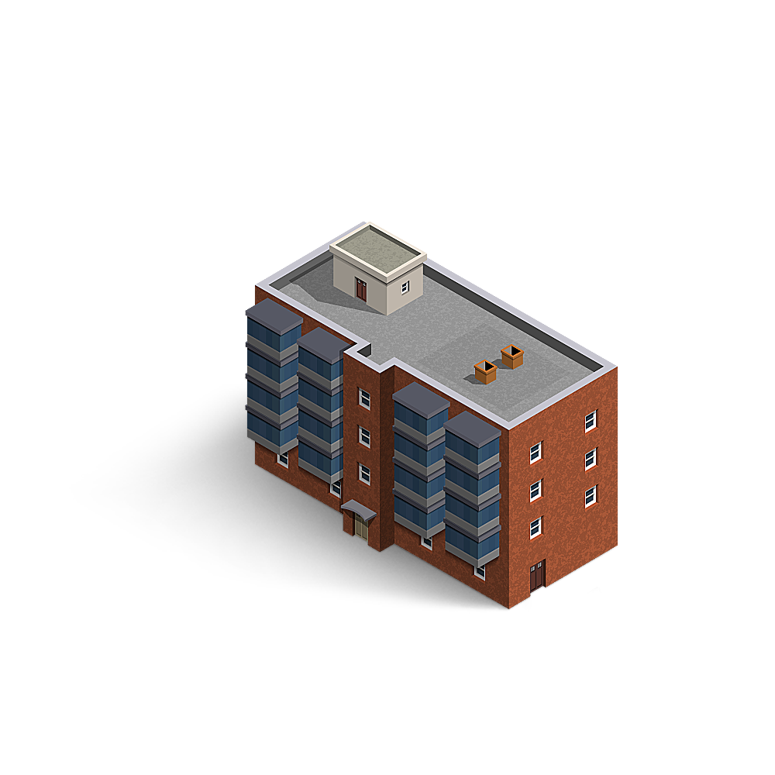
Green MIP Requirements Section 6.5
223(a)(7)
Green MIP
Certificate
YES
Existing Green MIP
(6.5.1)
Prior Green Certification
(6.5.A)
Green MIP
Please?
Prior Years
75⁺
Prior Recognized Certification (per 6.3.1 & 6.3.2)
ENERGY STAR
Score
None
223(a)(7)
NO
WITHOUT Prior Green MIP or Certification
6
Notes:
[KEVIN]
Section 6.5 of the new MAP Guide layouts the requirements for qualifying for Green MIP under Section 223(a)(7).
There are only 2 types of properties that can qualify:
Properties that already has Green MIP;
Properties that already achieved Green Certification in the past.
So, if you have an existing property that does not currently have Green MIP or existing Green Certification, there is no Green MIP available if you apply for a 223(a)(7) loan.
For properties with existing Green MIP, you have to have a clean track record. Meaning, the annual submission of SEPs must have been turned in on time and with an EnergyStar score of 75+. (Section 6.5.1)
I want to also clarify that even if the property got its existing Green MIP through Energy Star for Existing Buildings as its Green Certification, HUD will still recognize its Green MIP status. There were some questions around this because ESEB is not listed under Section 6.3.2 as HUD Recognized Green Certification. HUD will simply recognize the fact that the property already has Green MIP.
If you have a property that has Green Certification, because it was built or retrofitted to a certain Green Standard, that Green Standard has to be one of the HUD-recognized standards as listed in 6.3.1 or 6.3.2. (Section 6.5.2)
Also to clarify, this property only has Green Certification, and NOT Green MIP. So in this case, HUD does not recognize ESEB as one of the Green Certifications. It’s not listed in 6.3.2. So, if you have a property that does NOT have Green MIP and only has Energy Star for Existing Buildings as its only Green Certification, this property will NOT qualify for Green MIP under 223(a)(7).

Slide 7
223(a)(7)
Update Benchmark Score
Secure New ENERGY STAR Existing Building Certification
Submit Firm Application
Secure 12-months of 100% of energy data with average monthly occupancy of 80%+
End date of the 12-month data period must be within 6 months of loan application
Application must include an ENERGY STAR Existing Building Certification
Provide a HUD Custom SEP excel report with the CNA
HUD-91070M Cert;
HUD-92466 Rider 5 (6.4.3 & 4)
For EXISTING BUILDINGS CERTIFICATION
If 100% of 12-months of energy data is not available due to utility
Secure a sampled SEP benchmark with a score above 75
Non-critical repairs must include the installation of energy monitoring system
ENERGY STAR Existing Building Certification must be earned within 15 months of the completion of the non-critical repairs
100% Data Collection plan (6.4.5)
7

Slide 8
Green MIP Requirements Section 6.5
Q & A
223(a)(7)
Green MIP
Secure New ENERGY STAR Existing Building Certification
Newly Built w/ 221(d)(4):
No 12-month data w/ 80% min. occupancy
YES
MAP 6.5.2
New ESEB Certification w/ Firm App (6.5.2)
Deferred
For EXISTING BUILDINGS CERTIFICATION
75⁺
12 consecutive months of min. occupancy?: NO
SEDI based on as-built plans/specs, signed by Energy Prof.
Actual Energy Star Certification submitted within 15 months
SEDI
8
Notes:
[Kevin]
As mentioned, one of the requirements is an actual new ESEB Certification to be submitted with the Firm App, per Section 6.5.2.
Essentially, with the 2020 MAP Guide, we have re-purposed the use of ESEB Certification from being one of the HUD recognized Green Certification, to be the one of the eligibility requirement demonstrating that the Property can and will continue to get qualifying EnergyStar Score of 75+ annually. There are many good reasons to do this and I won’t get into them all, but one thing is that ESEB Certification requires an actual verification by a licensed professional about the property and its data, attested with a seal and signature.
Regarding this ESEB requirement for a7 deals, we did find an edge case that was not anticipated when we published the MAP Guide, and this results from the allowance of newly constructed MF properties for FHA loans.
When you have a newly built property under 221d4 with Green MIP and now coming in for an (a)(7) refinance, it’s possible that the property has not yet reached minimum of 80% occupancy. It’s still leasing up. If you don’t have at least 80% occupancy, EnergyStar cannot issue ESEB Certification because it lacks sufficient energy consumption data.
But given that this property already qualified for Green MIP under the original d4 loan, HUD will defer the ESEB Certification submission.
Instead, a SEDI based on the as-built plans/specs showing a score of 75+ will be accepted with the Firm App; and
The actual ESEB Certification does need to be submitted as soon as possible, within 3 months of recording above the minimum occupancy 12-month data.

Slide 9
Green MIP Requirements Section 6.6
223(f)
Green MIP
Certificate
a. Existing Green MIP
b. Prior Green Certification
(6.6.A)
YES
Green MIP
Please?
Prior Years
75⁺
Prior Recognized Certification (per 6.3.1 & 6.3.2)
ENERGY STAR
Score
None
223(f)
Yes, if…
WITHOUT Prior Green MIP or Certification
9
Notes:
[KEVIN]
Section 6.6 of the new MAP Guide layouts the requirements for qualifying for Green MIP under Section 223(f).
Like 223(a)(7), if you have a property that has existing Green MIP and/or previously achieved Green Certification (within the last 15 years), you can qualify for Green MIP with 223(f) Loan program.
In fact, you would follow the same requirements as 223(a)(7) for properties with existing Green MIP/Green Certification as described in Sections 6.5.1, 6.5.2 & 6.5.3.

Slide 10
Green MIP Requirements Section 6.6
223(f)
Green MIP
Certificate
a. Existing Green MIP
b. Prior Green Certification
(6.6.A)
YES
Green MIP
Please?
Prior Years
75⁺
Prior Recognized Certification (per 6.3.1 & 6.3.2)
ENERGY STAR
Score
None
223(f)
Yes, if…
WITHOUT Prior Green MIP or Certification
10
Notes:
[KEVIN]
If you have a property with no existing Green MIP or Green Certification, under 223(f) you CAN qualify for Green MIP IF you do some things – which is different from 223(a)(7)s. Under a7, properties without existing Green MIP or Green Certification cannot qualify for Green MIP, at all.
Let’s talk about some ways that you can qualify for Green MIP.

Slide 11
Green MIP Requirements
2) Properties WITHOUT Prior Green Certification Achieved (MAP 6.6.3)
Properties wanting to qualify with Energy Star for Existing Buildings Certification
None
Properties wanting to qualify with Green Certification (HUD Recognized or Other)
11
Notes:
[KEVIN]
The basic idea is that these properties can get Green MIP by committing to obtain a Green Certification as a part of the 223(f) Application.
So the question is, which Green Certification would qualify for Green MIP, and what’s the process.
First, getting the Green MIP by achieving Energy Star for Existing Buildings as the Green Certification will be allowed only for a limited time, under limited circumstances.
[Pass off to Stephen for the details]

Slide 12
Green MIP Requirements
A. Properties Qualifying with Energy Star for Existing Buildings (MAP 6.6.2)
Only allowed for applications filed within 2 years of MAP 2020 Publication Date (Deadline 12/18/2022);
Certificate of Occupancy:
Issued within 3 years
prior to date of application
MAP 6.6.2
12 consecutive months of min. occupancy?: YES
Energy Star Existing Buildings w/ Score: 90+
Submitted with the Firm Application
…or
90⁺
12 consecutive months of min. occupancy?: NO
SEDI Score: 90+ NOT contingent on proposed repairs/upgrade
Actual Energy Star Certification submitted within 15 months
SEDI
MAP 6.4 (General Requirements), including:
Energy Star Appliances:
Future replacements (6.4.2)
HUD-91070M Cert;
HUD-92466 Rider 5 (6.4.3 & 4)
100% Data Collection plan (6.4.5)
12
Notes:
[STEPHEN] Newly Built Properties without prior Green Certification - wanting to use Energy Star for Existing Buildings
Only allowed for applications filed within 2 years of MAP 2020 Publication Date (12/18/2020);
Certificate of Occupancy issued within 3 years of application (newly built).
Follow requirements in 6.6.2 "Newly Built Properties with No Prior Certification":
Properties that have achieved at least 12 consecutive months of minimum occupancy MUST submit the Energy Star for Existing Buildings Certification compliant with the following:
Must submit at the time of Firm Application;
The score must be 90+
Properties that lacks 12 consecutive months of min occupancy may submit SEDI compliant with the following:
SEDI based on the as-built plans/specs, signed by the Project Architect;
Owner's commitment to submit the actual ESEB Certification (within 3 months after 12 month of min occupancy);
The SEDI score must be 90+ and may not be contingent on completion of proposed repairs, alterations, upgrades.

Slide 13
Green MIP Requirements
2) Properties WITHOUT Prior Green Certification Achieved
Properties wanting to qualify with Energy Star for Existing Buildings Certification
None
Properties wanting to qualify with Green Certification (HUD Recognized or Other)
13
Notes:
[STEPHEN]

Slide 14
223(f) Existing Property with no prior HUD recognized green building certifications
Set expectations. This route will take some investment.
Assess current performance and plan for green certification
Prepare Firm application
Complete Renovation and Earn Green Building Certification
SEP Energy Benchmark
If 100% data is unavailable, 25%+ sampling is permitted and extrapolation method must be explained
ASHRAE Energy Audit to assess improvement scope
ASHRAE Level 2 Energy Audit acceptable where general contractor (GC) is retained to estimate costs
ASHRAE Level 3 Energy Audit is required if no GC is retained
SEDI report demonstrating that a score above 75 will be obtained with the recommended EEMs
(6.6.3.6) Engage Project Architect or Professional Engineer to meet requirements of 6.7.2
CNA should include energy usage for each recommended energy efficiency measure (EEM)
Register Project with Green Building Program
Work with Green Verifier during the construction to ensure green program requirements are met
Earn Green Building Certification at completion of project
Energy Star Appliances:
Future replacements (6.4.2)
HUD-91070M Cert;
HUD-92466 Rider 5 (6.4.3 & 4)
100% Data Collection plan (6.4.5)
14
Notes:
[STEPHEN]

Slide 15
221(d)(4)
Energy Efficient Performance
Path to Secure a Green Building Certification
Data Acquisition Plan
Statement of Energy Design Intent (SEDI) with a score comfortably over 75
CNA should include the custom-SEDI excel file with the eTool
Plan to secure a Green Building Certification (Project registered, scoresheet completed)
Building Components:
Must specify ENERGY STAR appliances, HVAC or high-performance option if ENERGY STAR option isn’t available
Must specify WaterSense labeled products
100% aggregated data from utility or install remote meters/data-loggers
Prepared by a Qualified Energy Professional
HUD-91070M Cert;
HUD-92466 Rider 5 (6.4.3 & 4)
100% Data Collection plan (6.4.5)
15

Slide 16
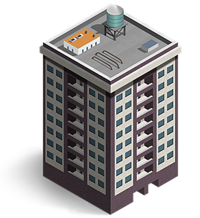
Q & A
Green MIP Requirements Section 6.6
221(d)(4)
More than one Green Certification for the same property?
A
Certificate
YES
A
Certificate
Certificate
B
B
Certificate
16
Notes:
[KEVIN]
One question that has come up for 221d4 that I want to mention is whether the owner can get more than one (a mix of) Green Certifications for the Property.
The answer is ‘Yes.’
We recognize that certain Standards only cover certain types of buildings (e.g., Residential structures, or midrise structures) and you may have different types of buildings for the same property. Or, you may have a situation where you have a mix of existing buildings and gut-rehab buildings that are more like new construction, so you may need a standard for both existing buildings and new construction.
So, we will allow more than one Green Certifications for a single property, as long as, those standards are within the same Green Standard Keeper.
e.g. LEED EB and LEED New Construction; or EnergyStar New Construction Single Family + EnergyStar New Construction MF.

Slide 17
Summary of the Key Changes
Key Points for Owners and Developers
Except for the transition period through Dec-2022, ENERGY STAR Existing Building Certification will no longer be an accepted Green Certification
Developers planning for a 223(f) after construction, should plan to secure a green building certification during construction
Owners considering a renovation should work with a Green Verifier to secure the certification during the renovation
New specific guidance for energy analysis:
SEP & Data Plan must be performed by Qualified Energy Professional
Essentially no sampling for SEPs: 100% aggregated data from utility or install remote meters/data-loggers
Submitted SEP should be based on data within 6 months of application
Qualifications for Energy Modeling are based on the type of buildings (3-story vs. 4+ stories)
Clear definition that if ENERGY STAR algorithm is changed, past loans will be held to the energy use intensity (EUI) at time of application
17

Slide 18
II. Green MIP Documentation
Robert A. Fradley
Construction Analyst, Multifamily Production
Denver HUD
18

Slide 19
Green MIP Documentation
The following documentation must be submitted with the Firm Application to ensure underwriting to the reduced MIP of .25
1) HUD-92013-D
Owner’s Certification and Acknowledgement of Program Obligation for Broadly Affordable, Affordable and Green/Energy Efficient Multifamily Housing Mortgage Insurance Premiums (MIPs) and the Acceptance of Housing Choice Vouchers
2) Evidence of the Energy Star’s standard keeper review, approval, or acceptance of the project. This is to include:
i. The identity of the standard keeper
ii. The name of the proposed national or multi-state green building certification
19

Slide 20
Green MIP Documentation
iii. The selected level or grade of achievement (e.g., silver, gold, platinum, etc.)
iv. The Project Architect’s certification
3) Documentation of design and construction milestones to achieve the Energy Star Certification:
i. Review of final drawings and specifications prior to application for firm commitment
ii. On-site inspections of the building envelope and rough mechanical installation prior to drywall or closing of wall cavities
iii. A final inspection or commissioning after construction completion
20

Slide 21
Green MIP Documentation
4) Energy Star Certification requirements included in the plans and specifications
5) Description of construction milestones included in the construction progress schedule
6) Statement of Energy Design Intent (SEDI) with a score of not less than 75
i. Properly filled out report including all relevant Property & Contact Information
21

Slide 22
Green MIP Documentation
ii. Report to be signed (and stamped/sealed if prepared by a licensed engineer)
If the SEDI is submitted unsigned, it will be considered a draft version and rejected
iii. HERS Index Score is not an acceptable alternative to the SEDI/SEP
** There is a potential risk for increased early repair/replacement costs if the project starts off with a low passing score. Per Section 6.4.1 - Continuing Performance Required under Green MIP:
1. All Borrowers with loans endorsed at Green MIP rates and secured by properties of 20 or more units must annually demonstrate continuing performance by delivering to HUD an ENERGY STAR® Statement of Energy Performance (SEP) showing an ENERGY STAR® Score of not less than 75. (See Section 6.4.5 on planning for future data collection for purposes of demonstrating continuing performance.) It is the property owner’s obligation to maintain, repair, and replace components as necessary to retain this minimum performance score for the life of the insured mortgage.
22

Slide 23
Green MIP Documentation
7) Data Collection Plan demonstrating the owner’s ability to annually submit Statement of Energy Performance (SEP).
i. Plan should show the owner understands the data needed, management procedures required, and any technical solutions implemented
ii. Plan must contain details of steps and technology used to obtain, organize, store, and report the data to EPA’s Portfolio Manager
1. Whole building metering or sub-metering is to be determined at the Firm Application phase, with the required metering equipment installed by the start of the monitoring process
iii. The plan should detail requirements of utility providers and tenant cooperation needed in the data collection
23

Slide 24
Green MIP Documentation
iv. Sampling should include whole building data, if available, from local utility or metering system.
1. When whole building data is not available, the following sample routine should be used:
a. 25% of all units, randomly selected, but must be representative all unit types, buildings, each size of unit and exterior exposure by direction (e.g., north, south, east, west), each floor or building level, and each materially different HVAC package.
24

Slide 25
III. Getting Ready for Construction
David Jasso
President
Leetex Group
25

Slide 26
Getting Ready for Construction
Conduct pre-construction conferences
Assist the development team with HUD requirements
Observe and report on on-site construction activities for compliance with contract documents (Plans/Specs/Green MIP)
Evaluate Builder’s organization, operations and supervision. Builder’s conformance with construction schedule (On-Schedule/Ahead/Behind)
Conduct Critical Phase inspections (When Applicable; Building Pad/Formwork Slab/Pre-Sheetrock/Fire Walls/Roofing/Formwork Paving/Green MIP)
Evaluate architect’s services and administration (Architectural Field Reports, Change Order Logs, ASI Logs)
Monthly review of Builder’s Requisition (HUD 92448) (includes on-site stored materials/retainage)
Monthly review of Advance of Escrow Funds (HUD 92464M)
26

Slide 27
Getting Ready for Construction
Review Change Orders (Betterments/Necessities/Time/Architect’s justification/Builder labor and material breakdown/Consent of Surety/Green MIP)
Review Architect’s Supplemental Instructions (Minor Change/No Impact on Cost/Time, Not Structural, Green MIP)
Report on Special Circumstances (Work Stoppage/Labor Issues/Extended Weather/etc.)
Report non-compliance (Deviation from Plans/Specs)
Conduct Davis Bacon wage interviews (HUD 11)
Conduct Permission to Occupy (Certificate of Occupancy/Owner Evidence of Insurance Coverage)
Conduct HUD Final Inspection (Adequate Ingress/Egress/Life Safety/Utilities Connected Operable/Establish Cut of Date/Items of Delayed Completion/Transmittals/Submittals/O&M manuals)
Warranty Inspections (9 and 12 Month Warranty)
Maintain Construction Record
27

Slide 28
IV. Construction Servicing
Barbara P. Lloyd
Managing Director
Housing & Healthcare Finance, LLC
28

Slide 29
Construction Servicing
Contacts:
Borrower
General Contractor & Surety
Supervisory Architect
Lender
Title Company
HUD Construction Analyst
HUD Contracted Inspector
HUD Underwriter
Investor
29

Slide 30
Closing / Servicing Handoff:
Pre-Construction Conference
Final Closing Documents
Initial HUD 92403 – Application for Insurance of Advance of Mortgage Proceeds
Final reconciled HUD 92451 – Financial Record of Mortgage Loan Transaction (or similar format in an Excel Worksheet)
HUD 2328 – Contractor’s and/or Mortgagor’s Cost Breakdown
Construction Progress Schedule
Fully executed Contracts/Agreements
Closing Statement
Chapter 12 - Construction Period, Section 12.2 Pre-Construction Conference
30

Slide 31
Post-Closing Welcome Call with Borrower:
Lender’s Team
Borrower’s Team
Construction Draw Forms
Remittance Information
Draw Timeline
Critical Construction Dates
Cost Certification
31

Slide 32
Monthly Construction Draw Package:
HUD 92403
HUD 92448
Architect’s Supervisory Fee
Calculation
No holdback
Title Date Downs
Supporting Invoices
Draw Securitization
2020 MAP Guide, Chapter 12 - Construction Period, Section 12.7 Application for Insurance of Advances, Appendix 12. Section A.12.1 Approving of Advances and Section A.12.2 Contractor’s Monthly Requisition
32

Slide 33
Construction Progress Monitoring:
Construction Progress Schedule
HUD Representative’s Trip Report (Form HUD-95379)
Schedule Progress vs. Actual Progress
Participants at Inspection
Site Work
Architect Supervision and Services
Approved and Pending Change Orders
Non-compliant Work
Stored Materials claimed on/off-site
Major / Minor Movables
Draw Approval
2020 MAP Guide, Chapter 12 - Construction Period, Section 12.3 HUD Construction Inspection and Monitoring
33

Slide 34
Construction Retainage Reductions are Permissible, when:
Contractor has no identity-of-interest with the owner greater than 5% equity interest
If applicable, prior written consent from the surety
No questions regarding the contractor’s performance concerning:
the quality of work
compliance with the contract
change orders or work in progress
2020 MAP Guide, Chapter 12, Section 12.15.5 Amount of Contractor’s Retainage and Release
34

Slide 35
Construction Cost Retainage Reduction:
10% holdback until 50% completion
5% until 75% completion upon HUD’s approval
2.5% until the loan achieves Final Endorsement upon HUD’s approval
2020 MAP Guide, Chapter 12, Section 12.15.5 Amount of Contractor’s Retainage and Release
35

Slide 36
Components Stored Offsite:
List of stored components must be approved by HUD at Initial Closing
Construction Contract must include the “Amendment to the Construction Contract for Components Stored Offsite”
2020 MAP Guide, Appendix 12.A.12.3 Components Stored Offsite & Appendix 12.A.12.4 Amendment to the Construction Contract for Payment for Components Stored Offsite
36

Slide 37
Change Orders:
HUD 92437 – Request for Construction Changes on Project Mortgages
Supporting Documentation
Modifying Energy Measures – 2020 MAP Guide, Section 6.4.10
HUD Approval
2020 MAP Guide, Chapter 12.8 – 12.11 Change Orders
37

Slide 38
Permission to Occupy:
HUD 92485 – Permission to Occupy (PTO)
Supporting Documentation
Acord or Certificate of property and liability insurance
Certificate of Occupancy or equivalent permit from the governing municipal authority for units and facilities listed on PTO, and
Any other required permits or authorizations
2020 MAP Guide, Chapter 12.8 – 12.14 Permission to Occupy
38

Slide 39
Releasing Escrow Funds:
Form HUD-92464M – Request for Approval of Advance of Escrow Funds
Lender Review and submission to HUD
HUD Approval
2020 MAP Guide, Chapter 12.15 Escrowed Funds, Letters of Credit, Deposits, Holdbacks and Related Matters
39

Slide 40
Construction Difficulties/Delays:
Reason for delays
Cure for delay
Written notification to surety with copy to general contractor
Ongoing discussions and construction progress to complete project and achieve final closing
2020 MAP Guide, Appendix 12.A.12.5 Projects Experiencing Difficulties Before Final Closing
40

Slide 41
Reminders:
2020 MAP Guide Chapter 12 and Appendix 12
Keep the 92451 updated
Do not overrun construction budget
Ensure monthly advances are proportionate to construction progress
Review Architect Reports and HUD Trip Reports (Form HUD-95379)
Amount approved for a requested item cannot exceed the amount claimed by Borrower
Reconcile any discrepancies before approval of advance
Explain any disallowance on 92403, page 2
Notify borrower of discrepancies
Forward copy of final approved HUD 92403, 92448 and 2451 to borrower after each draw approval
Send Approved Monthly Draw Packages to HUD Construction Team
41

Slide 42
2020 MAP Guide Updates/Changes:
Chapter 12.2 - Pre-Construction Conference Expected Attendees
Chapter 12.3 - HUD Construction Inspection and Monitoring
Chapter 12.6 - Completion Inspections for New Construction and Substantial Rehabilitation
Chapter 12.8 - Change Orders – HUD Duties
Chapter 12.11 - Change Order – HUD Underwriter Instructions
Chapter 12.14 - Permission to Occupy
Chapter 12.15 - Escrowed Funds, Letters of Credit, Deposits, Holdbacks
Chapter 12.16 - Insurance Upon Completion
Chapter 12.17 - Completion of Repairs and Alterations Pursuant to Section 223a7 and 223f
Chapter 12.18 - Casualty Events During Construction - New
42

Slide 43
LISTEN:
Lead
Involved and Informed
Stay Engaged
Teamwork
Empathize
Navigate
43

Slide 44
V. Green During the Construction Process
Kevin J. Han
Senior Technical Specialist
Office of Multifamily Production
HUD HQ
Stephen Evanko
Managing Director of Energy & Sustainability
Dominion Due Diligence Group
44

Slide 45
Green during the construction process
6.4.10 For properties where construction is proposed to achieve green building certification, change orders that modify construction … by reducing the proposed level of performance or reducing the approved level of certification may only be approved if HUD determines that the change is a necessary change order. In no event may a change order result in construction that will fail to achieve the approve green building certification”
45

Slide 46
Green Building Inspections must occur during construction
Design
Construction and Verification
Design Review
Construction Kick-off
Rough Pre-Drywall Inspection / Verification
Final Inspection / Verification
Certification Submission
GC/Subs should walk the site with the verifier
Correct any identified issues
Spend the time together on the first units, and capture lessons learned to avoid repeated issues
46

Slide 47
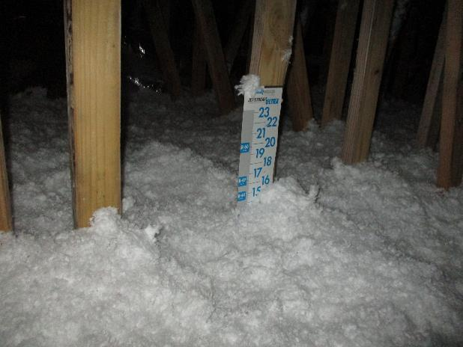
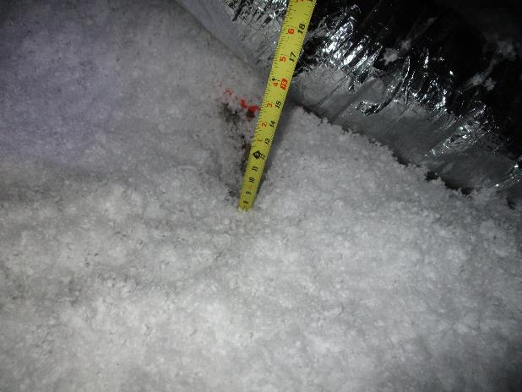
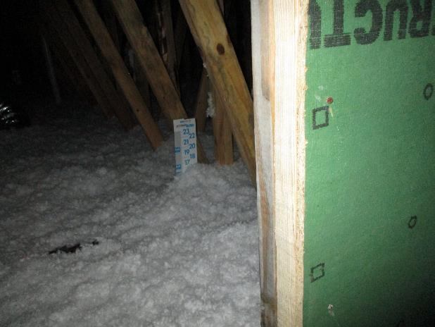
During Rough Inspection, we verify flashing, air-sealing and insulation quality among other green practices
Attic Insulation should have been R-38 which was about 13” of blown insulation
During inspection, we identified gaps where insulation was as low as 9” which is only an R-26
47

Slide 48
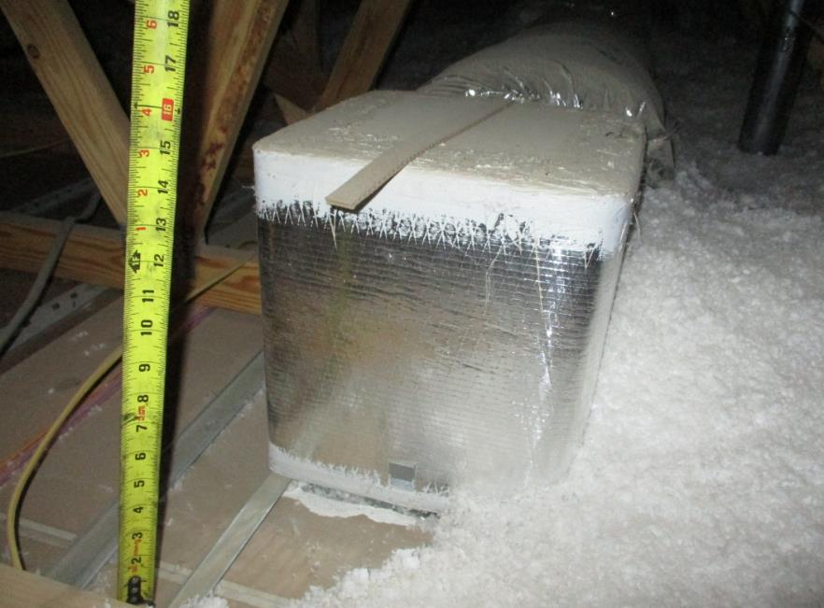
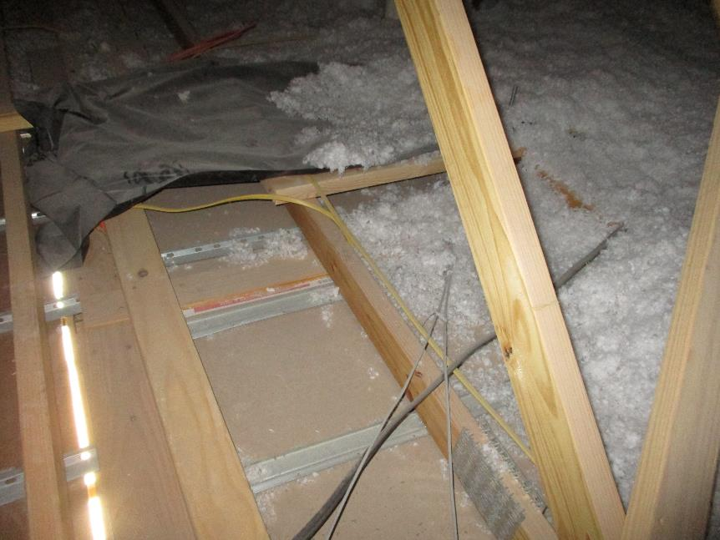
During Rough Inspection, we verify flashing, air-sealing and insulation quality among other green practices
See any issues with this one?
Breezeway
Dwelling Unit
48

Slide 49
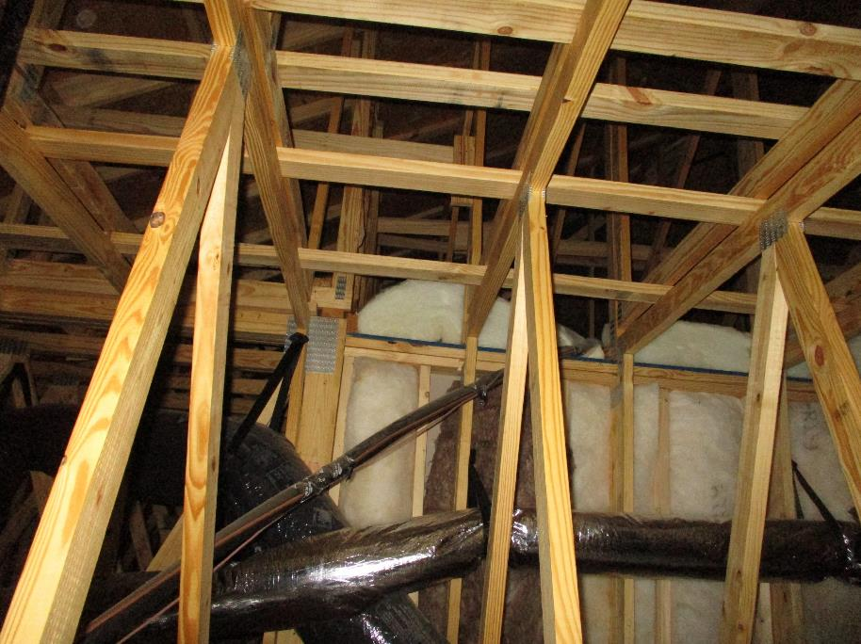
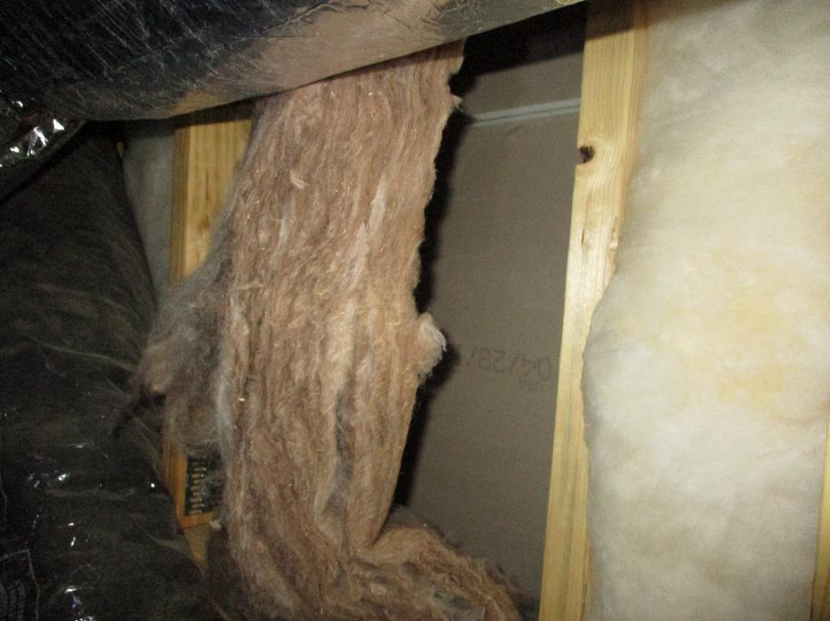
During Rough Inspection, we verify flashing, air-sealing and insulation quality among other green practices
Attic Insulation along vertical wall is already falling away which unrepaired represents a big weakness in the thermal envelope
49

Slide 50
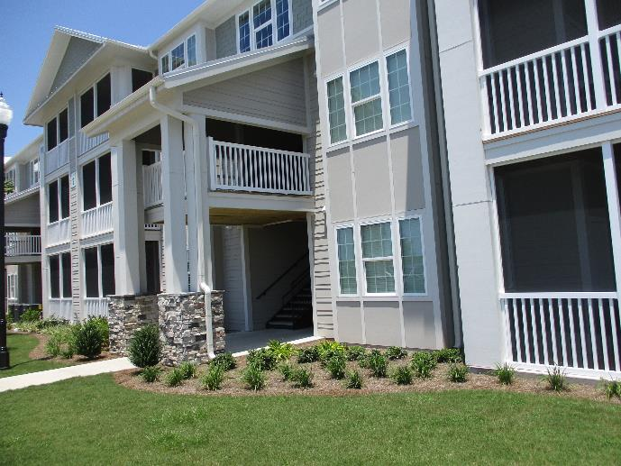
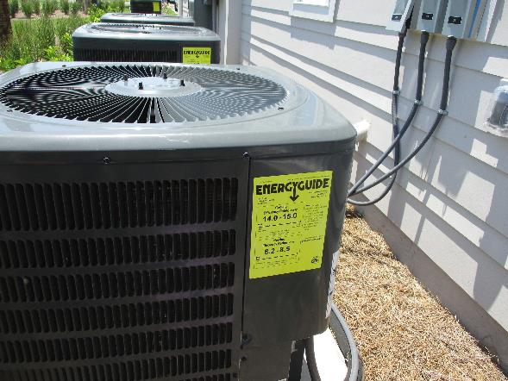
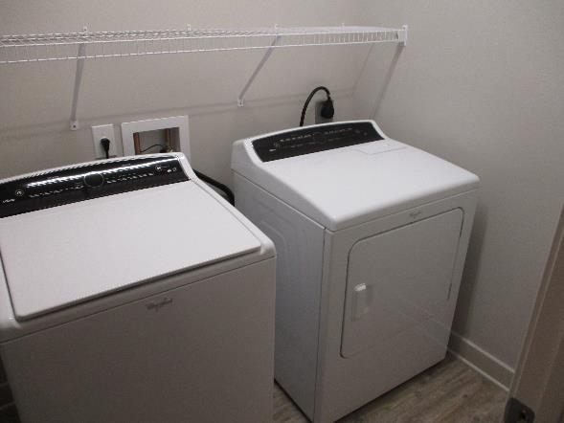
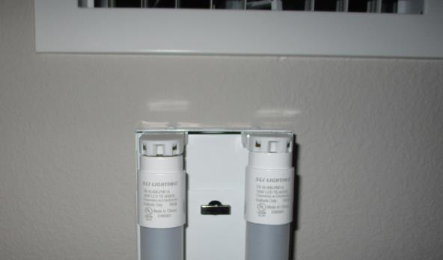
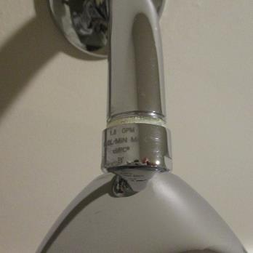
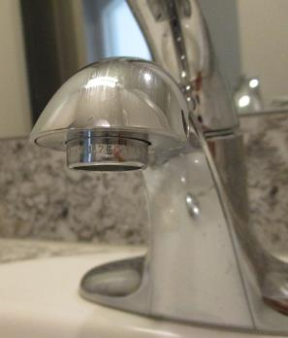
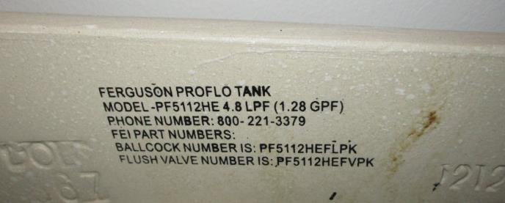
During the final inspection, we confirm appliances, HVAC, lighting, fixtures, etc.
50

Slide 51
Statement of Energy Performance
Annual Submission Timelines Section 6.4.1 & ML 2020-01
[MAP 6.4.1]
“…must annually demonstrate continuing performance by delivering to HUD an Energy Star Statement of Energy Performance (SEP) showing…Score of not less than 75.”
[ML 2020-01]
The SEP captures the consumption for a full calendar year (12 consecutive month period starting in Jan 1 to Dec 31).
The SEP is due annually by March 31.
Jan 1
12-month
Dec 31
Mar 31
Jan
Feb
Mar
Apr
May
Jun
Jul
Aug
Sep
Oct
Nov
Dec
51
Notes:
[KEVIN]
One important regulatory obligation of receiving the Green MIP rate is the “Annual Performance” reporting, which is submitting your Statement of Energy Performance (SEP) every year for the duration of the loan, as stated in MAP 6.4.1. The required SEP Score is 75, every year.
The timing of gathering the data on how much energy your property consumes and then submitting the SEPs are outlined in the Mortgagee Letter 2020-01.
The basic rules are:
Collect your data over a calendar year – meaning, 12 consecutive months starting in January and ending in December.
Generate your SEP from that calendar year data; and submit to HUD by 3/31 of the following year.
So, to reiterate, collect data from Jan to Dec – always from Jan to Dec, that continuous 12-month block.
And then, you can take up to 3 months processing that data to generate your SEP and submit that SEP by 3/31 of the following year.
It’s just like filing your tax return – you file your tax return by 4/15, but the tax that you are reporting is for the previous calendar year.
I want to emphasize that I’m talking about the Annual SEP requirement…I’m NOT talking about the Energy Star for Existing Buildings Certification submission timeline.

Slide 52
Statement of Energy Performance
Annual Submission Timelines Section 6.4.1 & ML 2020-01
223(a)(7)
&
223(f)
Green MIP
Initial Closing
Existing Green MIP
Jan 1
12-month
Dec 31
Mar 31
Year X
Year X+1
52
Notes:
[KEVIN]
Let’s first look at refinancing properties with already existing Green MIP. These properties already have Green MIP, so they already have been submitting SEPs annually, following that timeline I just described.
So they will just continue to do so, regardless of when the initial closing happens, and the new loan begins. The Annual reporting will just continue on.

Slide 53
Statement of Energy Performance
Annual Submission Timelines Section 6.4.1 & ML 2020-01
Certificate
223(a)(7)
&
223(f)
Initial Closing
Existing Green Certification
Jan 1
Dec 31
Jan 1
12-month
Dec 31
Mar 31
Year X
Year X+1
Year X+2
53
Notes:
[KEVIN]
Next, let’s look at properties closing under 223a7s or Fs, that did NOT have existing Green MIPs, but qualified for a new Green MIP because they had existing Green Certification.
In this case, the initial closing will happen sometime in a calendar year – as indicated in the yellow bar to the left. It doesn’t matter when that closing date is, the energy consumption data collection period will always begin in January of the following year and end in December of that same year, and then the actual SEP will be submitted by 3/31 of the year after that. That’s the green timeline that you see on the right.
So, again, your deal closes on a particular date in Year X, but the data collection period always begins in January of the following year, Year X+1, and the SEP generated from that collected data will need to be submitted by 3/31 of the following year of the data collection period – so, by 3/31 of Year X+2.

Slide 54
Statement of Energy Performance
Annual Submission Timelines Section 6.4.1 & ML 2020-01
Installation Completion
(Non-Critical Repair Period)
Certificate
223(a)(7)
&
223(f)
Need to install Submetering Devices to get 100% data.
Jan 1
Dec 31
Jan 1
12-month
Dec 31
Mar 31
Year X
Year X+1
Year X+2
54
Notes:
[KEVIN]
Okay, so hopefully that was simple enough. Now, let’s get into some more complicated situations.
Now let’s talk about 223A7s and Fs that qualified because they had existing Green Certifications (Not existing Green MIPs), but had to install submetering devices to be able to collect 100% aggregate data. So, these are usually the cases where the utility companies do not release energy data to the property owners. This is one exception that we do allow, for both A7s and Fs.
In this case, the date that matters is not the closing, but when the devices get installed. Typically, the initial closing happens and then the Non-critical Repair period begins, up to 12 months from the date of closing. So whenever the installation is completed in a particular calendar year (call that Year X), as indicated in the yellow bar to the left, then the energy consumption data collection period begins in January of the following year, Year X+1. The collection period runs from January to December, and the SEP is submitted by 3/31 of the year after that – so in March of Year X+2 from the date of installation.
That makes sense, if you think about it, because you need these devices to be able to collect that data in the first place.

Slide 55
Statement of Energy Performance
Energy Star for Existing Buildings Certification
VS
Timeline:
Energy Star for Existing Buildings Certification
First eligible 12-month period
Ending within the prior 6 months from Firm App
Earliest 12 months after data becomes available (i.e., installation of submeters)
Sustained 12 months of min. 80% occupancy.
Timeline:
Statement of Energy Performance
First available calendar year
i.e., Jan to Dec
55
Notes:
[KEVIN]
To show you the next scenario, I want to briefly make a distinction between the SEPs and the ESEB Certification.
One common confusion is this SEP timeline with the submission of deferred Energy Star for Existing Buildings Certification.
As described earlier, every 223(a)(7) and 223(f) applications for Green MIP must submit a new ESEB Certification with the Firm Application.
ESEB Certification also requires a 12-consecutive month period of data collection. But the key difference to keep in mind is, that ESEB should be generated based on the first eligible 12-month period, whereas the first initial SEP should be generated based on the first available calendar year data.

Slide 56
Statement of Energy Performance
Energy Star for Existing Buildings Certification
VS
Certificate
Installation Completion Date
First Available Calendar Year (Jan to Dec)
e.g., Mar 18
Dec 31
Jan 1
12-month
Dec 31
Mar 31
First Available 12 months
Mar 18
12-month
Feb 18
May 18
+3 months
56
Notes:
[KEVIN]
As mentioned, every 223a7 & 223f Green MIP application must be submitted with a new ESEB Certification at the time of Firm Application.
However, we did make one exception, allowing deferred submission of ESEB Certification when the property cannot get aggregate data from the utility company and installation of submetering devices are required.
When ESEB is deferred, it must be submitted no later than 15 months after the installation of these devices.
I wanted to put this deferred ESEB submission Timeline (in blue) along with the very first SEP submission date (in green).
In this example, let’s say the submetering devices were installed on 3/18. For the deferred ESEB, the 12-month data collection period starts from this date. So starting in March, collect 12 months of energy data – that’s March to Feb. Then, you get up to 3 months from Feb to turn in your ESEB Certification.
That is separate and distinct from the first Annual SEP submission timeline. For SEP, the data collection period starts with the first available Calendar year - in January of the year following the installation date. It doesn’t matter whether the installation happened on March 18, or Feb or Nov, etc. The SEP data recording period always starts in January and ends in Dec of the following year, and the SEP due on 3/31 of the year after that.
So in this example, the deferred ESEB is due on May 18 (15 months from the installation date), and the first SEP is due on March 31, 2 years from the year of installation.

Slide 57
Statement of Energy Performance
Annual Submission Timelines Section 6.4.1 & ML 2020-01
Newly-Built
223(a)(7)
&
223(f)
Certificate
Green MIP
Min. 80% Occupancy
Need to reach min. 80% Avg. Occupancy
Lease Up
Jan 1
Avg. Occupancy 74%
Dec 31
Jan 1
Avg. Occupancy 80%
Dec 31
Jan 1
Dec 31
Mar 31
12-month
57
Year X = Year of Avg. 80% Occ.
Year X+1
Notes:
[KEVIN]
Now, let’s look at something that’s more complicated… newly built properties that had not yet reached that 80% minimum occupancy needed for a proper SEP. For energy consumption data, in addition to needing that 12-consecutive-month data of all the meters at the property, that consumption data must be based on at least 80% average occupancy.
It’s the average of 80% occupancy across those 12 months – so it doesn’t mean every month is above 80%, but the average of 12 months occupancy percentages must be above 80%.
So, you may have a property that was recently built – under a d4 with Green MIP, or maybe just built with a HUD recognized Green Certification – that is now being refinanced under an A7 or an F. Because it’s newly built, it may not yet have reached the minimum 80% average occupancy.
In this scenario, the first Submission of Annual Performance SEP report will be based on the first eligible calendar year – when the property first reached that minimum average of 80% occupancy, measured from January to December.
So, let’s say a project was recently built, got refinanced with Green MIP, and closed.
After leasing up over the months, you would need to check at the end of the year to see what average occupancy your property sustained from January to December. May be the first calendar year, calculating the average occupancy from January to Dec, you didn’t hit that 80% (e.g., only 74%).
But the year after that, you calculate again from Jan to Dec timeline and the average is above 80%. Great – so that same January to December period would be your first available calendar year in which your energy consumption data can be collected for SEP. That SEP should be submitted by 3/31 of the year following that first eligible Calendar year.
To reiterate, your first energy data collection period will be the same earliest January to December period that reached and sustained the average of 80% min occupancy.

Slide 58
Statement of Energy Performance
Annual Submission Timelines Section 6.4.1 & ML 2020-01
221(d)(4)
New Const. & Sub-Rehab
Newly-Built
223(a)(7)
&
223(f)
Min. 80% Occupancy
Need to reach min. 80% Avg. Occupancy
CoO / Lease Up
Avg. Occupancy 74%
Dec 31
Avg. Occupancy 80%
Dec 31
Jan 1
Jan 1
Jan 1
Dec 31
Mar 31
12-month
58
Year X = Year of Avg. 80% Occ.
Year X+1
Notes:
[KEVIN]
Lastly, 221(d)(4) New Constructions and Sub-rehabs follow the same concept of needing to reach the average 80% minimum occupancy for collecting the energy consumption data.
After the construction is done and the Certificate of Occupancy is issued and the leasing begins, it will be some time before the property reaches and sustains that 80% occupancy for a 12-month period.
The earliest January to December calendar year period to demonstrate average of 80% occupancy should be the same months’ energy data collected to generate your first SEP report, to be submitted by 3/31 of the following year.

Slide 59
Statement of Energy Performance
Energy Star for Existing Buildings Certification
VS
None
Newly-Built w/o Green.
223(f) qualifying with ESEB
6.6.2
90⁺
12 consecutive months of min. occupancy?: NO
SEDI Score: 90+ NOT contingent on proposed repairs/upgrade
Actual Energy Star Certification submitted within 15 months
SEDI
Earliest 12 months w/ avg. 80% Occ.
Earliest Calendar Yr.
w/ avg. 80% Occ.
Month X
12-month
+ 3 mon.
Closing + Lease Up
Dec 31
Avg. Occupancy 80%
Dec 31
Jan 1
Jan 1
Jan 1
Dec 31
Mar 31
59
12-month
Notes:
[KEVIN]
This one may be the worst-case, the most complex scenario.
This property is:
Newly Built, without Green MIP/Certification;
Temporarily allowed under 6.6.2, qualifying by achieving ESEB Certification as THE Green Certification.
ESEB Cert is due with the Firm Application, but one exception allowed – if 80% min. occupancy not yet met.
SEDI showing 90+ is required with the Firm instead of ESEB Cert, BUT, the deferred ESEB needs to be submitted as soon as possible.
So, the timeline of ESEB will depend on the earliest 12-month period with average of 80% occupancy reached (blue timeline).
The first Annual Performance SEP will depend on the earliest Calendar Year with the average of 80% occupancy sustained (yellow and green timeline).
If you visualize the Blue timeline relative to the Yellow/Green timeline as I’m showing here, you can see that the Blue can slide to the right or to the left, to the point where you may have to submit both the ESEB and the first SEP in the same year, or the other end of the range would be that you submit your ESEB and then it can be over a year before you submit your first SEP. All depends on when the property reaches that 12-month above 80% average occupancy period.

Slide 60
VI. Questions
Questions from chat presented by Co-Moderator.

