Slide 1
New LIHTC and LIHTC Pilot September 2021 WMAC Virtual Conference HUD West Region
Tiger Hudson – HUD Senior Underwriter
Danny Gallant - HUD Senior Underwriter
Erica Kodiyan – Production Branch Chief
Office of Multifamily Production

Slide 2
23 New LIHTC Transactions in the West
Notes:
TIGER
To date, the West region has completed approx. $547.2 million in new LIHTC deals since pilot inception 2019 (D4s and sub rehab/2 heavy fs). Of this approx. $54.3 million was generated by the pilot program and approx. $493 million was generated by new LIHTC.

Slide 3
New LIHTC Deals by Type
Notes:
TIGER
To date the West region has completed 23 new LIHTC deals.
4 were eligible for the D4 pilot program, 2 were 223f refi, 6 were D4-NC and 11 were D4-SR.
Hasn’t been a demand for new LIHTC 223fs

Slide 4
New LIHTC Deals by State
Notes:
DANNY
Based on HUD’s data, California has done 8 new LIHTC deals, Colorado has done 3, Montana, Nevada and Washington each with 2 new LIHTC deals, and Alaska, Hawaii, Idaho, North Dakota, South Dakota and Utah each had 1 new LIHTC deal. Only California had pilot deals, 4 of them.

Slide 5
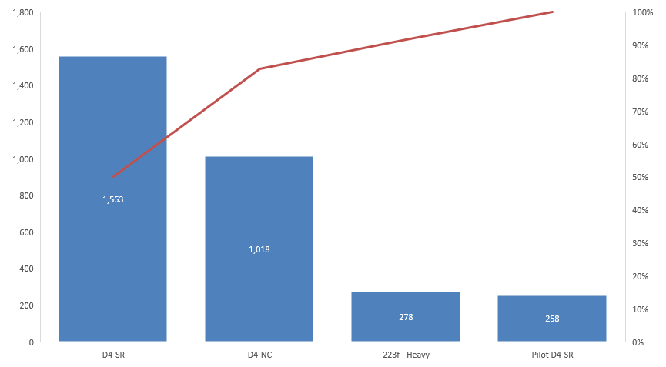
New LIHTC and Pilot Over 3,100 Units Insured West Region
Notes:
DANNY
In the West region, we have insured over 3,100, (3,117 per our records) since pilot program began in 2019. D4-SR is the most popular new LIHTC product, followed by new construction.

Slide 6
Issuing and Closing Times New LIHTC
Notes:
TIGER
New LIHTC outside of the Pilot program are achieving 45 to 60 day processing timelines and are heavily prioritized. Timing performance, average days to firm for new LIHTC 223f and 221d4
Answer: 19 non-pilot, new LIHTC deals processed, only 4 deals have been processed under the pilot program
Question: was processing timeline achieved?
Answer:For New LITHC pilot deal- Day to Firm commitment averaged 28 days, days to closing averaged 78 days
We only have four deals for data points on new pilot. The lender is running the pilot deals.
Answer: For Non-pilot, new LIHTC- Days to Firm commitment averaged 63 days, days to closing averaged 39
New LIHTC has priority in the Intake Queue

Slide 7
Eligibility Requirements for Both Tracks
Experienced Borrower Teams
Clear 2530s
Limited environmental risk factors
Evidence of LIHTC commitment
Maximum Loan Amount: $25 million
Pose limited risk (low Loan to Cost, few environmental issues)
Fast turn-around (excludes complex deals such as RAD)
Subject to Concept Meeting and Loan Committee reviews
Notes:
TIGER
Here are the common features of both pilot tracks

Slide 8
Expedited Approval Processing
Eligible deal types
9% LIHTC New Construction at 65% maximum Loan To Cost w/ rents 10% below market
4% or 9% LIHTC Sub Rehab. w/ Sec. 8 at 75% maximum Loan To Cost
Goal: Close within 90 calendar days (30 day review + 60 days to close)
Loan underwriting, construction monitoring, and release of escrow funds will be performed by the lender.
HUD will perform a limited review of the lender’s underwriting and will enforce statutory and regulatory requirements (i.e. environmental reviews, 2530s, Fair Housing Act compliance).
Notes:
DANNY
Here are the unique features of the Expedited pilot track. We have done 3 expedited pilot deals, all in California.

Slide 9
Standard Pilot Approval
Eligible deal type
4% or 9% re-syndication LIHTC sub. rehab. without Section 8 at 75% maximum Loan to Cost w/ rents 10% below market
Goal: Close within 120 calendar days (60 day review + 60 days to close)
HUD will review and approve the Lender’s underwriting conclusions & ensure compliance with statutory and regulatory requirements
Lender will be allowed additional authority during the construction phase (approve most change orders, escrow releases)
Notes:
DANNY
Here are the unique features of Standard pilot track. We have done 1 standard track deal, in California.

Slide 10
The Importance of the Pilot Eligibility Checklist
Submit the Eligibility Checklist with the Concept Package
Expedited Eligibility checklist.docx
Standard Eligibility Checklist.docx
Confirm your deal track based on eligibility requirements
Any proposed changes to any eligibility requirements – requires a waiver
Tool – try the concept meeting deliverable list link
NC_SR_LIHTC_Pilot_Concept_Meeting052119
Notes:
TIGER
These are live links that can be used to access the checklists
The early deliverables checklist can also be delivered at Concept
We want these early deliverables for all new LIHTC

Slide 11
LIHTC Pilot Waiver Examples
221(d)(4) NC – 89.28% Affordable. Threshold is 90%. Allowed to proceed via Pilot.
221(d)(4) SR – Floodplain. Due to the 8-Step being complete prior to application, the project was accepted into the Expedited Track. Otherwise, would have been eligible for Standard Track.
Notes:
DANNY
HQ is asking for a HUD-2 form for Pilot eligibility waivers

Slide 12
LIHTC Pilot Waivers - Continued
221(d)(4) SR – LTC is estimated at 76.13%. The LTC Threshold is 75%.
221(d)(4) SR – Waiver declined. Due to a LTC of 84% the project was ineligible for Pilot processing, but nonetheless, the Firm Commitment was issued in 30 days.
Notes:
DANNY
The last one did not require waiver because it was not eligible for the pilot program, but it is worth noting that HUD is striving to get these new LIHTC deals done in record time whenever feasible. Starting early with submission of long lead items at concept meetings assigned to a HUD UW really helps move the process forward.

Slide 13
Early Deliverables at new LIHTC Concept
4% or 9% LIHTC award or acknowledgement letter, preferably with hard funding deadline
Pilot Eligibility checklist
Phase 1/ HEROS
2530’s
Waiver requests
MUTM rent approvals
AFHMP
Prepayment approval
Secondary Instruments
Temporary Relocation Plan/Budget
Written SOW
Notes:
TIGER
For any new LIHTC deal the best way to speed up processing is to submit the long lead items earlier.
-For example, we recognize Lender may not have the MUTM approval, but we need understanding of where the request is in process with AE
Secondary Instruments: i.e. HOME funds, restrictive covenants – lender review of title, development agreements, condo regime, etc.
The earlier the better

Slide 14
Common Processing Delays
Subsidized Rent Increase -Unapproved MUTM (HAP rent increase)
Asset Management has 120 days processing timeline
Environmental/HEROS
Floodplain/8-step processing
Endangered species
SHPO/THPO
eTool
Relocation Plan/Budget
Pending Litigation
2530 flags
Notes:
TIGER
Here are some common issues, we see in processing new LIHTC deals, that cause processing delays.
Etool issues typically :missing reports, missing comments to RUL changes, deferred ADA issues, relocation plans, scope of work, contracts, etc.
These delays are universal to all deal types
Litigation that is not covered by insurance
We assign a HUD UW at concept meeting for all new LIHTC deals to enable earlier processing of these long lead items

Slide 15
Processing Flow New LIHTC Deals Milestones
Concept Meeting
Underwriter and Tech Staff are assigned at concept
Encouragement / Discouragement
Placed into Processing
National LIHTC LC / Regional LC Review
Firm Commitment Issuance
Closing Kickoff
Notes:
DANNY
Here are the key steps in the processing flow of a new LIHTC or pilot deal from start to FC issuance.
A new LIHTC or D4-Pilot deal has many of the same MAP Guide processing requirements as any HUD D4 deal, except we assign an UW and Tech staff at concept meeting, we accept long lead items earlier…at or soon after a concept meeting, and if qualified for one of the pilot tracks has a leaner architectural technical review.
Processing Time for Loan Committee to meet
National Committee
3 to 5 business days
Standardized loan committee template
National loan committee – all 5 regions represented
Non-pilot New D4 LIHTC deals go through Regional LC-
5-7 business days

Slide 16
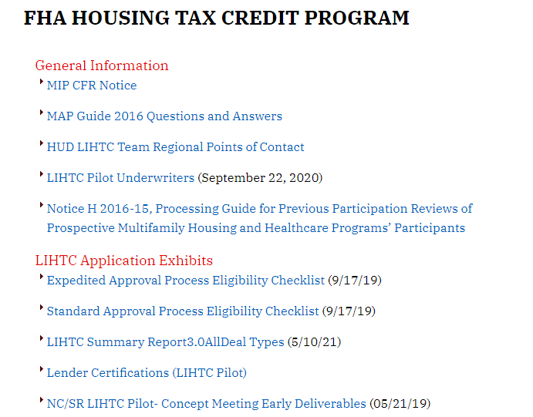
HUD LIHTC Web Page https://www.hud.gov/program_offices/housing/mfh/map/maphome/taxcredit
Notes:
TIGER
This is a live link to the public FHA Housing Tax credit program for your reference

Slide 17
Questions?
HUD Panelist:
Tiger Hudson, Senior UW, LIHTC Team
Danny Gallant, Senior UW, LIHTC Team
Erica Kodiyan, Branch Chief, UW

